Slide 1

Where is Buffalo?

Slide 2
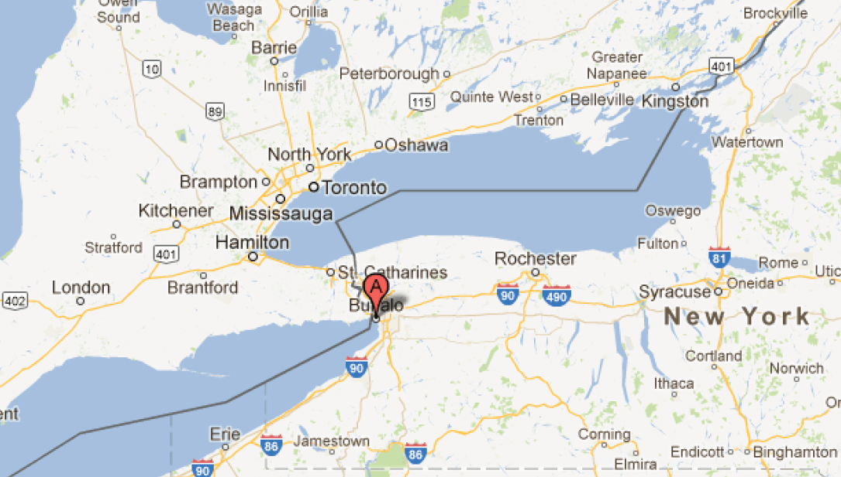

Niagara Falls

Slide 3
Academic Institutions Close By: University of Buffalo, SUNY University of Toronto McMaster University Brock College University of Rochester Rochester Institute of Technology Syracuse University

Slide 4
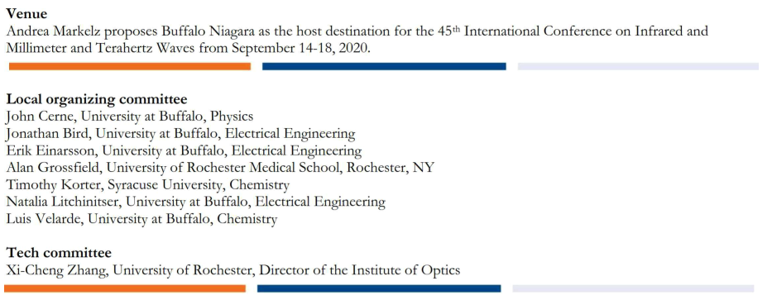

Slide 5
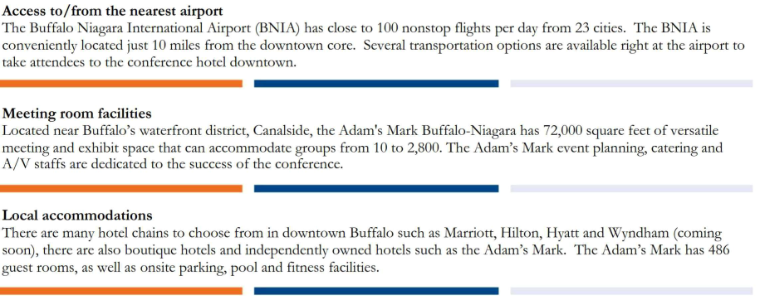
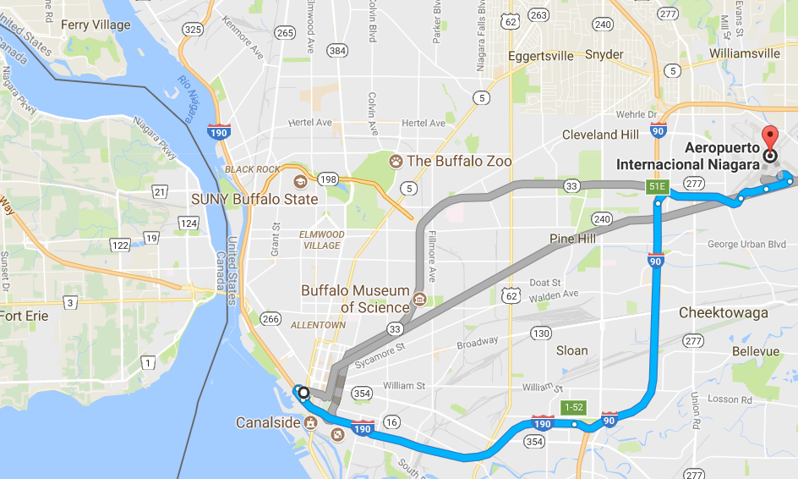
Toronto International Airport 2 h away: Direct flights from most major cities

Slide 6
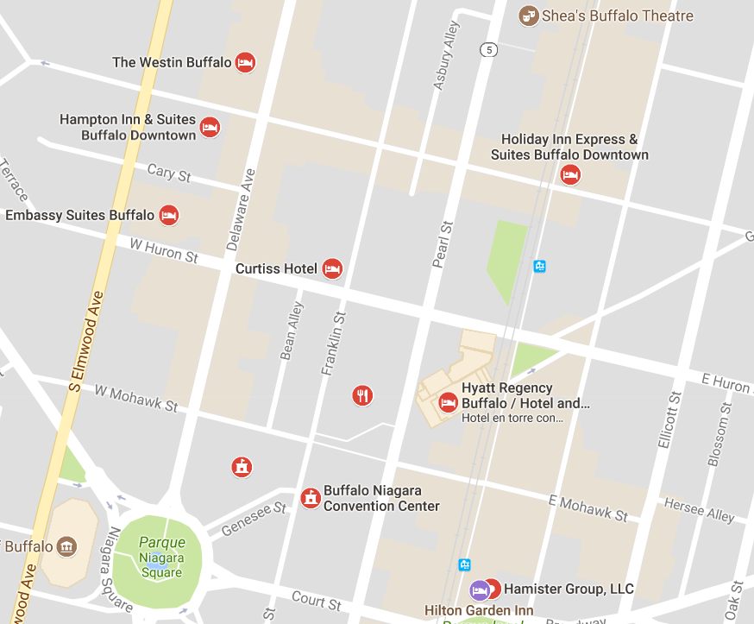
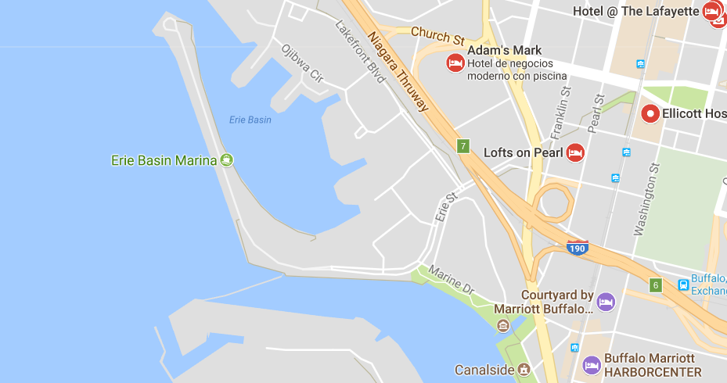

Slide 7
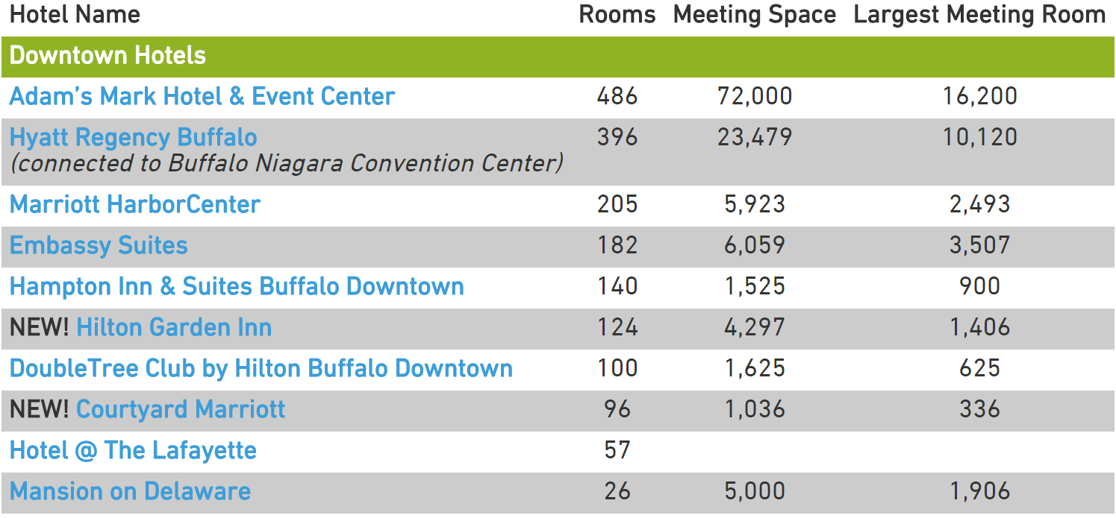

Slide 8
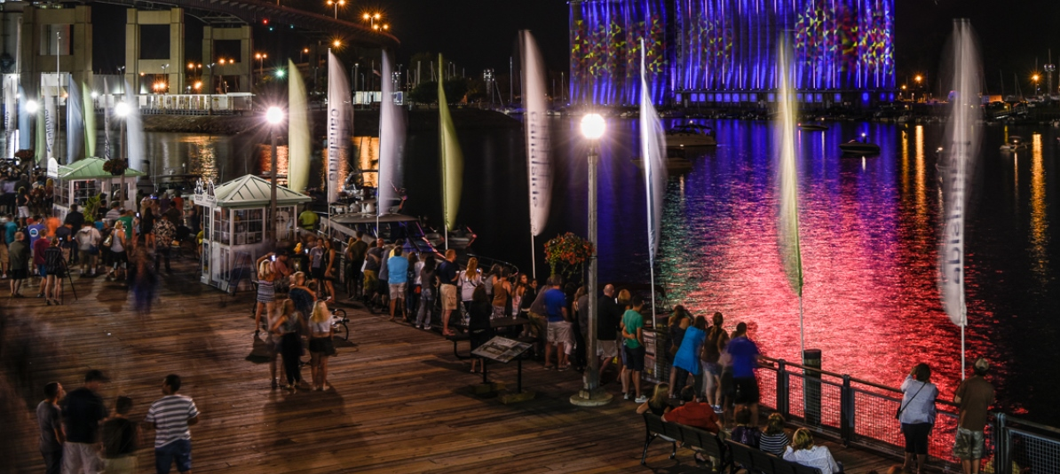
Canalside

Slide 9
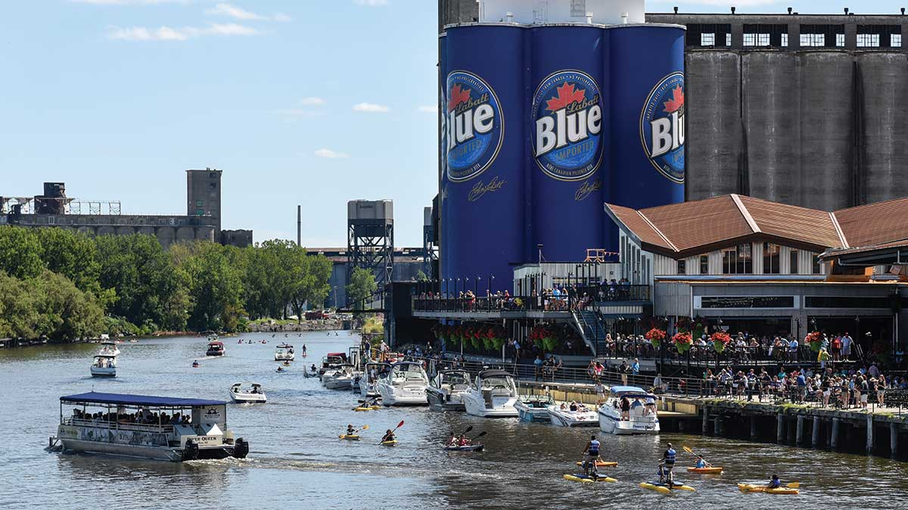
Riverworks

Slide 10
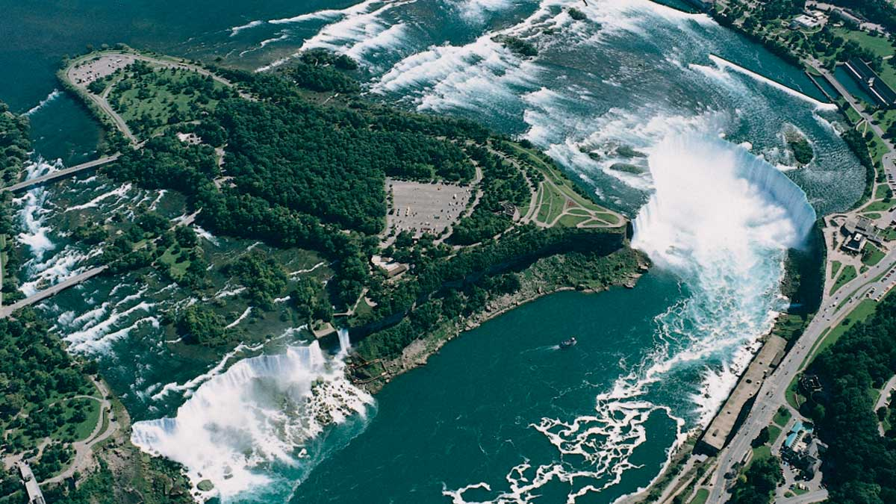
Niagara Falls

Slide 11
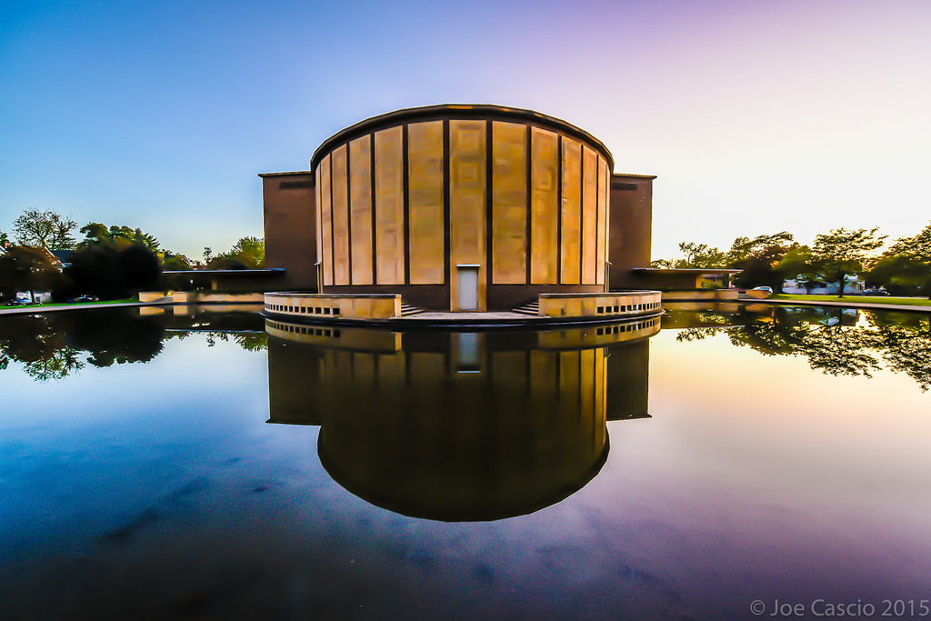
Buffalo Philharmonic Orchestra

Slide 12
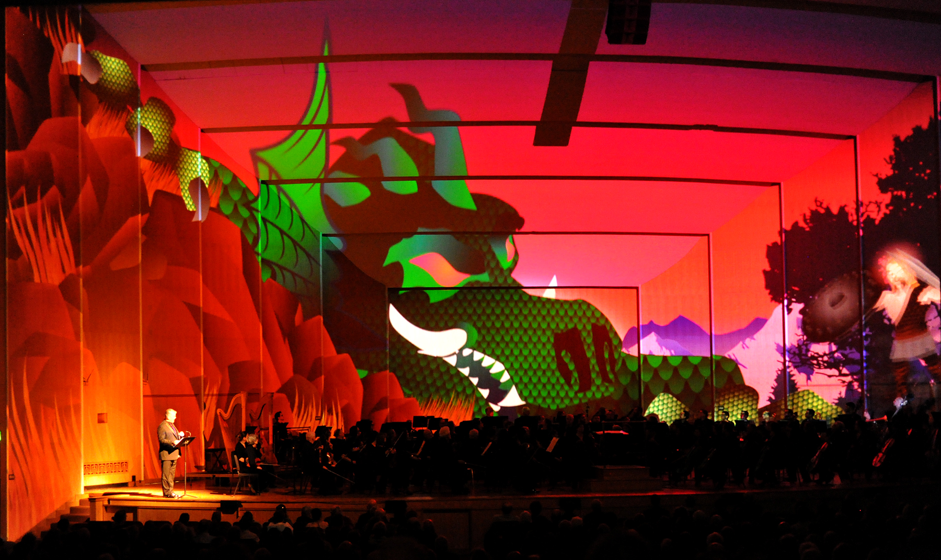
Buffalo Philharmonic Orchestra

Slide 13
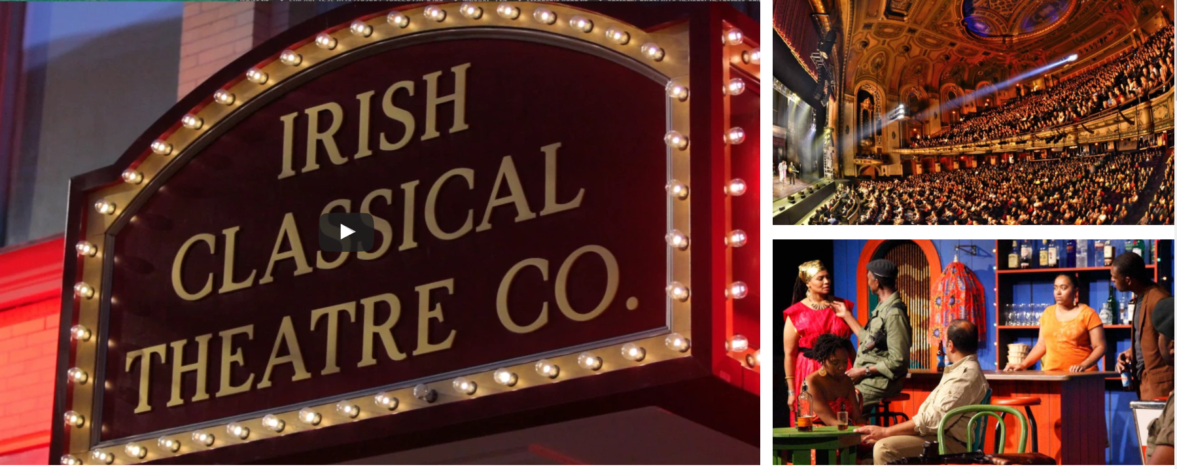
Buffalo Theater District

Slide 14
Fixed Expenses
Printed Materials | $5,000.00
AV Equipment | $20,000.00
Secretariat | $15,000.00
Special Arrangements
Welcome Reception | $35,000.00
Web Site | $1,000.00
Posterboards | $2,000.00
Transfer | $2,000.00
Other fixed expenses
Insurance | $2,000.00
Unforeseen expenses | $10,000.00
Audit | $2,500.00
Fixed Expense Total | $94,500.00
Variable expenses (per delegate)
Administrative (travel) service | $40.00
Conference dinner | $100.00
Lunches, Coffee/tea, breaks | $200.00
Registration folder & Standard Name badge | $5.00
Congress Bag | $10.00
Society Fee
Banking & Credit card costs | $15.00
Total variable costs per delegate | $370.00
Expected Exhibitor and Grant funding | $35,000.00
Regular Registration | $750
Student Registration | $450
Break even attendance (assuming 50/50 split) | 313
500 Delegates (50/50 split) | 600 Delegates (50/50 split)
Total Resources | Total Resources
$335,000.00 | $395,000.00
Total expense + 20% | Total expense + 20%
$335,400.00 | $379,800.00
Note that all facilities within Adam’s Mark are free for spending a minimum of $90,000 in food and beverages. If the banquet is held at the Adam’s Mark, the minimum registrants is then 300 to fulfill this requirement. For 450 registrants, the banquet can be held at a different facility and the requirement will still be fulfilled.

