Slide 1
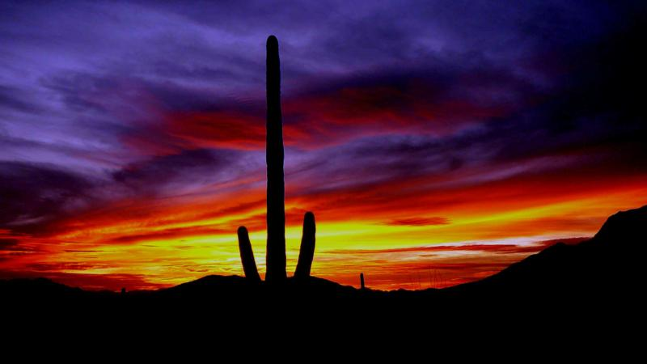


IRMMW-THz 2014
The Next Generation
39th International Conference on
Infrared, Millimeter, and Terahertz Waves
September 15 – 19th, 2014 on the campus of

Slide 2
PRESENTATION TO THE IRMMW-THz INTERNATIONAL ORGANIZING COMMITTEE
Sept. 3, 2013
IRMMW-THz 2013
Mainz

Slide 3
Local Organizing Committee
Prof. Chris Walker, UA: THz Astronomy/Instrumentation, co-Chair
Dr. Peter H. Siegel, Caltech/JPL: THz Applications, co-Chair
Prof. Hao Xin, UA: THz Instrumentation
Prof. Richard Ziolkowski, UA: THz Metamaterials
Prof. Scott Tyo, UA: THz Optics
Prof. Chris Groppi, ASU: THz Astronomy/Instrumentation, web manager
Dr. Craig Kulesa, UA: THz Astronomy/Instrumentation
Prof. Daniel Marrone: UA, Astronomy/Instrumentation
Eugene Lauria, UA: THz Instrumentation
Brian Duffy, UA: Conference Manager
Cathi Duncan, UA: Conference Coordinator

Slide 4
International Advisory Committee (MORE NEEDED)
Dr. Boris Karasik, JPL : THz Superconducting detectors and instruments
Dr. Ken Cooper, JPL: THz radar and Imaging Applications
Dr. Goutam Chattopadhyay: THz devices and antennas
Dr. Paul Goldsmith: Quasi-optics, THz astronomy
WE NEED 20+ IOC MEMBERS
TO VOLUNTEER FOR THIS!
Please see Peter to sign up

Slide 5
Plenary Speakers (10 total; 3- 5 MORE NEEDED)
Confirmed:
Dr. John Mather, NASA Goddard, Nobel Laureate speaking on JWST
Dr. Tom Lee, Stanford and DARPA, THz CMOS
Dr. Rich Saykally, Berkeley, Water Spectroscopy
Dr. Paul Goldsmith, JPL, THz Optics
KJ Button Talk
Pending:
Dr. Serge Haroche, CNRS, Nobel Laureate, Rydberg Atoms & THz
Dr. John Grunsfeld, NASA Space Science, former Astronaut, THz Space Apps
Dr. Patrick Thaddeus, Harvard, Millimeter Wave Spectroscopy in Astrophysics
Dr. Jonas Zmuidzinas, JPL, THz Space Science

Slide 6
POTENTIAL SPONSORS
(NO COMMITTMENTS YET!)
The University of Arizona
Arizona State University
Jet Propulsion Laboratory
Raytheon Missile Systems
Air Force Research Laboratory
Army Research Laboratory
NASA Space Science
DARPA MTO
TeraVision Inc.

Slide 7
KEY MILESTONES AND PARTICIPATION DATES
Aug. 28th: Website pointer up and active – downloadable brochure
Oct. 1: IAC formed, All Plenary speakers confirmed
Nov. 1: 50% of Keynote speakers named and invitations released
Jan. 2: Full website up and active (goal Dec. 1) – hosted at ASU, uses Shocklogic
Jan. 13-March 31: Early registration Period
April 1: Abstracts due (2 week extension possible)
Apr. 1-Aug. 4: Regular Registration Period
May 19: Authors notified
July 7: All final papers due (two week extension possible)
Aug 5-Sept 19: Late Registration Period
Aug. 11: Preliminary Program schedule completed
Aug. 25: Digest Completed and sent out for flash drive installation
Sept. 14: CHAOS BEGINS
Oct. 19: All papers and digest files due to IEEE

Slide 8
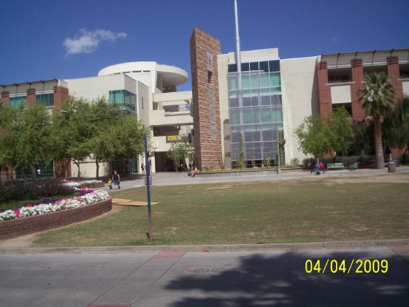
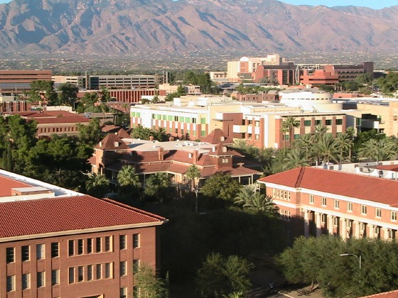
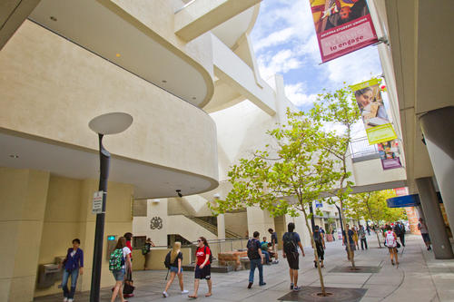
EVENT LOCATION:
STUDENT UNION
COMPLEX AT
U of A

Slide 9
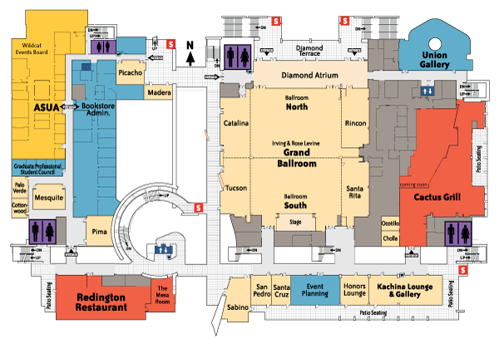
Student
Union
3rd Floor
4 lecture rooms
plus
Grand Ballroom
for Exhibitors,
Posters, Coffee.
2 overflow rooms
on lower floor
6,900 ft²
6,900 ft²
North Ballroom: Holds 702 (posters)
South Ballroom: Holds 600 (vendors)
Co-located Lecture rooms:
Catalina: seats 110
Rincon room: seats110
Luncheon room
Tucson: seats 110
Santa Rita: seats 118
Overflow rooms:
Ventana: seats 87
Kiva: seats 100

Slide 10
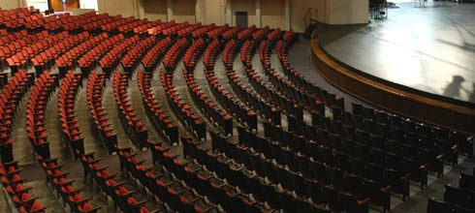
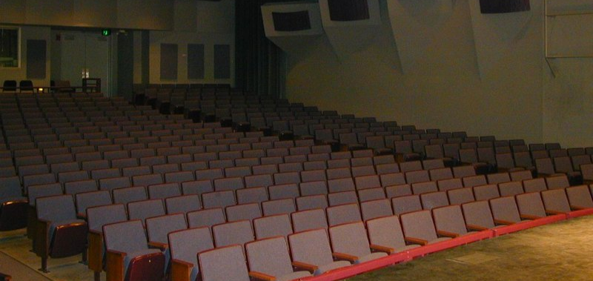
Plenary
Session
Space
Centennial Hall: 2,500 Seats
(Cannot reserve until UA class schedule has been set - soon)
Crowder Hall
544 Seats (BOOKED)

Slide 11
Banquet and/or Excursion
Banquet location and/or a coupled excursion are not yet finalized. These depend somewhat on registration numbers and potential grant/sponsor/vendor funding.
Due to continuing US govt. sequestration in 2014 we are budgeting for NO EXTERNAL FINANCIAL SUPPORT.
In a doomsday scenario, the Banquet will be held at the UA facilities in the Student Union.
If funds start to become available, or registration/exhibitor numbers increase, we will move the banquet to a more unique/costly site (Desert Museum, Biosphere, etc.).
An excursion is also planned, but not yet firmed up.
We will report to the IOC on final plans in the spring.

Slide 12
Session Map assuming 260 Oral talks
(4 II sessions, same as Pasadena in 2008)
ANNOUNCEMENTS
8:45-9:00 am
PLENARY SESSION (1P)
9:00-10:30 am
SESSION 2A
(M/T/W/R/F)
SESSION 2B
(M/T/W/R/F)
SESSION 2G
(M/T/W/R/F)
SESSION 2K
(M/T/W/R/F)
11:00-12:30 pm
LUNCH
12:30-2:00 pm
SESSION 3A
(M/T/W/R/F)
SESSION 3B
(M/T/W/R/F)
SESSION 3G
(M/T/W/R/F)
SESSION 3K
(M/T/W/R/F)
2:30-3:30 pm
SESSION 4A
(M/T/W/R/F)
SESSION 4B
(M/T/W/R/F)
SESSION 4G
(M/T/W/R/F)
SESSION 4K
(M/T/W/R/F)
4:00-5:30 pm
POSTER SESSION 5D (M/T/W/R)
5:30-7:00 pm

Slide 13
Over 120 Hotels and Resorts in Tucson (discounts, but no blocks):
(1000’s of rooms supporting of UA & annual Gem & Mineral Show)
Tucson Marriott University Park* |  |  | ~.5 Miles; 5mins.
Aloft Tucson University |  |  | ~.5 Miles; 5mins.
Arizona Inn |  |  | ~1.2 Miles; 5mins.
InnSuites Boutique Hotel Suite Collection |  |  | ~2.0 Miles; 10mins.
Best Western Plus; Royal Sun Inn & Suites |  |  | ~2.1 Miles; 5mins.
Hotel Congress |  |  | ~2.3 Miles; 10mins.
Lodge on the Desert |  |  | ~3.0 Miles; 10mins.
DoubleTree by Hilton |  |  | ~4.0 Miles; 10mins.
Best Western Plus; InnSuites |  |  | ~8.5 Miles; 20mins.
The Suncatcher: Fine Country Inn |  |  | ~7.1 Miles; 20mins.
The Westin La Paloma Resort & Spa |  |  | ~7.6 Miles; 20mins.
Westward Look; Wyndham Grand Resort & Spa |  |  | ~8.3 Miles; 20mins.
White Stallion Ranch |  |  | ~8.8 Miles; 25mins.
* IOC Conference Hotel ($160/night) TYPICAL PRICING IS $100-$175/room/night

Slide 14
REGISTRATION FEES:
Standard Early: $550
Regular: $600
Late: $650
Student Early: $400
Regular: $500
Late: $550
Vendors Regular: $2000
Revenue (450 attendees, 325R, 125S & 12 exhibitors): $275,000
MAJOR COSTS (Approximate):
Hall/Auditorium and booth Rentals: $9,500
Receptions/Committee Luncheons/Banquet: $45,000
All Breakfasts/Coffee Breaks/Poster Session food: $50,000
Paper Submission and Registration Databases : $5,000
Excursions, Gift bags: $18,000
Brochures, Program (book) and Digest (flash drive): $27,000
Audio Visual, signage, badges, tickets: $13,000
Honoraria/travel support: $10,000
Society fee ($50/paid attendee): $22,500
Expenses: $200,000 delta=$75,000 at 450 attendees

Slide 15
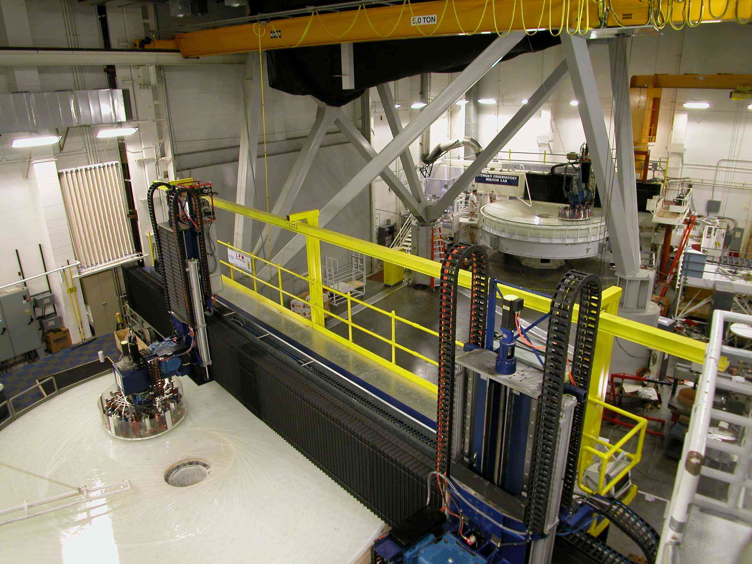
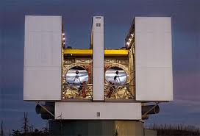
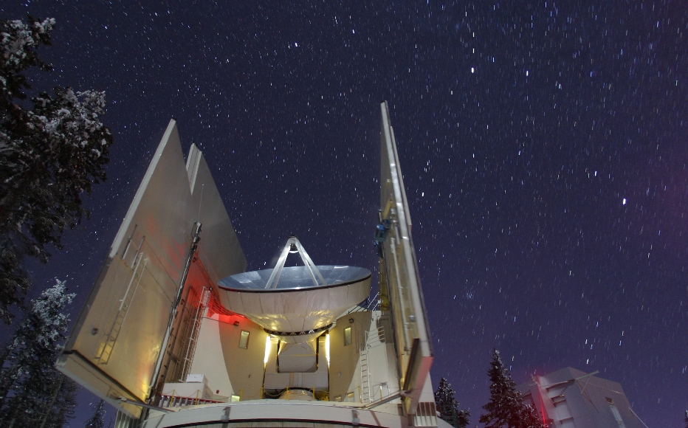
EXCURSIONS: TBD
ALSO Possible:
Desert Museum
BioSphere 2
Airforce Museum
UA mirror lab
Binocular Telescope
Heinrich Hertz THz Telescope
Catalina Mountains ~ 1.5 hr to top

Slide 16
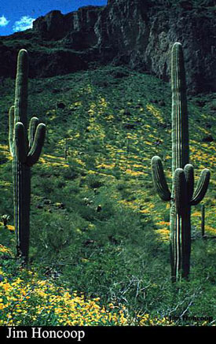
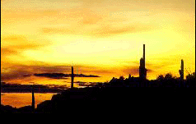
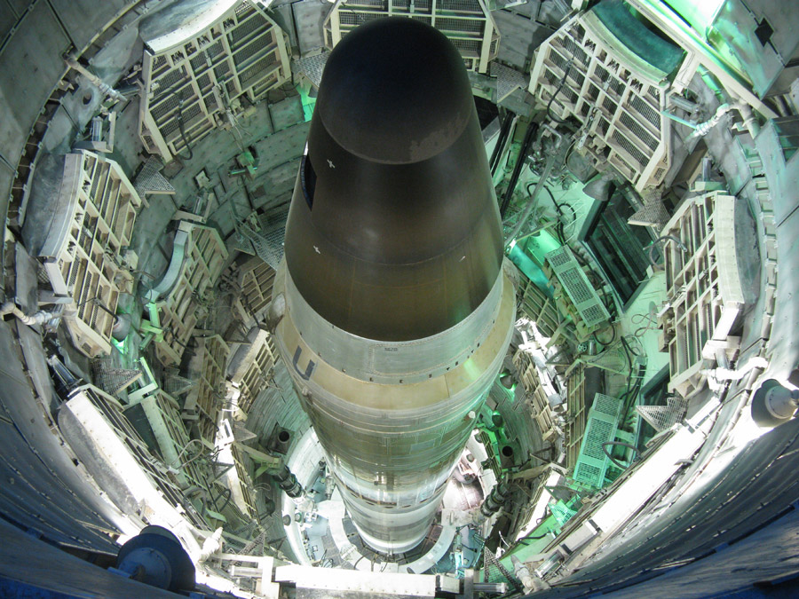
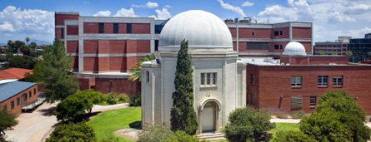
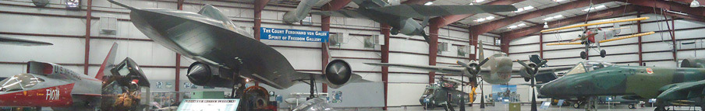
Many Local
Attractions
We Look Forward to Seeing You in 2014!

