Slide 1
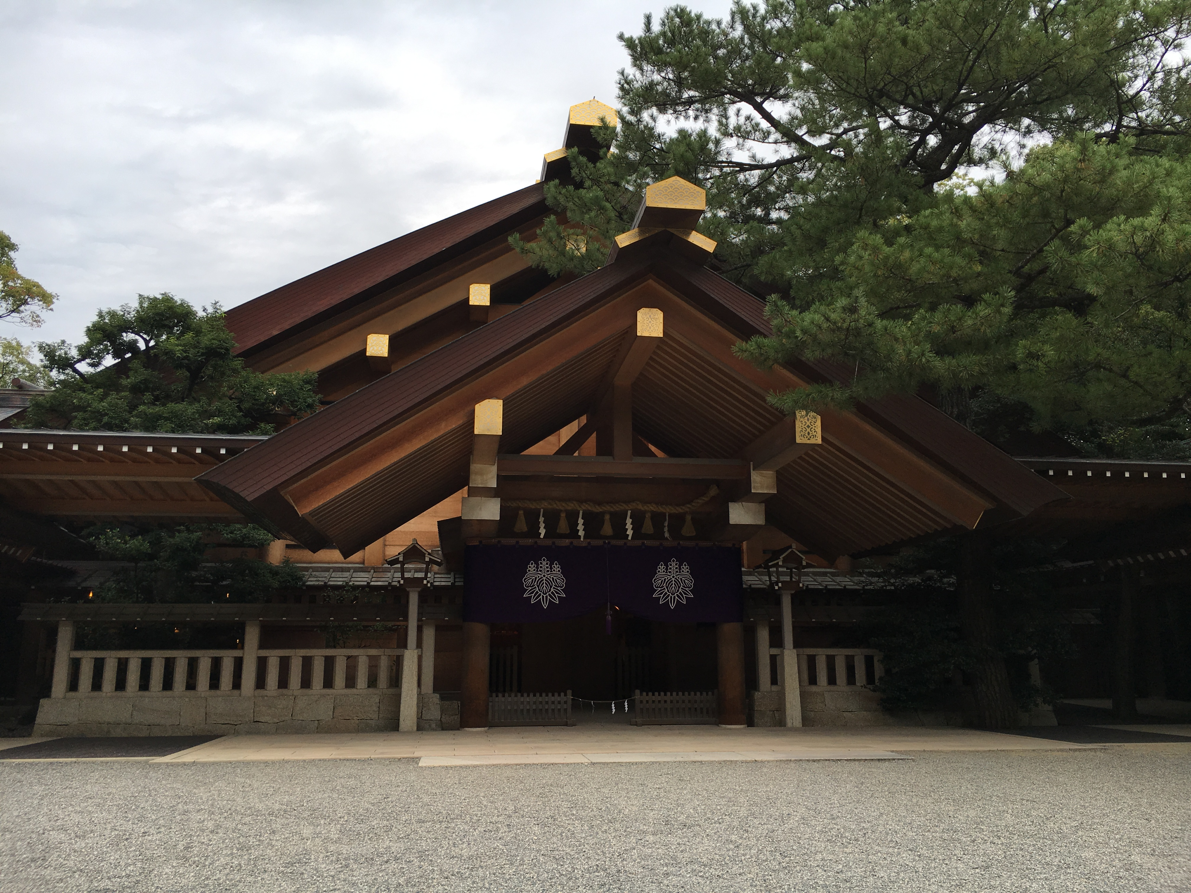
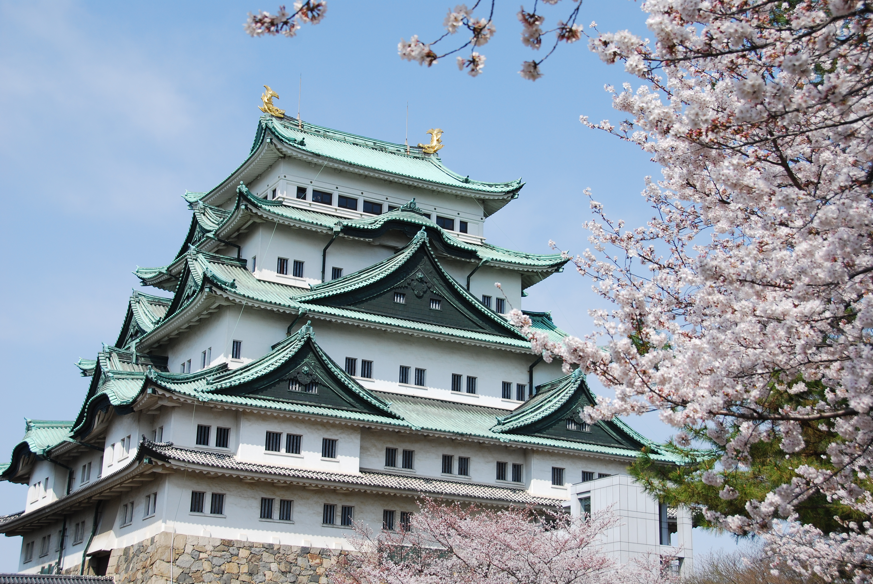
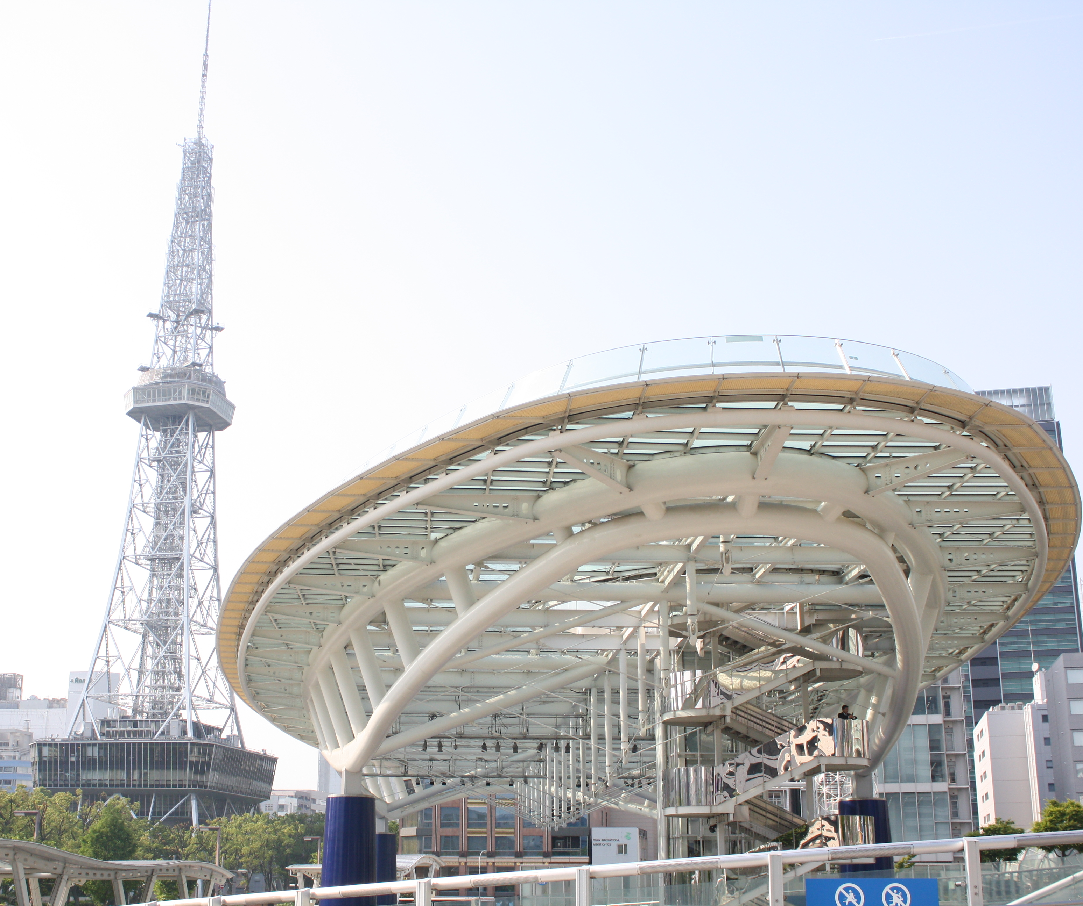
Proposal for The 43rd International Conference on Infrared, Millimeter and THz Waves
(IRMMW-THz 2018)
Co-chairs: Toshitaka Idehara (University of Fukui)
Masahiko Tani (University of Fukui)

Slide 2
Contents
Venue & Date
Meeting Room Facilities
Access to Nagoya
Accommodation
Members of the Local Organizing Committee
Finance

Slide 3
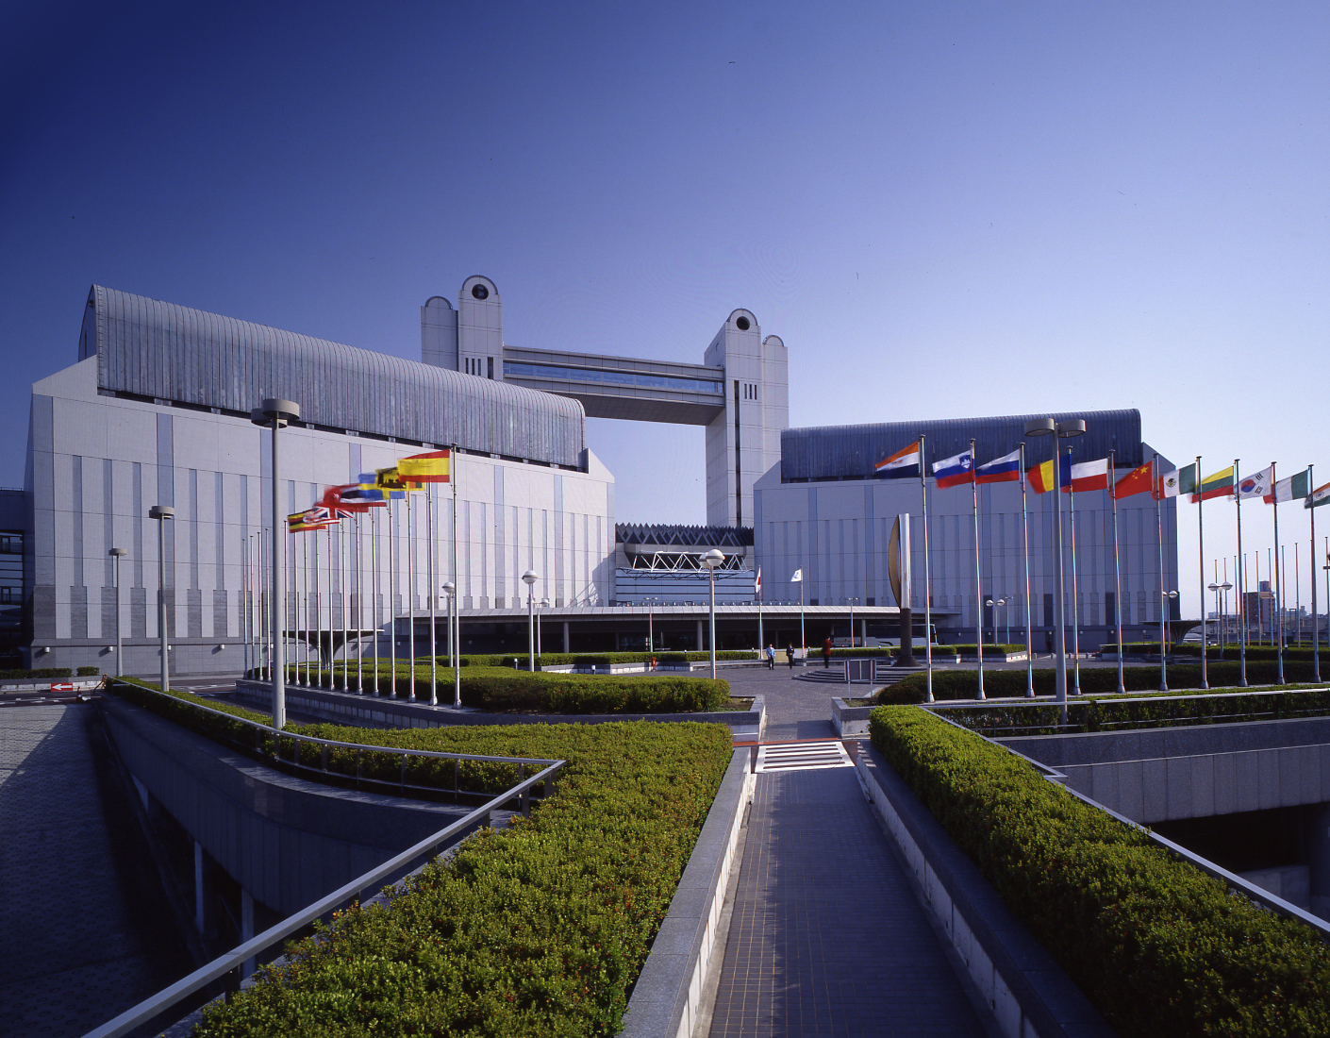
Venue and Date
Venue: Nagoya Congress Center
(Nagoya City, Aichi Prefecture, Japan)
Capacity for more than 700 participants
Date: September 9 – 14, 2018
Nagoya Congress Center
(Conference Venue)

Slide 4
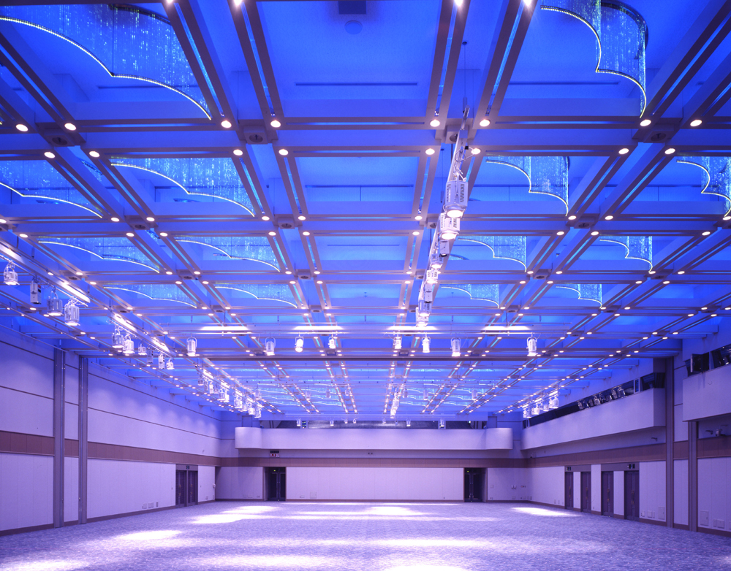
Meeting Room Facilities
Purpose of the space Number of Seats (Location and name of the room)
Plenary Session 1,280 (Bldg No.4, 1F, Shirotori hall)
Session room 1 360 (Bldg No.1 , 4F, 141+142)
Session room 2 162 (Bldg No.1 , 3F, 131+132)
Session room 3 162 (Bldg No.1 , 3F, 133+134)
Session room 4 288 (Bldg No.1 , 4F, Reception hall (1) )
Session room 5 288 (Bldg No.1 , 4F, Reception hall (2) )
Posters and Exhibition 823 (Bldg No.1 , 1F, Event hall)
Shirotori (White Swan)
Hall

Slide 5
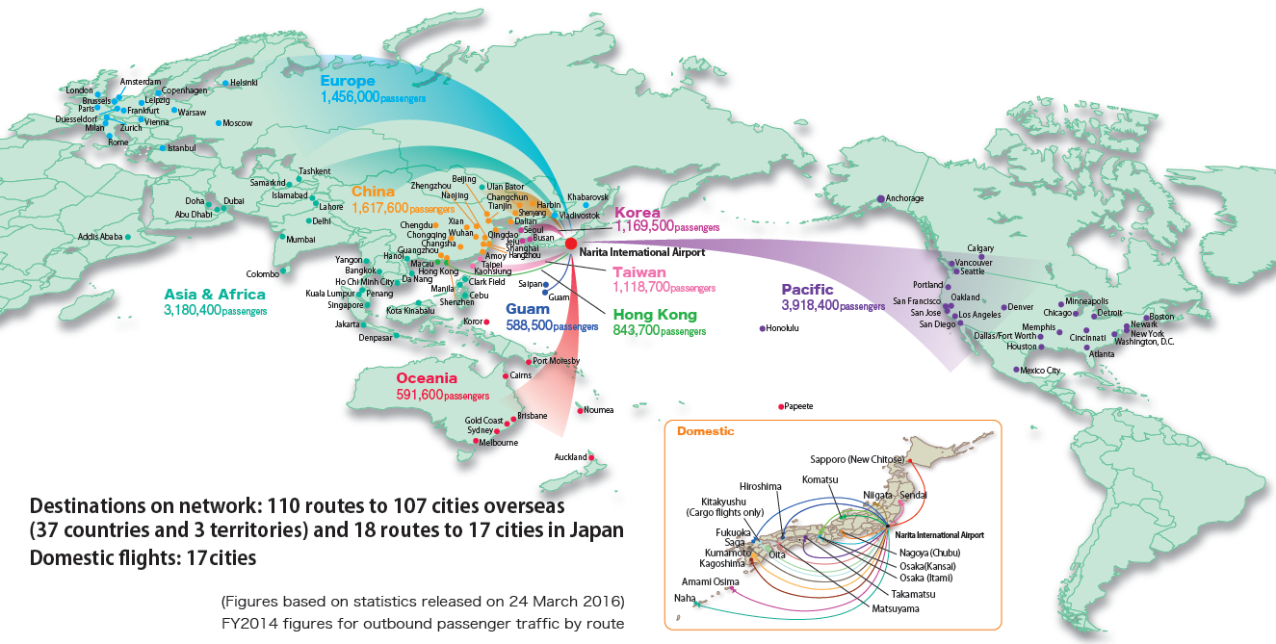
Access to Nagoya I: International Flights
Main gates to Japan:
Tokyo Narita International Airport (Flights to/from 100 overseas cities)
Tokyo Haneda International Airport (Flights to/from 30 overseas cities)
Kansai International Airport (Flights to/from 70 overseas cities)
Chubu Centrair International Airport (Flights to/from 40 Overseas cities)

Slide 6
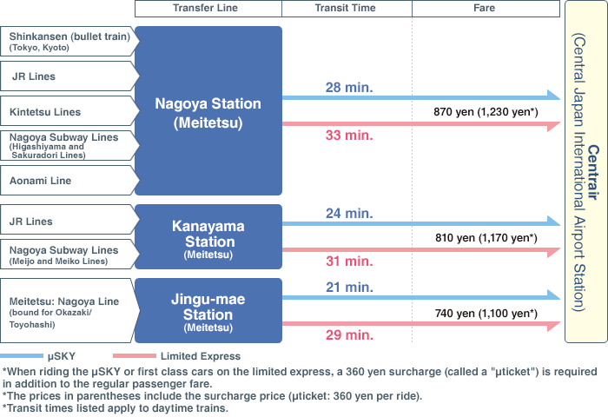
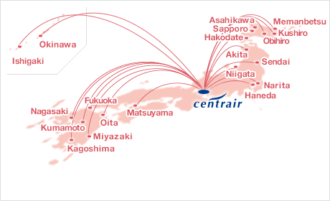
Access to Nagoya II: Domestic Flights
Chubu Centrair International Airport (http://www.centrair.jp/en/)
Many flights from East and South East Asian Countries are available.
Good domestic flight connections from major cities in Japan: 4 flights from Narita and 3 flights from Haneda a day, and 2 hours by Express and Bullet train from Kainsai Airport.
Good access to the Nagoya downtown area: 30 min by train
Access from Centrair to Nagoya downtown
Domestic Flights
Information from http://www.centrair.jp/en/flight_information/network/

Slide 7
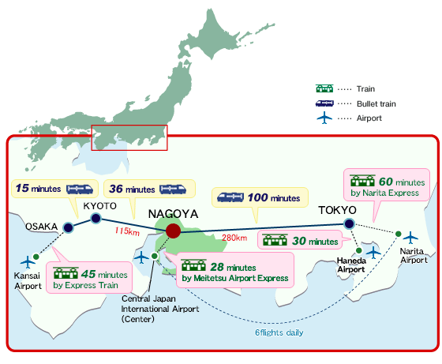
Access to Nagoya III: Domestic connections

Slide 8
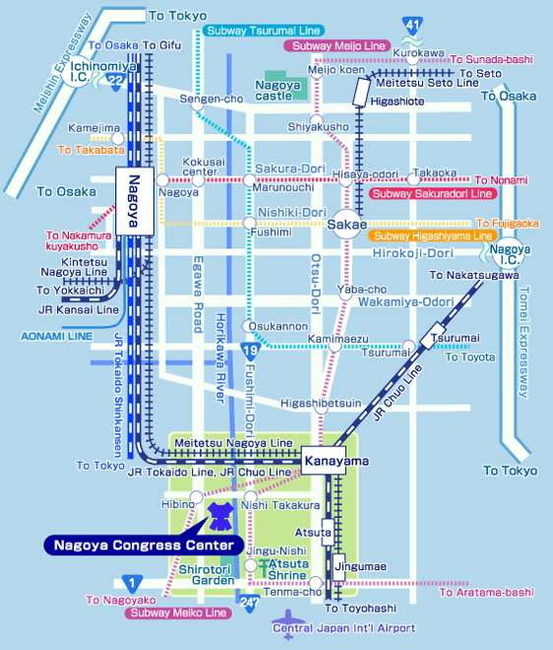
Nagoya Local Area Map
Directions to the Venue
28 min from Chubu Centrair International Airport to Nagoya Sta. by Meitesu Airport Express “μSKY”.
20 min from Nagoya Sta. to the venue by train:
Use subway lines (Higasiyama Line and Meijo Line or Meikou Line) to Nishi-Takakura Sta. or Hibino Sta.
5 min from nearby subway stations

Slide 9
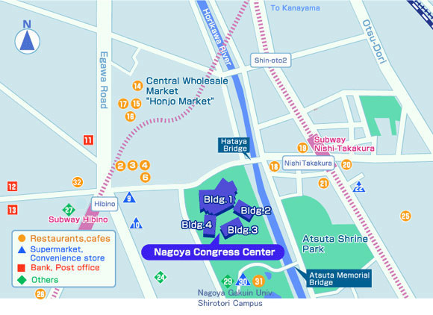
Area map around the venue

Slide 10
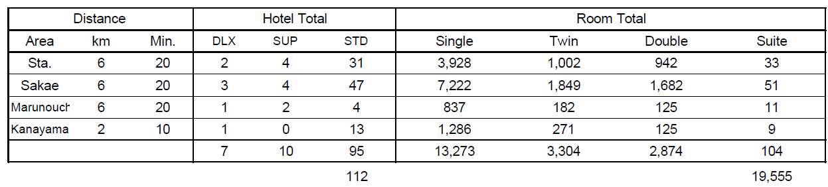
Accommodation around the venue
Total number of hotels near the venue is 112, and
Total capacity is 19,555.
Nagoya is the fourth largest city in Japan with a population of 2.3 millions.
The number of visitors for sightseeing is about 43 mil/year

Slide 11
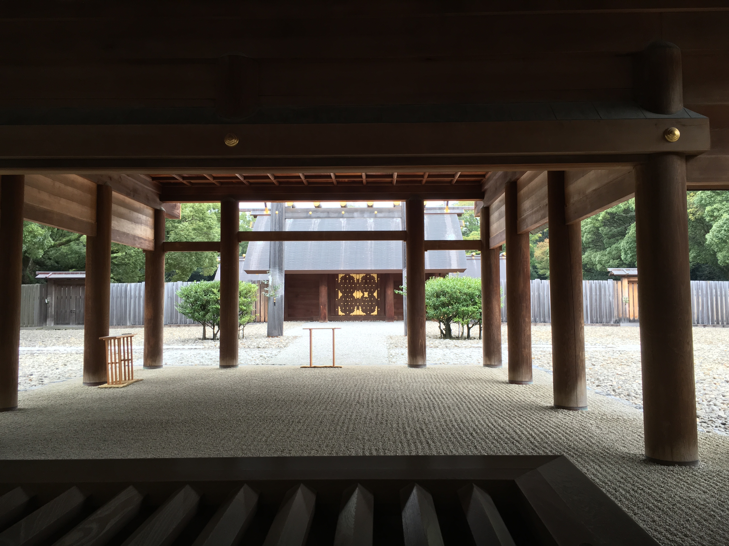
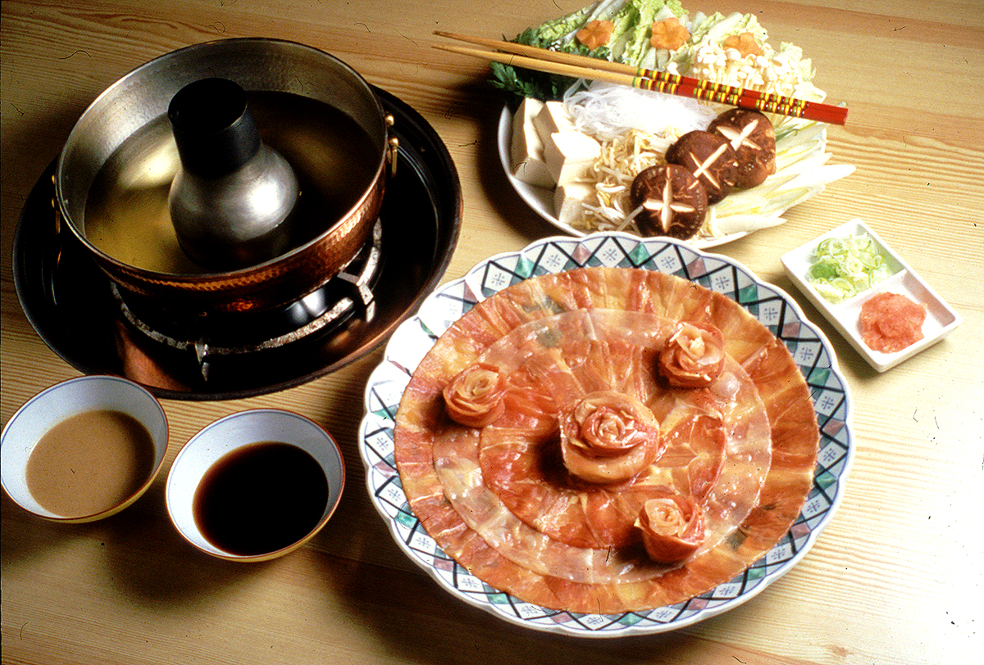
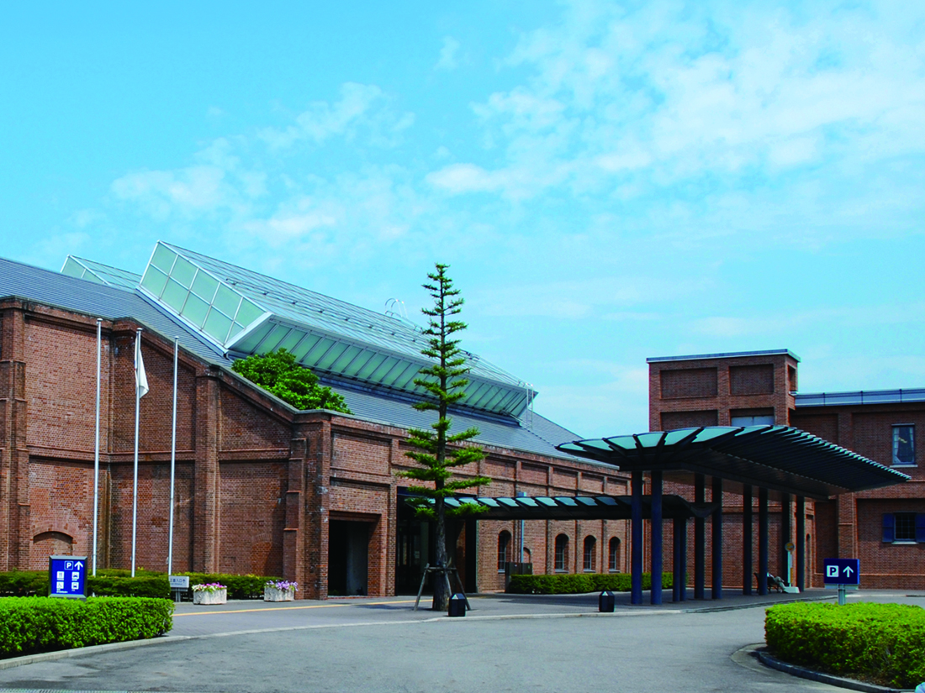
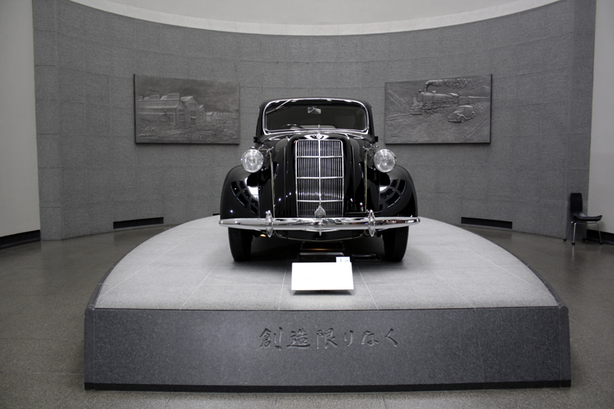
Nagoya’s sightseeing and attractions
The Venue is very close to Atsuta Shrine, where the conference banquet is to be held.
It is just 36 min from Nagoya to Kyoto by a bullet train.
To Ise Shrine it is about 1.5 hours by train.
You can Local Cuisines (Nagoya Meshi) of Nagoya.
Atsuta Shrine
Toyota Commemorative Museum of Industry and Technology (http://www.tcmit.org/english/)
Notes:
11

Slide 12
Structure of Organization of IRMMW-THz 2018
International Organizing Committee (IOC)
Local Advisory Committee (LAC)
Local Organizing Committee (LOC)
Local Arrangement
Treasurer
General Affair
Program
Supportive Organizations
Technical Program
Committee
Note: The role of International Advisory Committee might be taken by TPC but it is still under discussion in LOC

Slide 13
IRMMW-THz 2018 Local Committees
Local Organizing Committee, Core Members
Conference Co Chairs:
Toshitaka Idehara (Univ of Fukui),
Masahiko Tani (Univ of Fukui)
Treasurer:
Masaaki Ashida (Osaka Univ)
Hiroaki, Minamide (Riken)
Koji Suizu (Chiba Inst of Tech)*
Local Arrangement:
Yutaka Kadoya (Hiroshima Univ)
Tatsuo Nozokido (Toyama Univ)*
Kohji Yamamoto (Univ of Fukui)
General Affair:
Chiko Otani (Riken)
Iwao Hosako (NICT)
Shingo Saito (NICT)
Program:
Taiichi Otsuji (Tohoku Univ)
Keisuke Tominaga (Kobe Univ)
Local Advisory Committee
Mitsuhiro Motokawa
Yoshizumi Yasuoka
Kiyomi Sakai
Koji Mizuno
Hiromasa Ito
Nobuhisa Hiromoto
Masahiko Asada
Hitoshi Ohta
Keishi Sakamoto*
Kazuhiko Hirakawa
Technical Program
Committee (To be determined)
* New members

Slide 14
Planning till Sep. 2018（Key Dates）
2017/March Launching HP for IRMMW-THz 2018
2017/April Formation of Technical Program Committee (TPC)
2017/July-Aug Printing of the “First Circular” of IRMMW-THz 2018
2017/End of Aug. Aug 27-Sept 1st in Cancun, Mexico
IOC meeting (Reporting the preparation of IRMMW-THz 2018)
2017/Sep. Start of nominations of Plenary Talks
from Technical Program committee
2018/Jan. – Feb. Call for Papers
2018/SEP. Sep. 9 - 14th IRMMW-THz 2018 in Nagoya

Slide 15
Planning till Sep. 2018（Key Dates）
2017/March Launching HP for IRMMW-THz 2018
2017/April Selection of Chairs of Technical Program (TPC)
2017/June Printing of the “First Circular” of IRMMW-THz 2018
2017/End of Aug. Aug 27-Sept 1st in Cancun, Mexico
IOC meeting (Reporting the preparation of IRMMW-THz 2018)
2017/Sep Start of nominations of Plenary Talks
from TPC (till 2017/Oct.)
2018/Jan. – Feb. Call for Papers
2018/SEP. Sep. 9 - 14th IRMMW-THz 2018 in Nagoya

Slide 16
Finance
Assuming 650 participants
Japanese Yen basis
Exchange rate: 0.01 USD/JPY
INCOME
Registration Fees (Regular)
$650(Early Bird) x 500
$750(Reg.) x 35
$850(Late) x 15
------------------------------------------------------------------------
Subtotal $364,000
Registration Fees (Student)
$500(Early Bird) x 90
$600(Reg.) x 7
$700(Late) x 3
------------------------------------------------------------------------
Subtotal $51,300
Financial supports
From local governments $15,000
JSPS $30,000
Terahertz Technology Forum $20,000
----------------------------------------------------------------------
Subtotal $65,000
Exhibition and Advertisement Fees $60,000
-------------------------------------------------------------------------------------------------
TOTAL $540,300

Slide 17
Finance
Assuming 650 participants
EXPENSE
Conference Venue (Facility and Equipment) $82,600
Conference registration $22,000
Web-Site, Abstract registration $31,400
Conference Materials (Proceedings etc.) $32,500
LOC Meetings $20,000
IOC Meetings (Room rental, etc) $3,800
Social meeting (Welcome reception and Banquet, etc) $105,000
Coffee service $17,600
Personnel expenses (Part-time jobs, etc) $16,500
Hosting fee (to IOC) $32,500
IEEE Xplore archive fee * $9,750
Lunch support (for attendees) $32,500
Student Award & Travel supports $20,000
Commission fees $68,300
Charge required in credit card use $12,500
Miscellaneous cost (Tax, exchanging rate diff., etc) $25,000
---------------------------------------------------------------------------------------------------
TOTAL $ 531,950
650名参加で設計を余剰金として計上した場合
* To be waived.
Balance +$8,350

Slide 18
Thank you for your Attention

