Slide 1

Conference Overview
Roger Lewis

Slide 2
Number of delegates:
457
Number of countries:
27

Slide 7
453 Presentations
5 Plenary sessions
10 Plenary talks
50 Parallel Sessions
57 Invited talks
199 Contributed talks
3 Poster sessions
187 Posters

Slide 8
Word count
infrared/infra-red/infra red | 400
millimeter/millimetre | 352
terahertz/THz | 5226
gyrotron | 564
plasma | 482
quantum cascade laser/QCL | 272
sources/emitters | 613
waveguide/optics | 1464
sensors/detectors | 1199
imag/tomo | 499/54
bio/medic/industry/security/defen | 183/79/70/61/26

Slide 9
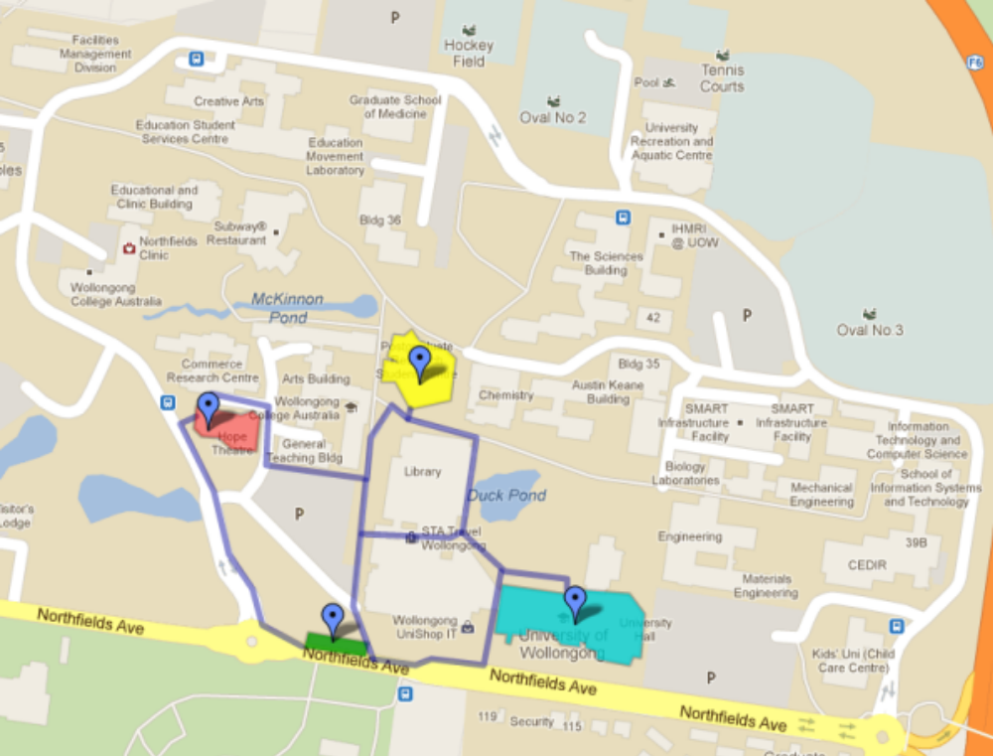
Student Prize Session
Building 24, Room 101
17:30-19:00 (coincides with posters)

Slide 10
INNOVATIONS
  • social media – twitter
  • LaTex templates for abstracts

Slide 11
ABSTRACTS
TOTAL | 633
Live | 453
Non-live | 180
Break up of non-live…
Incomplete | 124
Withdrawn | 42
Rejected | 9
Off topic | 5

Slide 12
BUDGET
  • income more or less known and falling
  • expenditure still rising and less precisely known
  (eg, lunch vouchers, weather for BBQ…)
  • expect to be able to pay the IOC tax

Slide 13
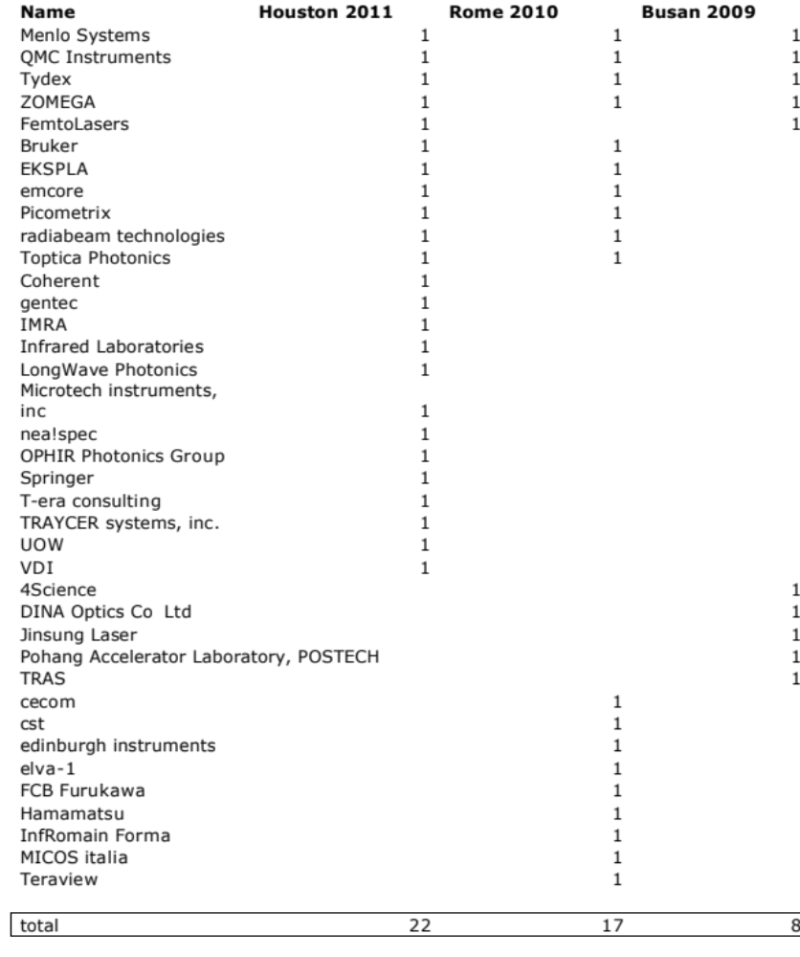

Slide 14
emcore | 1 paid
SynView GmbH | 1 paid
Toptica Photonics | 1 paid
TREASURE (Alpes Lasers) | 1 paid
ZOMEGA | 1 paid
NTT-Japan | 1 paid
QMC Instruments | 1 paid
Rene Biegang IRMMWTHz2013 | 1 paid
Menlo Systems | 1 paid
EKSPLA | 1 paid
NEC Japan | 1 paid
UOW | 2 paid Diamond Sponsor
ETRI | 2 paid Gold Sponsor
edinburgh instruments | 2 paid Silver Sponsor
Tydex | 2 paid Silver Sponsor
IPOS | 2 paid Silver Sponsor
Lake Shore | 2 paid Silver Sponsor
TRAS | 2 paid Silver Sponsor
ONR | 3 invoiced as Diamond Sponsor

Slide 15
registration
EARLY | student | Credit card | 80
 | other | Credit card | 220
STANDARD | student | Credit card | 5
 | other | Credit card | 52
 | student | Bank Transfer | 3
 | other | Bank Transfer | 8
LATE | student | Credit Card
 | other | Credit Card
 | student | Cash | 9
 | other | Cash | 17

Slide 16
SHOCKLOGIC
  • no comment

Slide 17
HOTEL | BLOCK | APMT | IRMMWTHz | CONFIRMATION
Belmore | 16 |  |  | Confirmed: RAL visa card
Best Western | 51 |  |  | Confirmed: RAL visa card
Boat Harbour | 10 | $125 | $110 | Confirmed: no deposit required
Chifley | 132 |  |  | ~$20k deposit
City Beach | 16
Flinders |  | $120 | $100
Medina | 40 | $145 | $140 | Confirmed: no deposit required
Novotel | 118 | $189 | $177 | ~$20k deposit
Quest | 20 |  |  | Confirmed: no deposit required
TOTAL | 403
• UOW advanced deposit ~$40k
• Chao negotiated competitive rates
• Price includes taxes

Slide 18
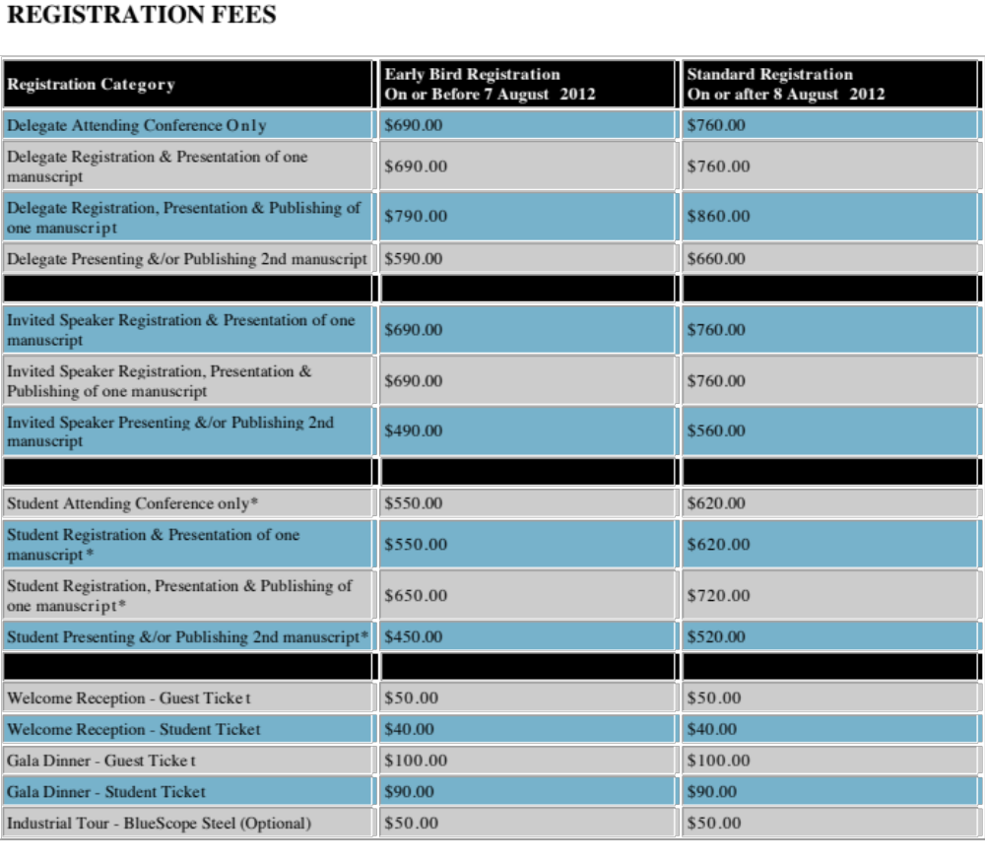
AMPT conference

