Slide 1
Emma’s update for IRMMW-THz 2015
23-28 August
Hong Kong

Slide 2
Overview
Statistics
New things this year
  Best poster
  Poster session chairs
  Conference app
Encouraging students
  Student workshop
  Student prize
  Financial support
Shocklogic
Budget and sponsors (who to thank for what)
Dinner info

Slide 3
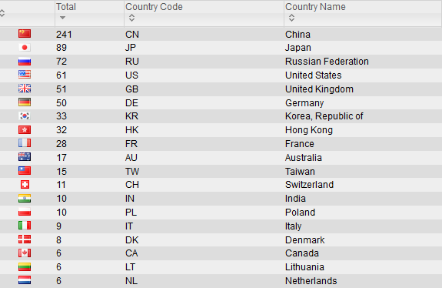
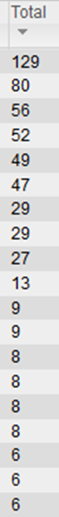
Abstracts per country
753 Submitted
600 Accepted
575 Attending as of 18/8
123
94
36
59
41
52
29
24
30
14
8
6
6
7
6
5
7
4
6

Slide 4
Reviewing burden!
750 abstracts, each needing 2 reviews
TPC of 50 people
  On average at least 30 papers each
  For papers with bipolar reviews, we sought a third opinion
Only 40/50 of the TPC were active
  Big strain to chase reviewers and find TPC members able to help to make up for it later.
Miraculously we kept to the deadlines!
Warning to future TPC
  Screen your team, make sure they know the extent of the commitment before giving them the CV points!

Slide 5
Shocklogic
  Abstract logic
    Unannounced change in the IEEE copyright transfer process from the IEEE's end close to our submission deadline ☹. This caused a cascading issue with the submissions and many headaches for the team, which meant chasing up a large number of abstracts.
    Building the schedule is not seemless, lots of manual inputs necessary
    Inflexible for some output material, especially for indexing in the conference booklet
    There is a cost associated with adding or modifying features and often not able to do it anyway
    Can’t handle session chairs easily
Participant logic
  Couldn’t send out invitation letters automatically to registrants
  Payment gateway linking issues (pay extra each time)
Notes:
Slide 5:
The issue with the IEEE linking was due to a change in the copyright transfer process from the IEEE's end. This caused a cascading issue with the submissions and many headaches for the team, which meant chasing up a large number of abstracts.
As for other issues:
1. Steep learning curve for teams
2. Building the schedule is not seemless, lots of manual inputs necessary
3. Inflexible for some output material, especially for indexing in the conference booklet
4. Payment gateway linking issues
5. There is a cost associated with adding or modifying features
Advantages:
1. Statistics since 2011, records are kept
2. Large change to a new system may cause more problems

Slide 6
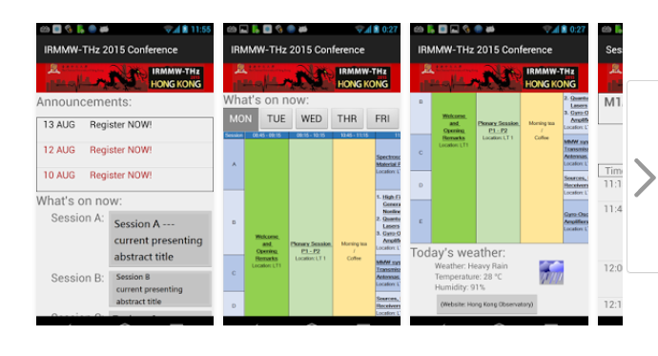
New things this year
Student work shop (22-23 Aug)
Best posters
  Top 4 posters for each day
Poster Session chairs
  Note any missing or substandard posters
Conference app
  https://itunes.apple.com/hk/
  https://play.google.com/store/

Slide 7
Financial support - travel
Gave 10,000 USD to 20 applicants with financial need out of this year’s conference budget
  Including students from India and Romania
Xi-Cheng applied to ARO and NSF and gave 10,000 USD to cover travel expenses for 5 students from the US.
The Croucher Foundation subsidised all plenary speakers (about USD 1000 each)
The KC Wong Educational Foundation gave approx. 22,000 USD to support 10 scholars from Mainland China to attend

Slide 8
Other sponsors
Ruby sponsors (Virginia Diodes, Microtech and TeraView)
  Gave 5000 USD each, and also registered.
  They will come to the dinner tonight.
Prof Cun-Lin Zhang from CNU
  about 10,000USD
  also invited to the dinner
  Please thank them!
Chinese University – seed funding and good room hire rates
HKUST about USD 2500
HK Tourist board – free entertainment at the banquet, pens, leaflets

Slide 9
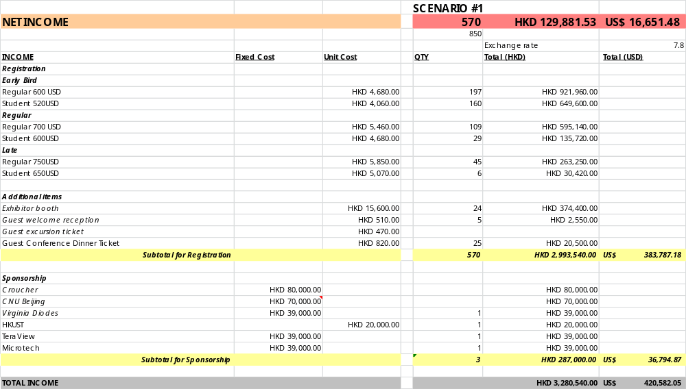
Budget from 18 Aug

Slide 10
Dinner tonight!
All partner ticket requests approved!
  IOC, Plenary speakers and sponsors attending
Coach leaves the Hyatt at 6pm
  Bernice will help you!
  I will check on the poster session first and take a taxi there.
There will be free drinks before dinner
  you can spend more time looking at the view, then dinner will start to be served around 7:30-8pm.
9:30-10:00pm Coach from The One, Tsim Sha Tsui to Hyatt Regency Hong Kong Sha Tin
  Depends on the food serving time but should be before 10:00pm.
  Can take MTR/taxi back easily if you want to stay later! Taxi drivers will know where to go more easily if you say Sha Tin first, then University

Slide 11
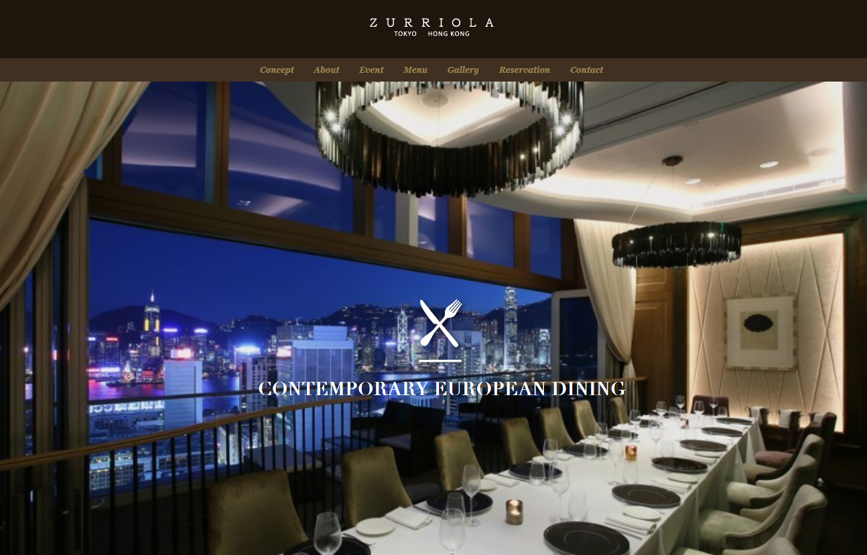
See you later!

