Slide 1
IOC report, 2016 meeting
753 total registrants (including exhibitors and student helpers)
690 regular registrations
325 talks (10 plenaries, ~50 keynotes, 265 contributed)
385 posters

Slide 2
Review process
826 regular submissions
3 reviews per paper = 2478 reviews (!)
64 TPC members, all on time with all reviews
710 total number of papers, 650 accepted (10 plenaries, 50 keynotes)
Rejection rate approx. 22%

Slide 3
Submissions, percentages

Slide 4
Submissions, absolute numbers

Slide 5
Expenses overview
Venue expenses: 1,174,200 DKK (156,560 €)
Printed matter: 88,000 DKK (11,733 €)
Registration crew: 114,000 DKK (15,200 €)
Speaker support: 105,000 DKK (14,000 €)
Student workshop: 50,000 DKK (6,667 €)
Social activities: 349,000 DKK (46,533 €)
Cost per delegate (x690) 2,040,330 DKK (273,870 €) (cost per delegate 2,957 DKK)
Total expenses: 4,043,008 DKK (542,685 €)

Slide 6
Income overview
Registrations: 3,627,900 DKK (483,720 €)
Exhibition+company sponsors: 340,000 DKK (45,333 €)
Other sponsorships: 100,000 DKK (13,333 €)
Total income: 4,067,900 DKK (542,387 €)
Total expenses: -4,043,008 DKK (542,685 €)
Net result (as of yesterday): 24,892 DKK (3,319 €)
Expenses include (of course) the society fee.
Expenses for professional registration team: 295,500 DKK (39,396 €) – 9.5% of total budget

Slide 7
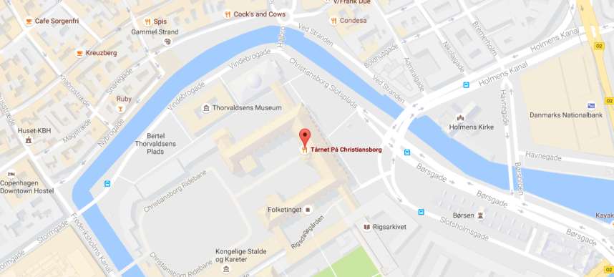
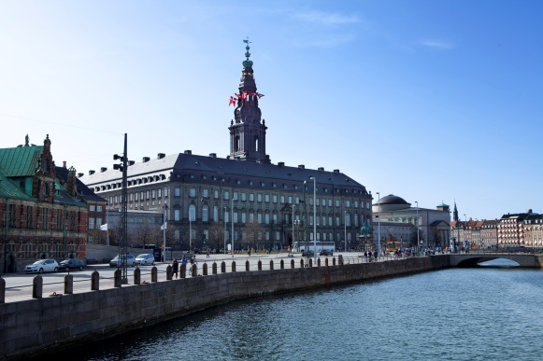
IOC dinner info
Bus pick-up Tuesday 19:00 in front of registration desk
Restaurant Taarnet, Christiansborg (if you go by ourself)
Security check a la airport at entrance
End time ~23:00, bus return to Bella Center

Slide 8
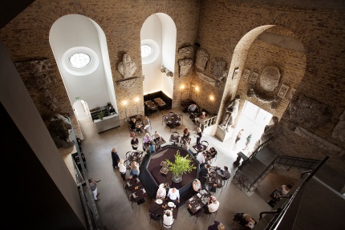
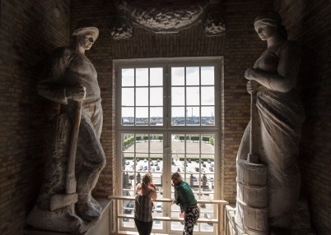
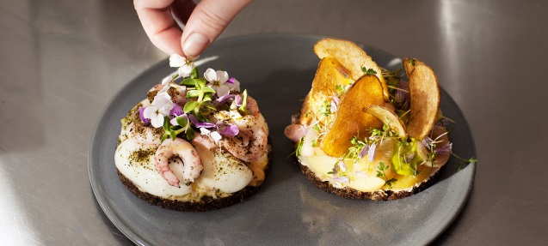
IOC dinner menu
-Crispy rye flakes with salted cod creme and horseradish
-Cured salmon with beach crab vinaigrette, wheat grass oil and cauliflower
-Salt-baked celeriac, pickled rose hip flowers, fried seaweed and sauce with Vesterhav cheese
-Roasted duck breast, duck leg terrine, blackcurrants, fried corn and a sauce with burnt hay
-Danish cheese served with quince jelly and toasted rye bread
-Chocolate cake with Oialla 92% chocolate mousse and blackcurrant sorbet

