Slide 1

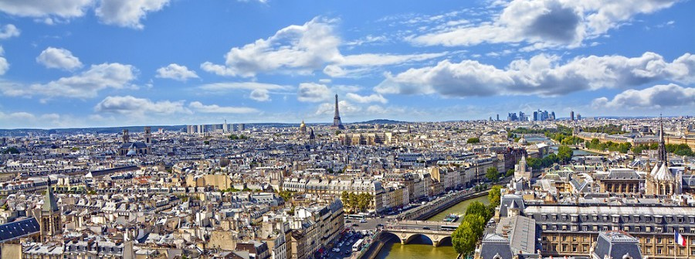
General Chairs
Carlo Sirtori - University Paris 7 -
Jerome Tignon - Ecole Normale Supérieure-

Slide 2
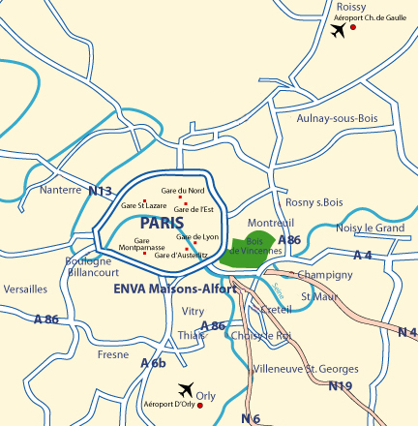
1. Welcome to Paris
Accessibility, riche range of accommodation, cultural dynamism... Paris is the place to meet!
Paris, at the heart of Europe, is a
connected city with
- 2 international airports (Paris
Charles-de-Gaulle and Paris Orly)
- an extensive rail network
France is an easy entrance
country with
- more than 60 countries exempt
from a visa process
- an easy visa process for other
nationalities

Slide 3
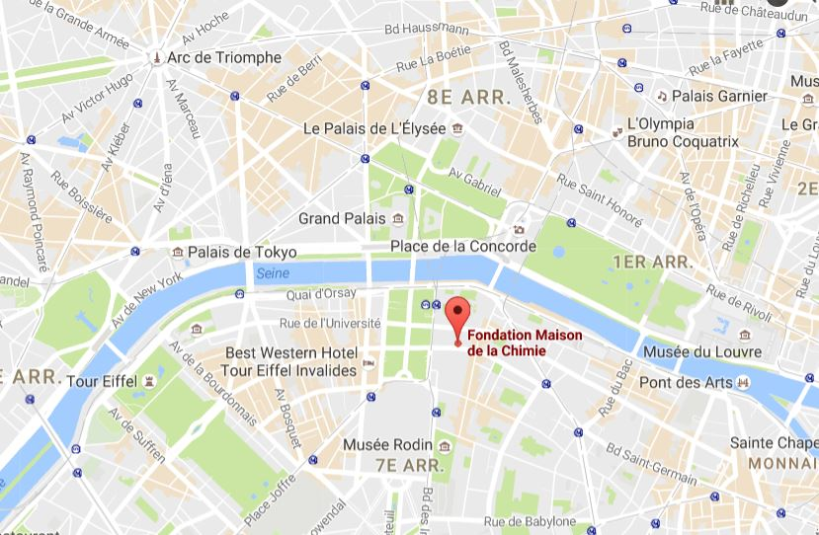
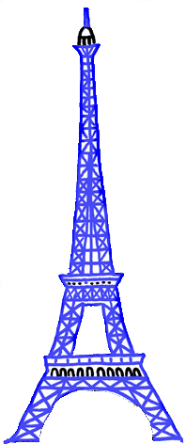
2. A prestigious Conference Venue, in the center of Paris
The conference venue, Maison de la Chimie, is located in the heart of Paris, in the 7th arrondissement, situated on the Rive Gauche (the left bank of the River Seine).
An area with numerous available facilities:
Plenty of close hotels
A wide range of restaurants
An easy access by private
and public transport (metro, city train, bus)
This area includes
some of the major
tourist attractions of Paris:
The Eiffel Tower
Hôtel des Invalides
World-famous museums
(Musée d'Orsay, Musée Rodin, Musée du quai Branly...)

Slide 4
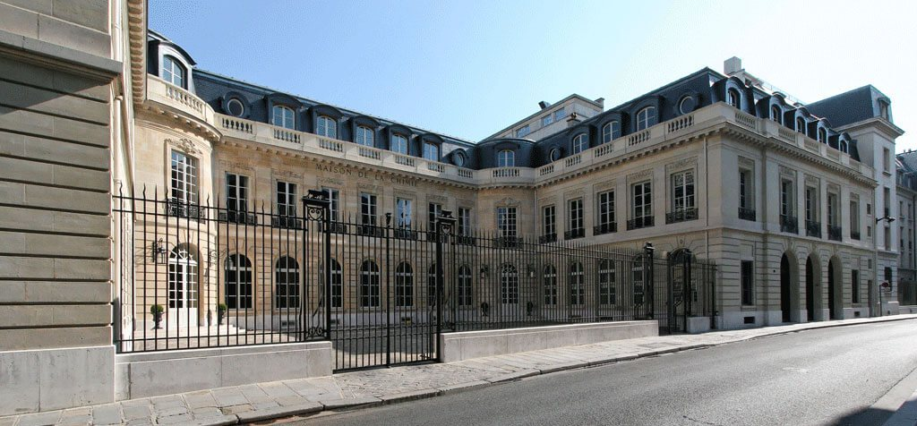
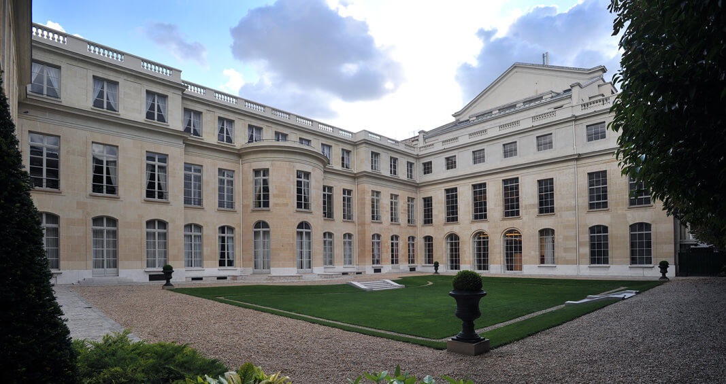
Maison de la Chimie: an exceptional location appropriate for a large conference
A functional, welcoming, elegant, enjoyable and secure workplace
28 rue Saint-Dominique
7th arrondissement, Paris
Courtyard
Exterior facade
The building combines the charm of a former 18th century town house
and an authentic Art Déco decoration making it an outstanding venue.

Slide 5
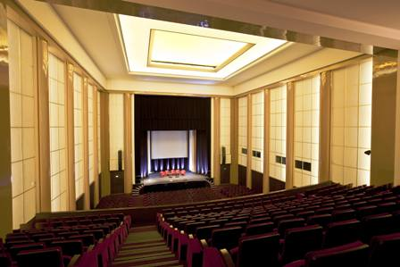
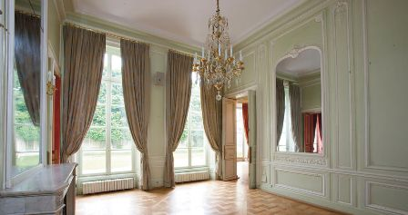
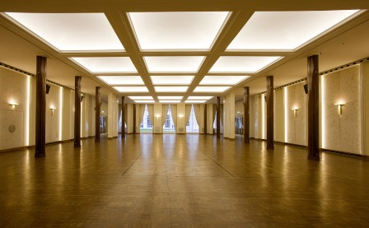
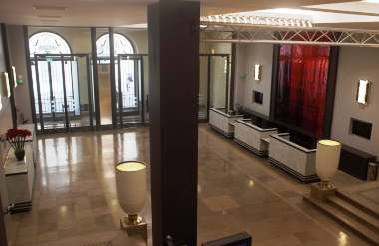
The grand Amphitheatre dedicated to plenary sessions. Capacity: 854 delegates
4 or 5 large Rooms dedicated to parallel sessions, meetings. Capacity: 150 delegates each
0
The large Salon dedicated to poster sessions,
exhibition and coffee breaks.
The Hall dedicated to registration.

Slide 6
An ample range of accommodations in the close proximity of the venue
Hotels ****
Hotel d'Orsay
Add.: 93 rue de Lille - 7e
Price: 180 euros - Capacity: 42 rooms
Walking time: 7 min
Hotel Le Bellechasse - Saint Germain
Add.: 8 rue de Bellechasse - 7e
Price: 200 euros - Capacity: 33 rooms
Walking time: 7 min
Hotel Duc de Saint Simon
Add.: 14 rue de Saint-Simon - 7e
Price: 275 euros - Capacity: 34 rooms
Transport time: 7 min / Walking time: 10 min
Hotel La Comtesse - Paris Tour Eiffel
Add.: 29 Avenue de Tourville - 7e
Price: 220 euros - Capacity: 40 rooms
Transport time: 14 min / Walking time: 15 min
Hotels***
Hotel Best Western - Tour Eiffel Invalides
Add.: 35 boulevard De La Tour Maubourg - 7e
Price: 115 euros - Capacity: 30 rooms
Walking time: 7 min
Hotel Ibis Paris Tour Montparnasse
Add.: 22 rue du Maine - 15e
Price: 90 euros - Capacity: 45 rooms
Transport time: 13 min / Walking time: 29 min
Hotel Ibis – Paris Tour Eiffel
Add.: 2 rue Cambronne - 15e
Price: 105 euros - Capacity: 527 rooms
Transport time: 12 min / Walking time: 27 min
Inter-hotel Lecourbe
Add.: 28 rue Lecourbe - 15e
Price: 95 euros - Capacity: 44 rooms
Transport time: 19 min / Walking time: 28 min
Hotels**
Hotel restaurant Campanile - Tour Eiffel
Add.: 30 rue Saint Charles - 15e
Price: 80 euros - Capacity: 76 rooms
Transport time: 20 min
Hotel de la Tour Eiffel
Add.: 17 rue de l'exposition - 7e
Price: 95 euros - Capacity: 24 rooms
Transport time: 18 min / Walking time: 16 min
A detailed list of hotels will be provided

Slide 7
3. An experienced Local Organizing Committee
The Conference co-chairs
Carlo SIRTORI - University Denis Diderot, Paris
Jérôme TIGNON - UPMC, Ecole Normale Supérieure, Paris
The Local Organizing Committee
Jean-Louis COUTAZ (University of Savoie, Chambéry)
Jean LEOTIN (Université Toulouse 3, Toulouse)
Jean-François LAMPIN (CNRS, University Lille 1, Lille)
Angela VASANELLI (University Paris-Diderot, Paris)
Juliette MANGENEY (CNRS, Ecole Normale Supérieure, Paris)
Wojciech KNAP (CNRS, University Montpellier 2, Montpellier)
Sukhdeep DHILLON (CNRS, Ecole Normale Supérieure, Paris)
Yanko TODOROV (CNRS, University Paris-Diderot, Paris)
Gaël MOURET (University Littoral Côte d'Opale, Dunkerque)
Patrick MOUNAIX (CNRS, University Bordeaux, Bordeaux)
Emilien PEYTAVIT (CNRS, University Lille 1, Lille)
Jean CHAZELAS (Thales, Elancourt)
Daniel DOLFI (Thales, Palaiseau)
The LOC will be assisted by a Professional Conference Organizer
ellipse&co is a French company specialised in the organisation and administration of scientific events.
ellipse&co has a over 13 years experience in organising events.

Slide 8
The conference organization will be implemented by the Local Organizing Committee following the guidelines of the International Society of Infrared, Millimeter, and Terahertz Waves.
The LOC will
exchange regularly on the organization with IOC
use the support of the SFP (French Physical Society) for promoting the conference widely
expand the announcement to related communities in the areas and disciplines involving infrared, millimeter and terahertz waves
design a dedicated conference website
extend this mailing list to all French institutions potentially interested by this conference but not used yet to participating
Organise a school (classes and labs) prior to the conference at the CNRS IEMN at Lille, 1h train from Paris

Slide 9
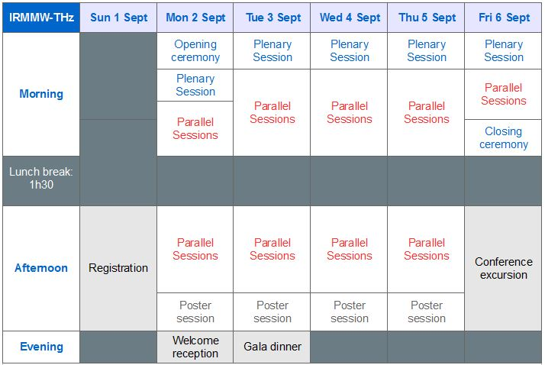
4. An exciting conference program
Proposed date: September 1-6, 2019
Option: September 8-13, 2019

Slide 10
Scientific program
Program committee – under construction
Program Chair: Jean-Louis COUTAZ (University of Savoie, Chambéry)
The PC will be set up with experts from different institutions and from the IOC to represent all main topics.
Sessions
5 Plenary sessions
4 or 5 oral sessions hold in parallel
1 Award ceremony organized by IOC
(Student Paper Prize, Exceptional Service Award,
2019 K. J Button Award, travel grants...)
4 poster sessions
scheduled in the afternoon on
Monday, Tuesday, Wednesday, Thursday
Key dates
Call for abstracts: November 5th 2018
Abstract submission deadline: March 18th 2019
Notification of acceptance and session schedule: May 10th 2019
Early registration deadline: June 3rd 2019
Final papers due: July 8th 2019
Conference: September 1- 6th 2019

Slide 11
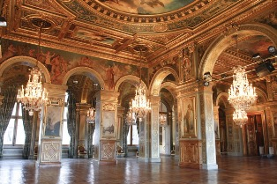
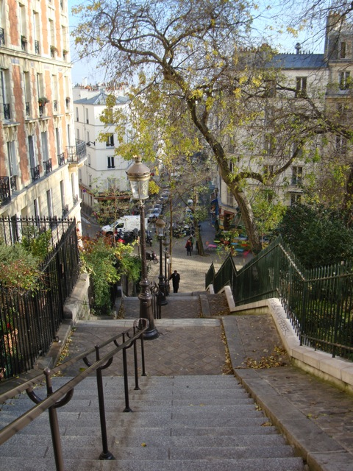
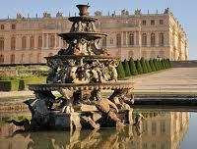
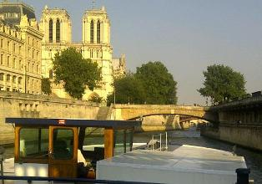
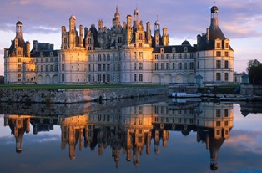
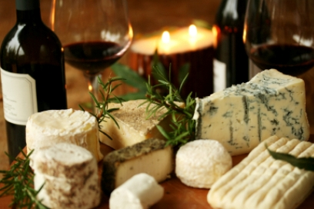
An exciting social program
Welcome reception - salons of the City Hall
Conference excursion - choose 1 among 4
Gala dinner - Boat trip on the Seine
Wine & cheese - during poster sessions
Optional pre-conference tour - Loire valley

Slide 12
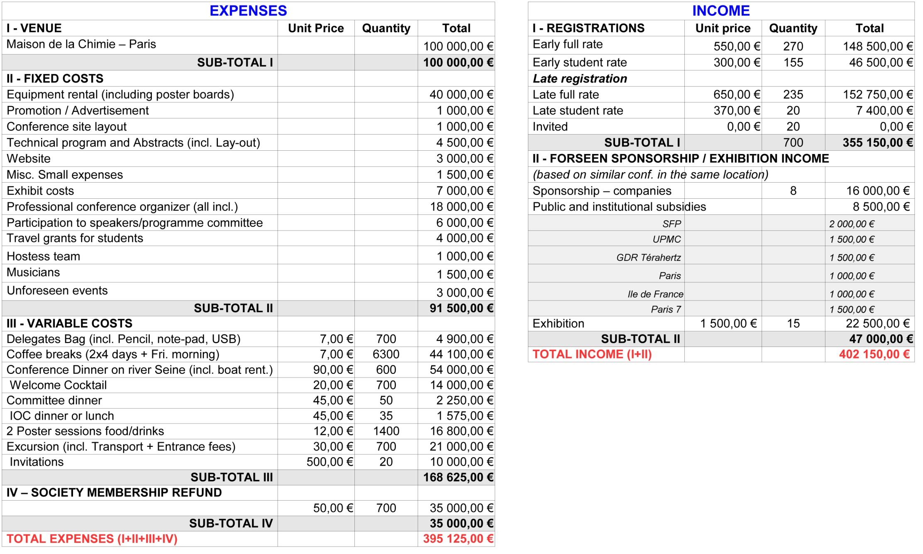
5. A safe provisional budget
Targeted budget: 700 participants
700 participants, 680 paying participants
and 20 invited participants
Any profit will be reallocated to the
benefit of the conference and the
IRMMW-THz Society

Slide 13
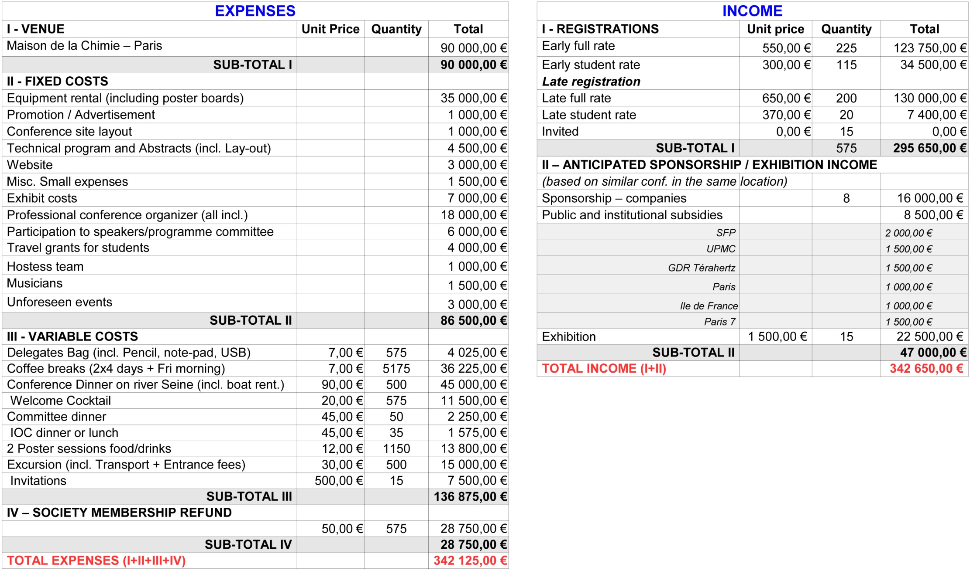
5. A safe provisional budget
Low hypothesis: 575 participants
575 participants, 560 paying participants and 15 invited
Any profit will be reallocated to the benefit of the conference and the IRMMW-THz Society

Slide 14
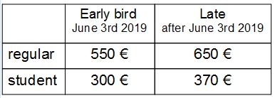
Registrations fees
In addition for attendees
Lunches: a list of a large number of restaurants very close to the conference venue will be provided.
A paying option (80 euros), will be arranged for the participants who prefer to have on-site lunches all along the conference.
Accommodation: a list of a large number of hotels very close to the conference venue will be provided.
Optional pre-conference tour: a trip in Loire valley scheduled during the previous week-end.
Optional Accompanying program: accompanying persons will have the opportunity to join the conference at certain times (possibility to purchase full package or separate ticket): welcome reception, gala dinner, conference excursion. The LOC will provide a list of activities, information and contacts for atypical visits of the city and monuments, museums, french cooking classes, wine tasting...
Registration fees include
admission to all scientific sessions and exhibition
material for attendees: registration material (bag, note-pad, pen), conference paper program, electronic conference proceeding
Welcome reception
coffee-breaks
2 wine & cheese
1 gala dinner
1 conference excursion
1 year membership at IRMMW-THz Soc.

Slide 15
Sponsors & Exhibitors
Public sector & academic sponsors
Société Française de Physique (SFP)
IEEE
European Physical Society (EPS)
University Paris 7 (René Diderot)
Ecole Normale Supérieure, Paris,
University Paris 6 (Pierre et Marie Curie)
Region Ile de France - City of Paris
Ministry of Foreign Affairs - DGA
E.U.
Agence Nationale de la Recherche
CNRS
C'Nano
ONERA (French aeronautics, space and
defense research lab)
GDR (Groupement de Recherche) "THz-MIR"
Board of Education of Université la Sorbonne
Institut d'Astrophysique de Paris (IAP)
Conservatoire des Arts et Métiers (CNAM)
Institut d'Electronique de France (IEF, Orsay)
LPN, CNRS (Marcoussis)
Institut d'Optique (Palaiseau)
University Paris 13 - University Montpellier 2
University de Savoie - University of Dunkerque
Industrial sponsors and/or exhibitors
Thales, worldwide electronics group
specializing in aerospace, defense and
information technology
Lakeshore
ANRISTU
Menlo
Toptica
REM
Springer
Coherent,
TeraVision
ALPES
Cascade Technologies
Hamamatsu
Newport
Spectra Physics
Roper Scientific
Lyted
LETI, Grenoble
…

Slide 16
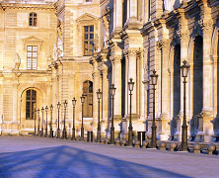
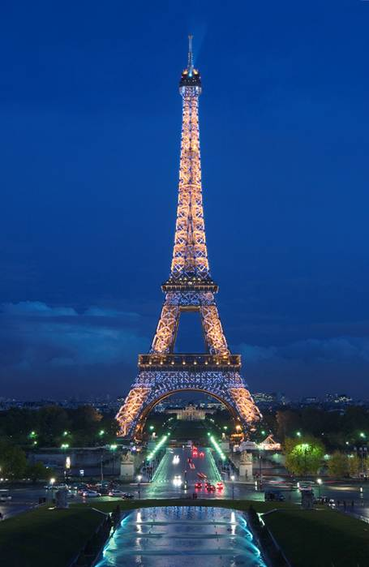
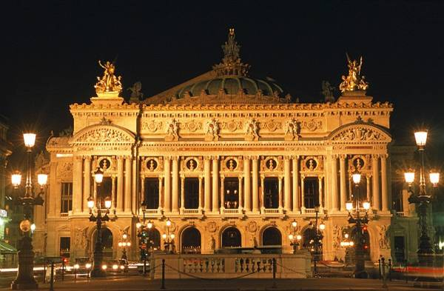
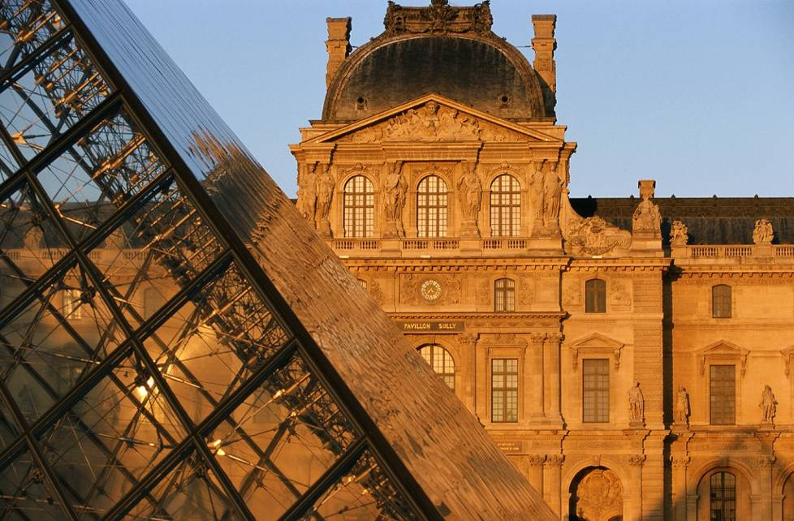
Last but not least, Paris is
A major cultural destination
149 museums
30 monuments
4 operas
200 illuminated buildings
numerous architectural
achievements
426 Parks & Gardens
A gastronomic destination

Slide 17
Summary of the merits of Paris for 2019
Paris offers many advantages to welcome the 2019-IRMMW THz conference:
The attraction of one of the most beautiful and exciting cities in the world
An easy access Conference venue
An exceptional Conference venue at reasonable cost
A venue with a lay-out well-suited to the format of the conference
A skilled LOC, experienced in conference organization
An opportunity to reach a wider scientific community
A wide list of sponsors, public, academic and industrial, liable to provide substantial financial support and to contribute to the success of the 2019 conference

Slide 18
Thank you for your attention

Slide 19
ANNEX 1
Contact information
Prof Carlo SIRTORI
Directeur du laboratoire Matériaux et Phénomènes Quantiques
Université Paris-Diderot - Paris7
Bâtiment Condorcet
Case courrier 7021
75205 Paris cedex 13
carlo.sirtori@univ-paris-diderot.fr
Prof Jérôme TIGNON
UPMC
Directeur du Laboratoire Pierre Aigrain
École Normale Supérieure
24 rue Lhomond
75005 Paris
jerome.tignon@lpa.ens.fr
+33 (0)6 16 92 86 63
Dr Armelle Guilloux
ellipse&co
www.ellipseco.fr
armelle.guilloux@ellipseco.fr
+33 (0)6 12 53 66 28

Slide 20

ANNEX 2
ellipse&co, company presentation - www.ellipseco.fr
Our services include
The definition and the implementation of all the tasks
necessary for the success of the event as
The supply of a functional dedicated website including a powerful tool
An organization implemented by considering two aspects: efficiency and environment-friendly process
. organization of periodic LOC meetings
. promotion of the event
. management of the relationships with participants, authors, exhibitors by email and phone
. document production (flyers, conference poster, paper program...)
. participation in the development of partnerships and sponsorships
. management of the external service providers (tenders, comparative study, monitoring)
. social program building
. on-site installation arrangement in connection with the venue manager
. ensure the smooth progress of the event all along the conference period
For scientific event organizations, ellipse&co uses a cloud based software solution provided by
the company etouches (used by over 20,000 event professionals) to manage registration and
abstract submissions. http://corp.etouches.com/event-software/
Main technical features of the dedicated website:
. online registration and payment for attendees and for exhibitors
. confirmed exhibitor at a glance: possibility to see the booth allocation on the exhibition map
. online abstract submission, paper submission, reviewing procedure
. detailed Program and individual program "My conference"

