Slide 1

Carlo Sirtori, Jerome Tignon
General Chairs of the conference

Slide 2
Overview of the conference programme
Plenary session starts everyday at 9:00 (daily announcements 8:50)
Poster sessions (with wine and cheese!) close the scientific programme everyday but Friday
Conference Banquet on the Seine river → Wednesday 8:00
Two awards ceremonies:
        IRMMW-THz Awards (K. Button, Y.S.A. & B.S.A.) → Thursday 12:30
        Paris 2019 Awards (GdR, Swiss THz Prize) → Friday 12:45

Slide 3
Overview of the conference programme
Monday 2nd
Tuesday 3rd
Wednesday 4th
Tuesday 5th
Friday 6th
Registration
Registration
Registration
Registration
9 – 10:30
Plenary
9 – 10:30
Plenary
9 – 10:30
Plenary
9 – 10:30
Plenary
9 – 10:30
Plenary
Exhibition
Award
Exhibition
Exhibition
Exhibition
Award
17 – 18:15
Posters
18:15 – 19:30
Posters
18:15 – 19:30
Posters
18:15 – 19:30
Posters
8:00
Banquet

Slide 4
Numbers of IRMMW-THz 2019
1015 abstracts received
10 plenaries (first plenary by G. Mourou, Nobel 2018)
78 keynotes
374 regular oral presentations
445 posters
80 topical sessions
12% rejection rate
950 participants

Slide 5
Some statistics
Submissions
Others:
Australia
Netherlands
Taiwan
Spain
Lithuania
Canada
Poland
Sweden
Denmark
Greece
Hungary
Armenia
Austria
Czech Republic
Israel
Belgium
Mexico
Ukraine
Hong Kong
Turkey
Brazil
Ireland
New Zealand
Romania
Thailand
Chile
Algeria
Finland
Iran
Philippines
Pakistan
Slovenia
United Arab Emirates
Others 16%
China 20%
Switzerland 2%
Korea 2%
India 2%
Italy 2%
Russian Federation 12%
United States 6%
United Kingdom 6%
Germany 12%
France 9%
Japan 11%

Slide 6
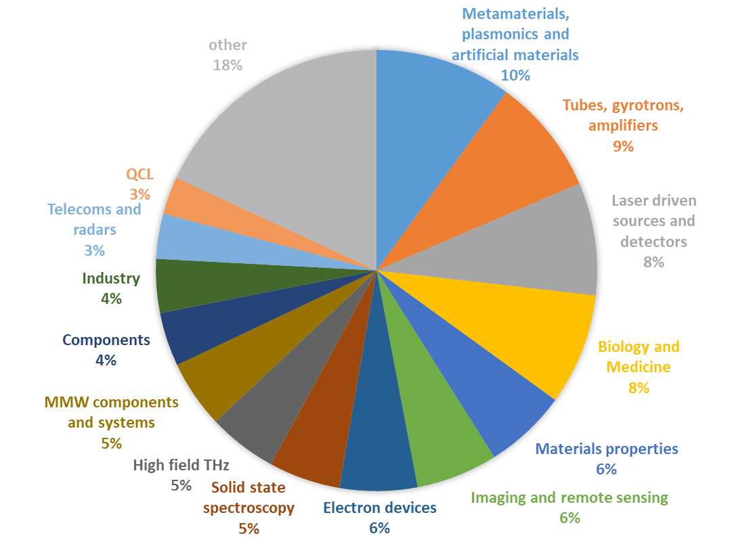
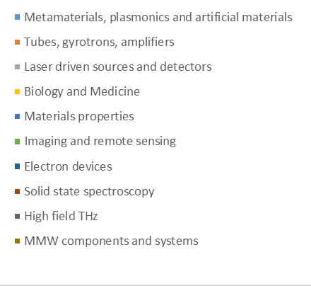
Some statistics
Topics

Slide 7
Exhibition
29 exhibitors are presents this year at the conference!
2 demonstrations of THz technologies

Slide 8
Difficulities
Shocklogic
  Hacking of the abstract English platform (lack of clear communication)
  Delay in the review process (re-submission)
High number of delegates (organisation, banquet, … )
Organisation of the scientific programme due to
  Diversity of the topics
Internal issues with the CNRS registration software
  We were obliged to use it as the CNRS played as bank for us
  Very poor assistance with 6% tax

Slide 11
Acknowledgements
Technical Programme Committee
    Chairman: Jean-Louis Coutaz, co-chairwoman Juliette Mangenay
Organising Committee
ellipse&co CEO – Armelle Gouilloux
IEMN Student Workshop - Training on selected THz/MIR experimental techniques
IRMMW-THz (Dan and Peter )
Exhibitors
Sponsors

Slide 12


Sponsors
Platinum

Slide 13
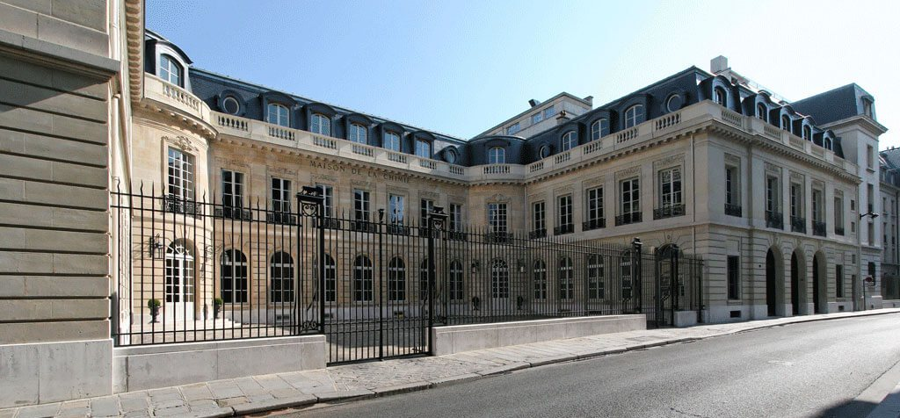
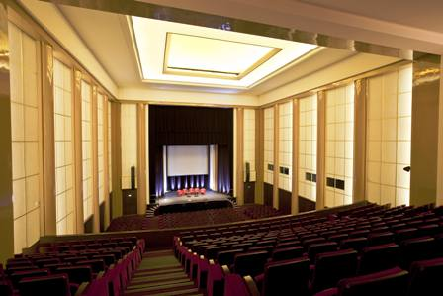
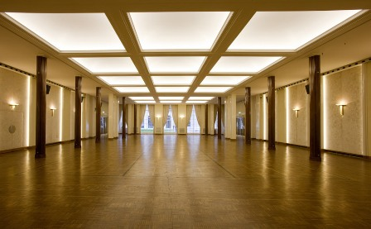
The venue: Maison de la Chimie
28 rue Saint-Dominique 7th arrondissement, Paris
0
Grand Amphitheatre - plenary sessions
Salon - poster sessions, exhibition and coffee breaks

