Slide 1


Registrations and Papers in IRMMW-THz 2018
847 total attendees (Including exhibitors, plenary speakers, accompanying persons)
788 total registrations = 575 Regular registrations, 183 Student registrations, and 30 Accompanying persons (8 is below 15 years old)
727 total papers
394 oral talks (9 plenaries, 39 Invited Keynotes, 42 Contributed Keynotes, 304 contributed orals)
333 posters

Slide 2
Review Process
769 Regular submissions
3 reviews per paper = 2,307 reviews(!)
82 TPC members, all on time with all reviews
817 total number of papers, 727 Accepted (9 plenaries, 39 Invited keynotes, 42 Contributed Keynotes)
Rejection rate approx. 11.7%

Slide 3
Submissions, percentages by Countries

Slide 4
Submissions, absolute No. by Countries

Slide 5

Income Overview
Registrations: 43,870,000 JPY (398,818 USD)
Exhibition+company sponsors: 9,050,000 JPY ( 82,273 USD)
Other financial supports: 16,600,000 JPY (150,909 USD)
Total income: 69,520,000 JPY (632,000 USD)
Total expenses: -68,514,719 JPY (-622,861 USD)
Net result (as of yesterday): 1,005,281 JPY ( 9,139 USD)
Expenses include the IOC hosting fee.

Slide 6
Expenses Overview
Venue expenses: 15,722,579 JPY (142,933 USD)
Printed matter + USB: 2,939,325 JPY ( 26,721 USD)
Operating cost: 15,185,591 JPY (138,051 USD)
(Schocklogic, Commission, LOC meeting, support staffs, etc)
IOC meeting: 1,482,699 JPY ( 13,479 USD)
Speaker support (intend to do): 2,000,000 JPY ( 18,182 USD)
Student workshop: 215,460 JPY ( 1,959 USD)
Excursion support: 1,080,000 JPY ( 9,818 USD)
Cost per delegate: 18,613,367 JPY (169,212 USD)
(reception, banquet, coffee break, lunch, etc)
Total expenses: 68,514,719 JPY (622,861 USD)

Slide 7
IOC and other meetings schedule
Meeting | Date and Time | Place
IRMMW-THz Society Board of Directors Meeting | Sep 9 (Sun) 14:00-17:00 | CYPRESS GARDEN HOTEL (Kanayama), “Partir”, 3rd floor
IRMMW-THz Young Scientist Award Committee Meeting | Sep 10 (Mon) 11:30 - 12:30 (Lunch Meeting) | Nagoya Congress Center (NCC), Room 143(90m^2)
IRMMW-THz Student Award Presentation Meeting | Sep 10 (Mon) 18:00-20:00 (Parallel to the poster session) | NCC Room 143 (90m^2)
IRMMW-THz IOC Meeting | Sep 11 (Tue) 12:30 - 14:00 (Lunch Meeting) | NCC Room 431 (140m^2)
IRMMW-THz K. J. Button Prize Committee Meeting | Sep 12 (Wed) 12:30-14:00 (Lunch Meeting) | NCC Room 143(90m^2)
IEEE-T-TST Meeting | Sep 12 (Wed) 15:30-17:00 (Parallel to the poster session) | NCC Room 143(90m^2)
JIMT Editorial Board Meeting | Sep 13 (Th) 12:30-14:00 (Lunch Meeting) | NCC Room 143(90m^2)
IOC Dinner | Sep 11 (Tue) 19:00-21:00 | GAJOUEN (Japanese restaurant)

Slide 8
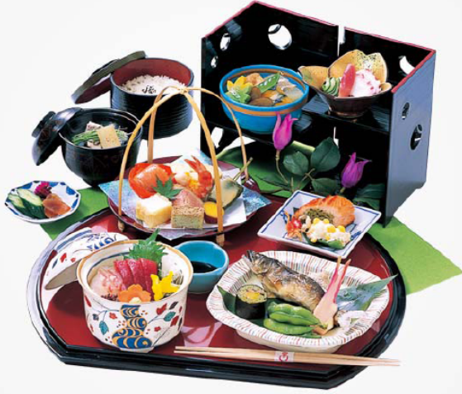
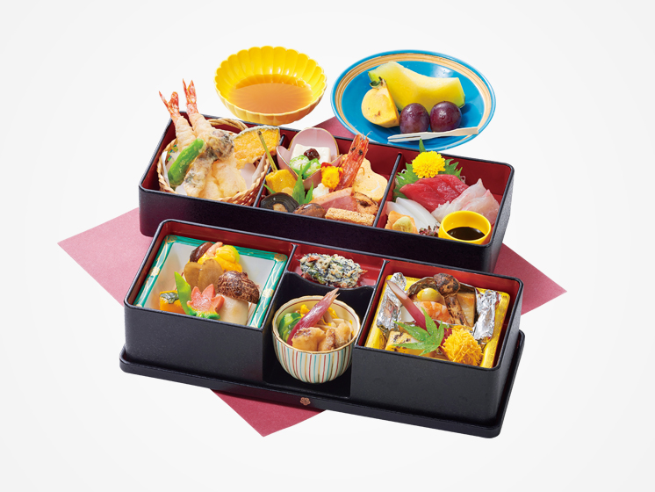
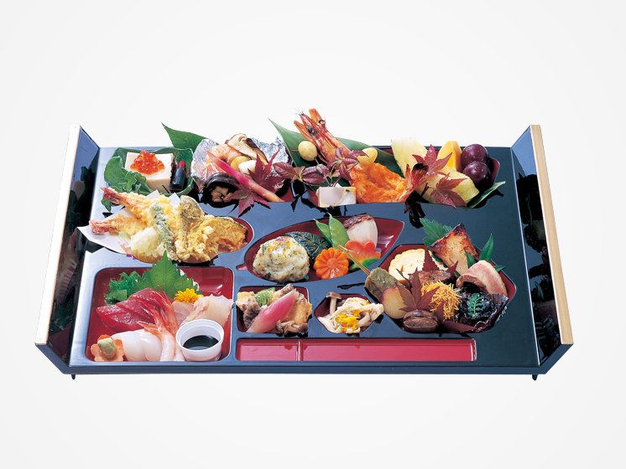
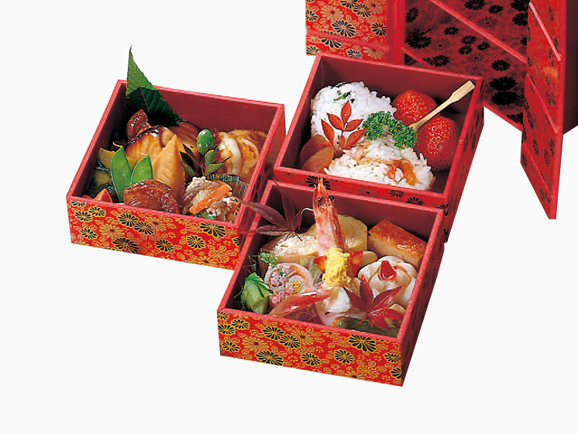
Lunch boxes in the meetings
Sep 10(Mon) Young Scientist Award Committee Meeting: NODATE ( 野立)
Sep 11(Tue) IOC Meeting: KAISEKIWARIKO
(会席割子)
Sep 12(Wed) K. J. Button Prize Committee Meeting: FUKIYOSE ( 吹寄)
Sep 13(Thu) JIMT Editorial Board Meeting: RIKYU ( 利休)

Slide 9
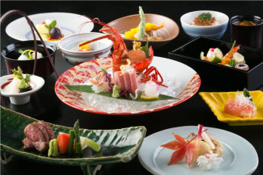
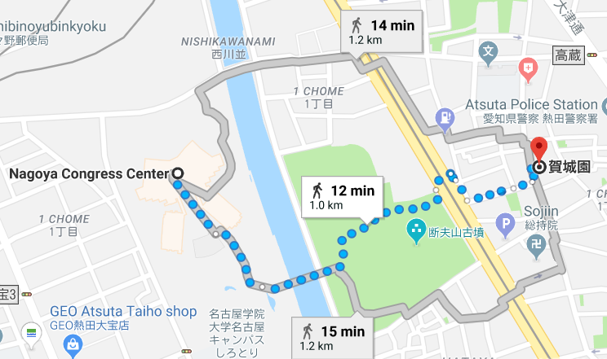
IOC Dinner: Schedule and Venue
Bus pick-up Tuesday 18:45 at the main entrance of the Nagoya Congress Center
The venue is a Japanese Restaurant “GAJOUEN” (you may walk)
Starting from 19:00
Bus returns to the Kanayama Station at around 21:30
NCC
Gajouen

Slide 10
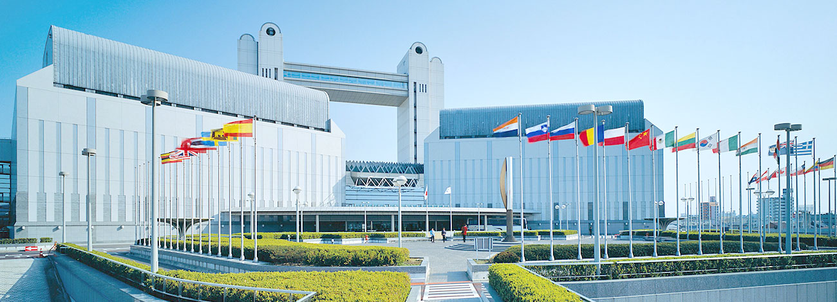
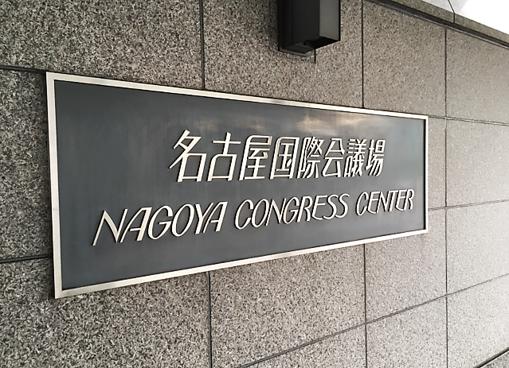
Meeting Point for the IOC Dinner Sept 11(Tue)
Meeting Point Here!
Bus pick-up at 18:45 on Sep. 11(Tue) in front of the main entrance of the Nagoya Congress Center, near the sign board of NCC (see the picture on the left).

Slide 11
Banquet on Sept 12(Wed)
From 18:30 in ATSUTA JINGU KAIKAN
Bus pick-up from the main entrance of NCC from 17:00
The banquet is held in Main Hall and Sub-Hall. Please come to the Main Hall.
It’s a stand-up dinner party but a limited number of tables are served to IOC members in front of the podium in the Main Hall.
Award Ceremony and Announcements:
IRMMW-THz Society Exceptional Service Award
Young Scientist Award
Student Award
Announcement for IRMMW-THz 2019 in Paris
Announcement for IRMMW-THz 2020 in Buffalo
Announcement of Venue for IRMMW-THz 2021

