Slide 1
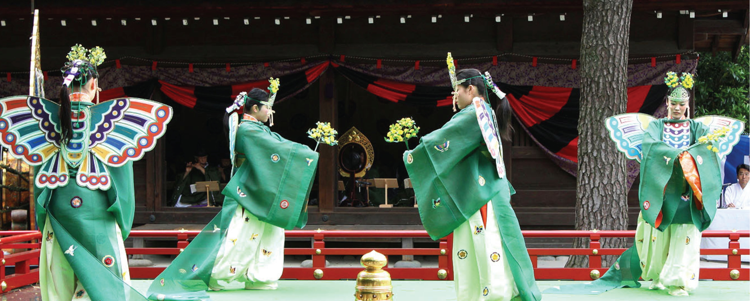
IRMMW-THz 2018
Nagoya
IRMMW-THz Society
Secretary/Treasurer’s Report & Updates
Society Finances, KJB Status & Finances,
Report on Financial underwriting of ISSTT 2018,
Web/Conference Changes for 2020 and beyond,
IRMMW-THz 2021 & MOTION for future financial sponsorship
Sept. 9-14, 2017
NAGOYA, JAPAN
Peter H. Siegel, General Secretary

Slide 2
IRMMW-THz 2018
Nagoya
IRMMW-THz Society Finances 1.
Total Assets as of 9/30/2017 (Start of FY’18)
Vanguard VBIAX (9/30/17): $484,046.16
Checking Account (9/30/17): $ 13,685.49
TOTAL ASSETS (9/30/17): $497,731.65*
* Includes 2017 hosting fee of $20,850 received on 9/25/2017

Slide 3
IRMMW-THz 2018
Nagoya
IRMMW-THz Society Finances 2.
Earnings in FY’18 (9/30/17-present):
Hosting Fee for 2017 Conf. in Mexico: $20,850
Vanguard Div’s (paid quarterly, 3 total): $ 7,909
Total Earnings to date in FY’18: $28,759
Capital Gains on endowment (as of 9/1): $12,350
TOTAL Earnings plus Capital Gains in FY’18: $41,110

Slide 4
IRMMW-THz 2018
Nagoya
IRMMW-THz Society Finances 3.
Expenses in FY'2018 Sept. 30, 2017-present) | US$
Web fees (hosting, DNS, email, etc.): | $1,728
Society Website (Ashday & Handmade): | $3,965
Student Paper Prize for 2018: | $2,000
Young Scientist Award for 2018: | $2,000
Legal Services (S. Sommers, Esq.): | $41
Tax Filing & Accounting Fees: | $3,335
Postage/wire fees/bank fees: | $9
Other (supplies for awards): | $347
Total Expenses in FY’18 (to date): | $13,425

Slide 5
IRMMW-THz 2018
Nagoya
IRMMW-THz Society Finances 4.
Yearly Asset Change: 9/30/2017 to 9/1/2018
 | 9/30/17 | 9/1/18 | Inc. or Decr.
Checking: | $13,685 | $5,172 | ($8,514)
Vanguard: | $484,046 | $522,247 | $38,200
TOTAL | $497,732 | $527,418 | $29,687
Percentage Asset earnings (dividends plus cap gains): $20,260 or 4.2% for FY’18 with one more dividend due on 9/30/18

Slide 6
IRMMW-THz 2018
Nagoya
IRMMW-THz Society Finances 5.
Summary of Income and Expenses for FY'18
Income: | 2017 Hosting fee: | $20,850
 | 3 Vanguard Divs (9/30/17-9/1/18): | $7,909
 | Vanguard Cap. Gain (as of 9/1/18): | $12,350
 | TOTAL INCOME PLUS GAINS: | $41,110
Expenses: | Legal, Accting, awards, web, etc: | ($13,425)
Total (Gains - Expenses) for FY2018: |  | $27,685

Slide 7
IRMMW-THz 2018
Nagoya
IRMMW-THz Society Finances 6.
The 2017 Conference was financially successful. Enrique contributed a hosting fee of $20,850 (417 registrants) to the Society.
FY18 earnings topped $41K bringing the endowment+checking to $527,418.
Dividend income in FY’2018 will be ≈ $10,000 (about 2%) but capital gain YTD is only 2.5% ($12,350) significantly less than last year.
Expenses in FY’2018 were $13,425 including new YSA award ($2000) and major web site upgrades in prep for 2020 ($3965).
Expenses in FY’2018 exceed dividend income but are < divs+cap gains
Costs in FY2019 expected at ≈$15,000 due to continuing development of website and increased accounting costs for 501c3.
In FY 2020 Shocklogic contract will have to be renewed (≈$5000).

Slide 8
IRMMW-THz 2018
Nagoya
KJB Award Endowment 1.
Note: All KJB funds now held by: IRMMW-THz Society!
  In Nov. 2017 we received notice that the estate of Ken Button had left $20,000 to the KJB Prize fund – but the donation was to the IOP in UK!
  IOP was willing to turn the money over to us but only via the Pasadena Community Foundation – our prior surrogate for the endowment.
  Peter negotiated with both IOP and PCF to have the funds transferred to PCF and then donated to the IRMMW-THz Society but with some fees. On 11/9/2017 we deposited $19,555 into the KJB Endowment being held in our Vanguard VWENX account!
  The full endowment now stands at: $229,335

Slide 9
IRMMW-THz 2018
Nagoya
KJB Award Endowment 2.
  Investment Income in FY’18: 3 divs plus cap gains (all reinvested): $17,091
  Endowment Income (gifts) in FY’18: $19,555
  Expenses in 2018: $3000 Prize money to Qing Hu
  Gross Profit for FY’18 (gift plus inv. income-Prize): $33,646
  Investment Return for FY’2018 to date (not including Gift): 8.7%!!

Slide 10
IRMMW-THz 2018
Nagoya
Report: Financial Sponsorship of ISSTT 2018
Last year the Society board voted on a motion to financially support the 2018 ISSTT (Int. Sym. on Space THz Tech.) conference along with IEEE MTTS Society at the 50% commitment level.
The conference was held at Caltech on March 26-28, 2018.
116 participants attended and 109 papers were presented.
The conference was chaired by Dr. Boris Karasik of JPL and was considered to be a great technical and financial success.
The conference generated a surplus of $18,160.
In addition to some positive advertising the IRMMW-THz Society expects to receive approximately $9000 for its share of financial liability (payment is expected before 12/31/2018).

Slide 11
IRMMW-THz 2018
Nagoya
Report: Web/Conf Mods for 2020 and Beyond
In 2016 the Society board voted on a motion to financially underwrite the 2020 conference, and to set up a Hosting Oversight Committee (HOC) to oversee and assist with all financial arrangements.
The 2020 conference team is now solidifying behind Andrea Markelz, and the technical program committee will be chaired by Frank Hegmann.
The HOC has already had significant contact with the 2020 LOC, and is assisting SUNY Buffalo personnel assigned to the 2020 event with their plans for the local arrangements and finances.
As part of this process, Peter has been formulating a new website that can serve as the gateway for all local conference interactions.

Slide 12
IRMMW-THz 2018
Nagoya
Web/Conf Mods for 2020 and Beyond, cont.
Over the last year, Peter has transferred the Society website to new servers, sought out, vetted and hired a new web update/maintenance team – Handmade Interactive LLC, and begun the process of turning the Society website into the main server/site for all Society and local conference interactions. That is, the irmmw-thz.org URL will be the gateway for all web traffic, starting in 2020, with local conference activities included as conference specific pages under this URL.
A beta site has already been set up with the 2014 Conference serving as a template for 2020 and future events.
The goal is to start re-populating this series of pages with 2020 specific information after Nagoya (a separate Header Page will point visitors to the IRMMW-THz 2019 website for the Paris venue).

Slide 13
IRMMW-THz 2018
Nagoya
Financial Sponsorship of Conferences 1.
As per the MOTION in 2017, the Society has now vetted a process for finding and selecting local hosting committees to compete for IRMMW-THz 2021 in Asia using a Hosting Oversight Committee (HOC)
Dan Mittleman assembled the 2021 Hosting Oversight Committee in 2018 chaired by Gun Sik Park.
Two competing proposers – Chengdu and Perth - eventually surfaced, and their proposals were vetted and deemed acceptable by the HOC.
Comprehensive site visits were made to both venues at no cost to the Society.

Slide 14
IRMMW-THz 2018
Nagoya
Financial Sponsorship of Conferences 2.
Due to difficulties with funds leaving China, the LOC for Chengdu requested that they be allowed to locally finance the conference under an agreement whereby the Society would receive a hosting fee of $60 per registered attendee (similar to locally sponsored conferences through to 2019).
This arrangement was brought to a vote by the full IOC, and passed.
Peter generated a special MOU for this situation and has received a signed copy from the Chengdu team.
The Perth conference will participate under Society finances in accordance with the procedures set in place for 2020 in Buffalo.
We propose continuing this process for the foreseeable future.

Slide 15
IRMMW-THz 2018
Nagoya
Financial Sponsorship of Conferences 3.
PHS would like to make a motion for IRMMW-THz 2022 and beyond that would allow local committees to petition for local financial sponsorship, if it is deemed necessary, and with the stipulation that a hosting fee replaces the Society financial sponsorship.
MOTION:
The Society Board allows any future local committee to petition the IOC for local financial sponsorship of a conference. The local committee must make it clear why this approach is necessary, and alert the IOC at the time of submission of the initial hosting pre-proposal (normally due by Jan 31, 3 years before the conference is to take place). A Hosting Fee set by the IOC, will replace financial underwriting if the local committee’s proposal is accepted.

