Slide 1

IRMMW-THz 2021 Conference Work
Chengdu,China

Slide 2
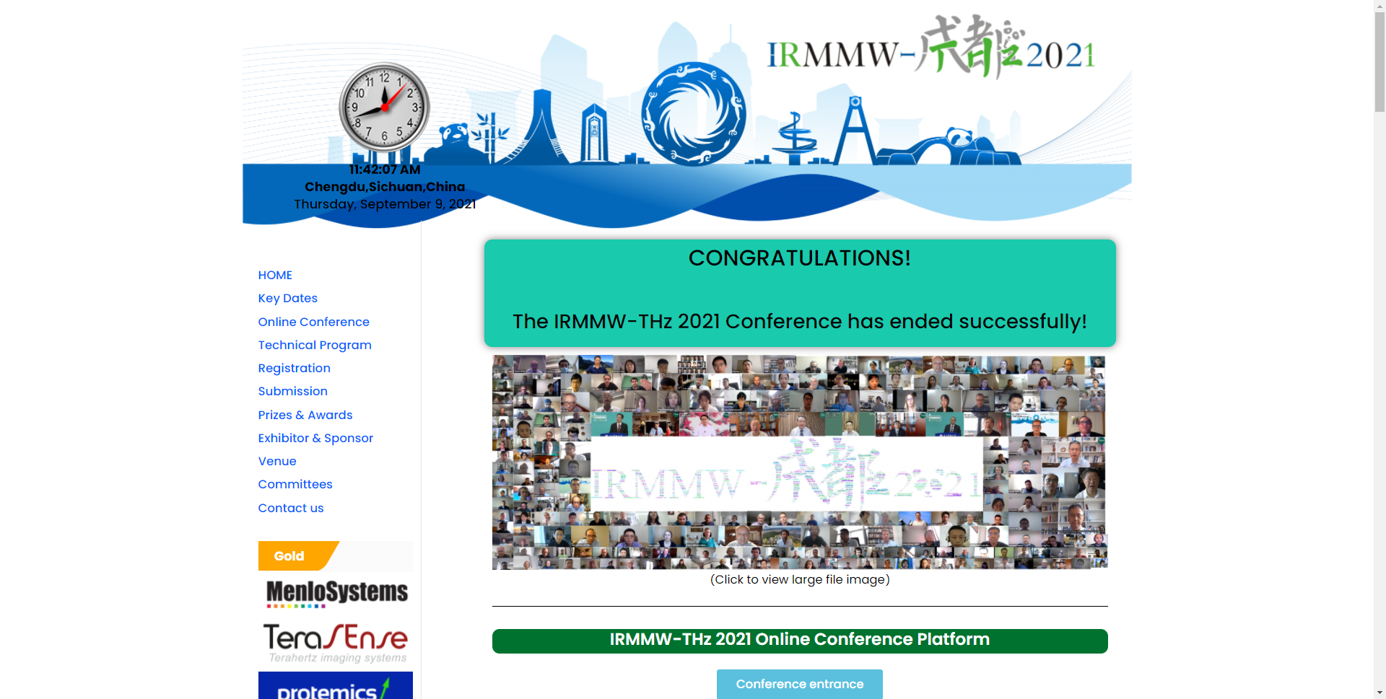
FIRST
Create the conference website
1. Buy the cloud service
2.Contact peter to resolve the domain name:irmmw-thz2022.org to the IP address of the cloud server
3.Then you can start designing the conference website

Slide 3
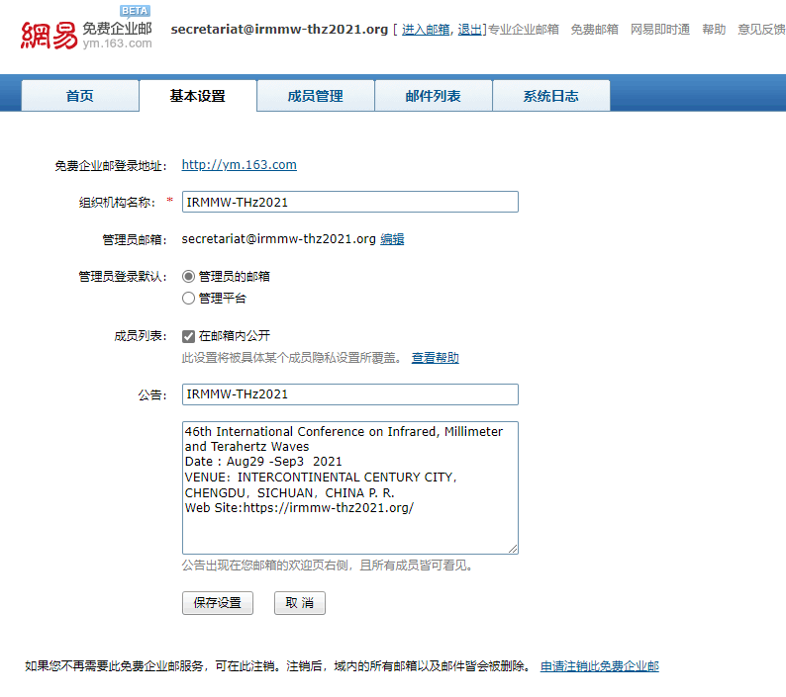
SECOND
Create Conference dedicated mailbox
1. Choose a business email service provider
2.Contact Peter to resolve the domain name:irmmw-thz2022.org to the IP address of business email
3.Then you can create the mailbox:secretariat@irmmw-thz2022.org/TPC@irmmw-thz2022.org

Slide 4
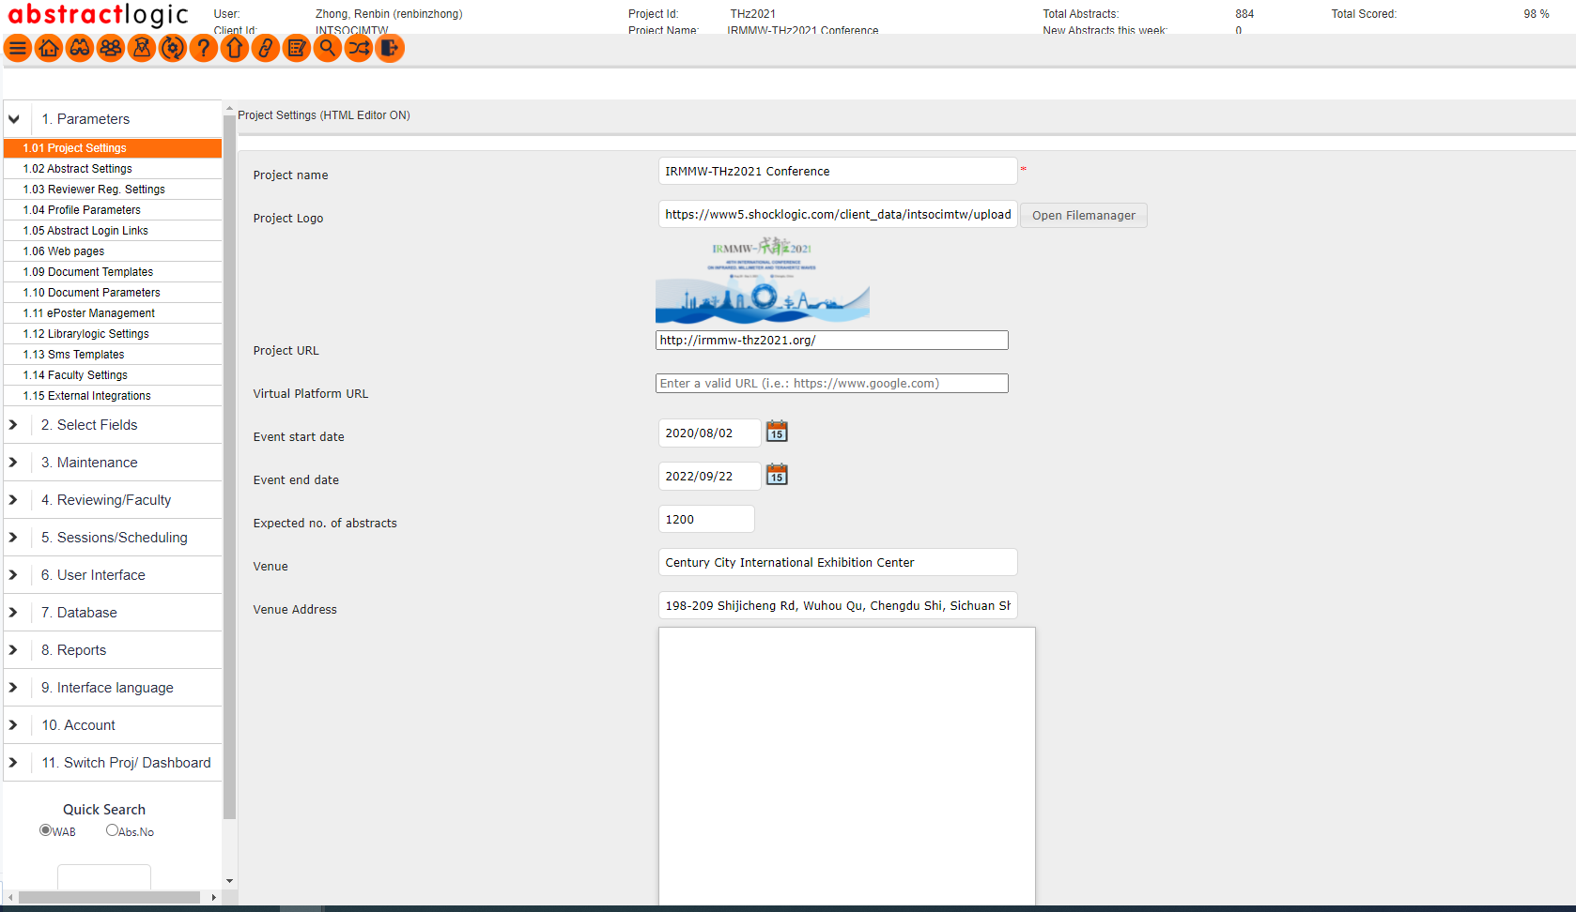
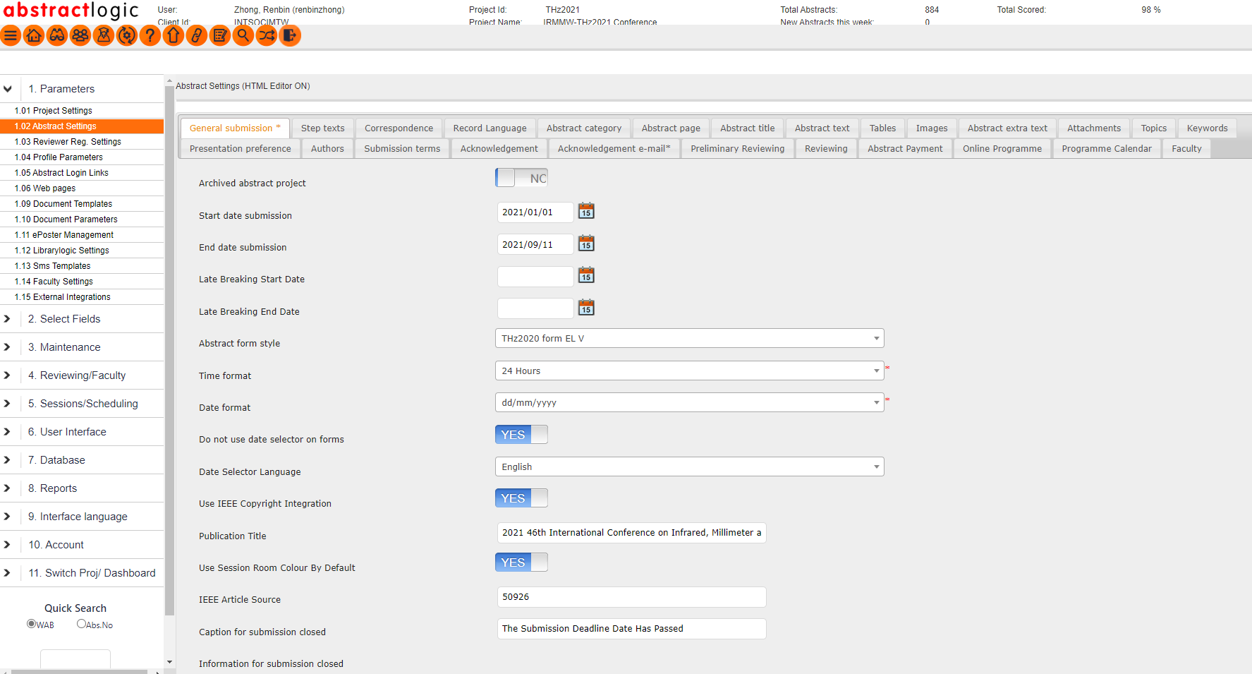
THIRD
Shocklogic submission system
Set the basic information
Manage Abstract submit process and requirements

Slide 5
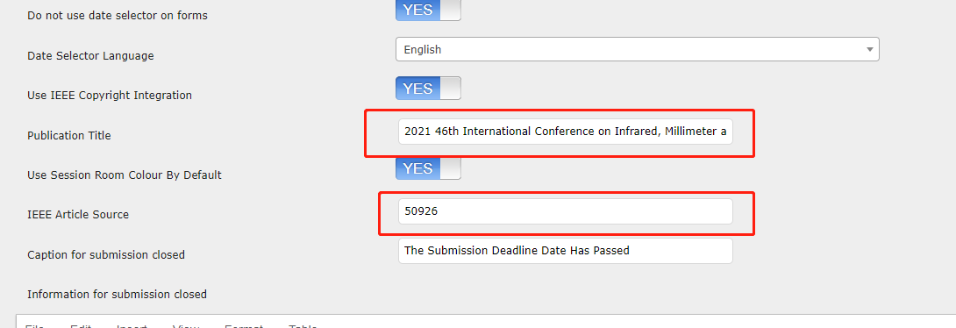
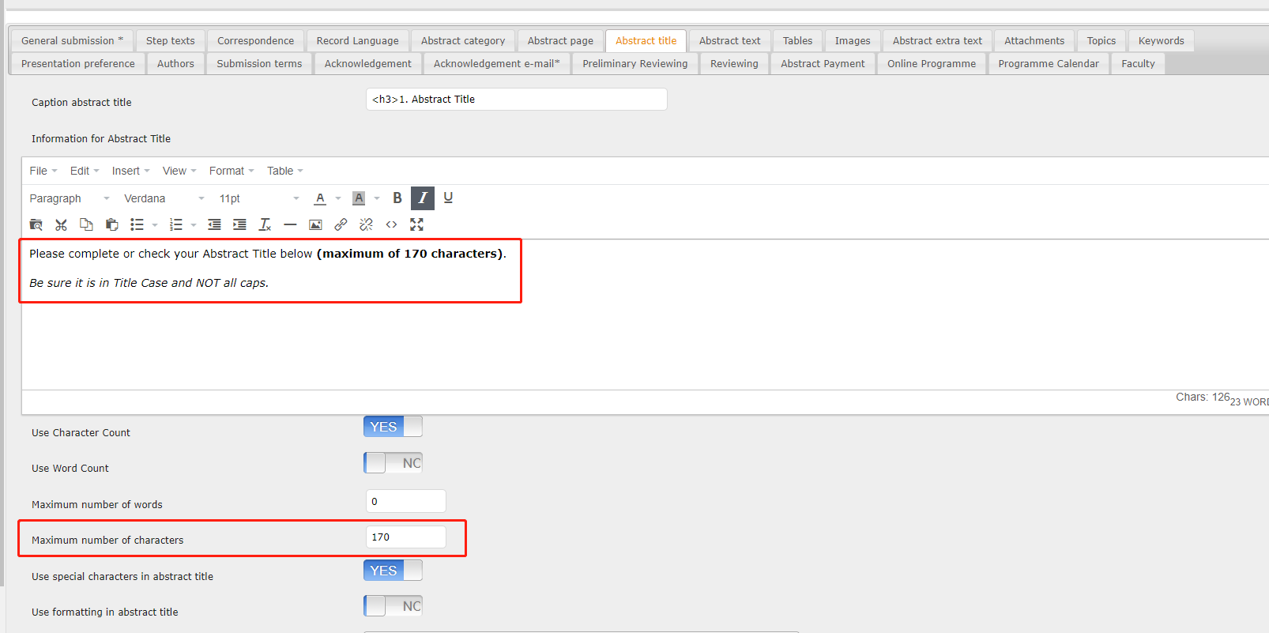
NOTE: Publication Title and IEEE Article Source Must be the same as the information provided by IEEE Xplore
NOTE: Must set Maximum number of characters , in order to prevent participants from filling in the title by mistake

Slide 6
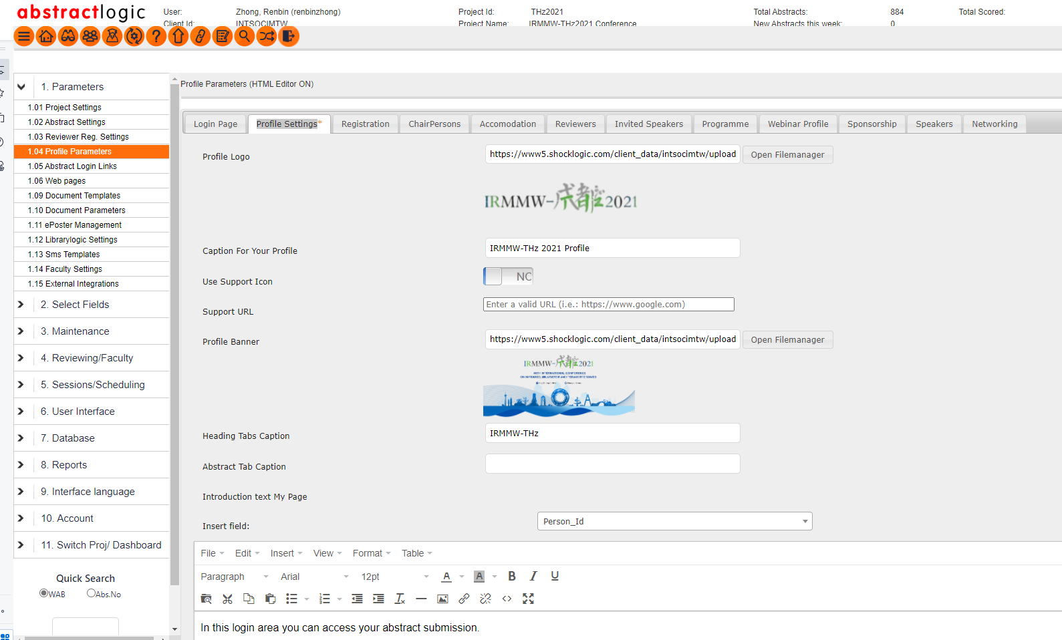
Manage Profile Settings
Configure information about the Login page
Configure information about Profile Page

Slide 7
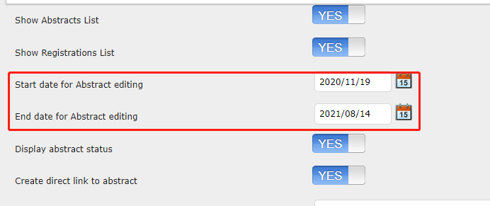
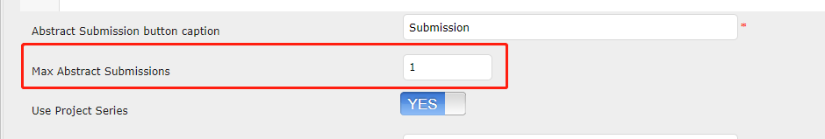
NOTE: Here you can set the deadline for Abstract editing
NOTE: Here you can set the Max amount Abstract Submissions a person

Slide 8
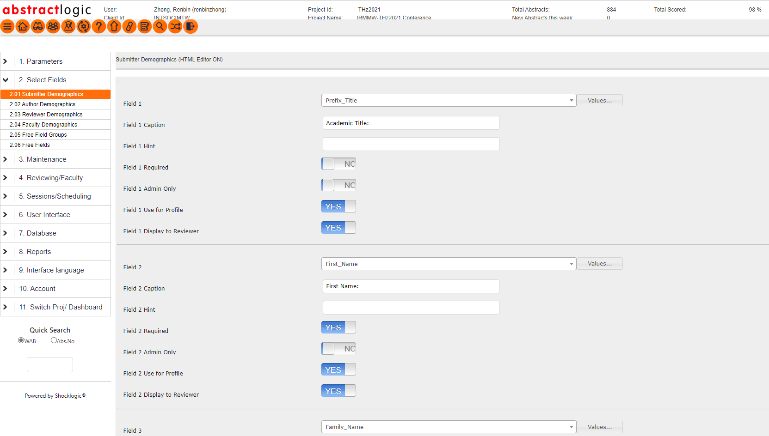
Configure submitter Demographics
Here you can set what information the submitter needs to fill in (what information is required to be filled in) when submitting

Slide 9
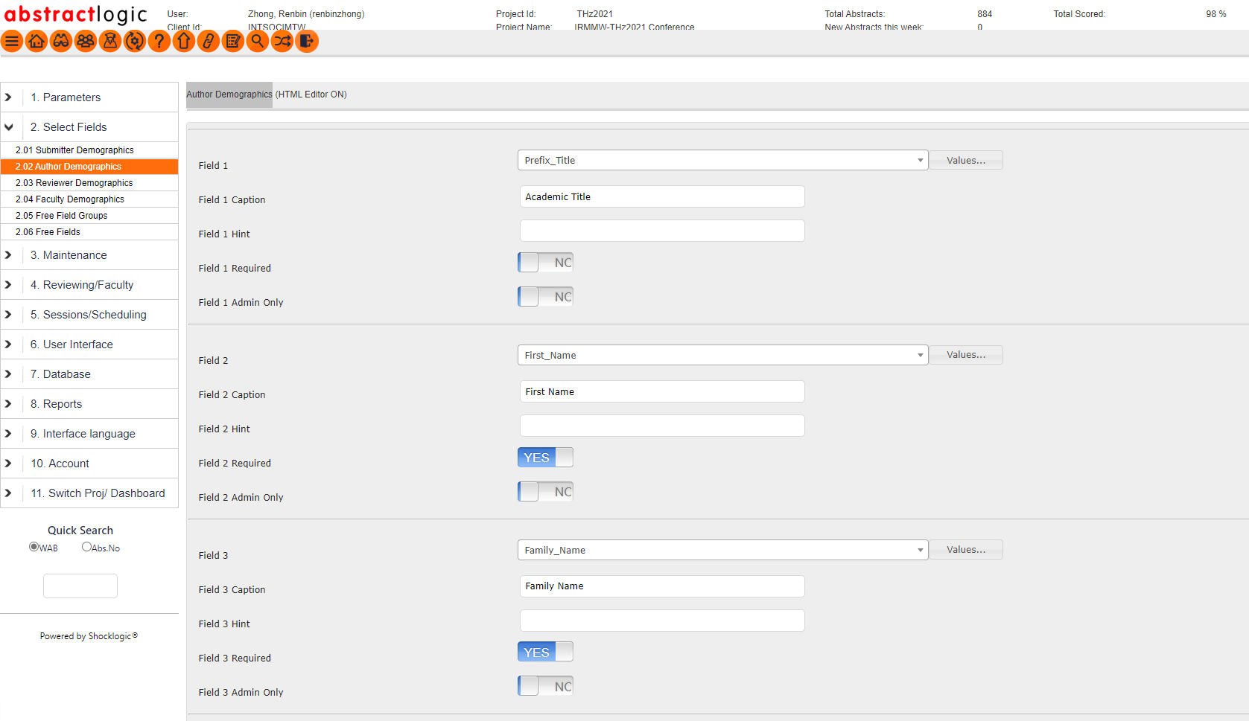
Configure author Demographics
Here you can set what information needs to be filled when the submitter registers an account

Slide 10
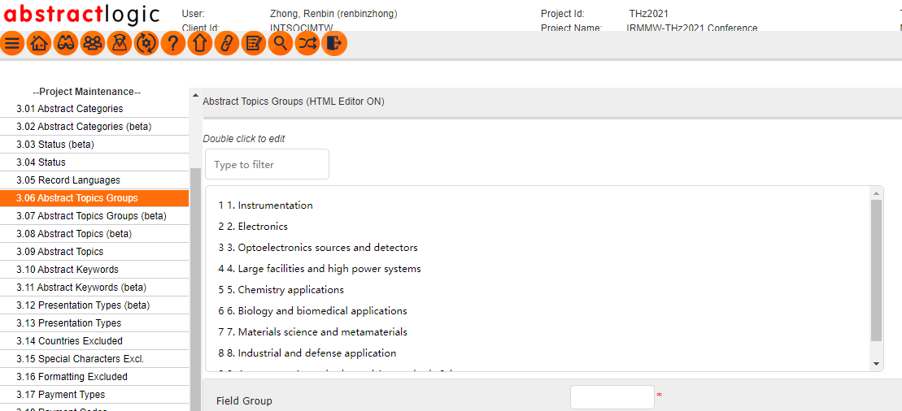
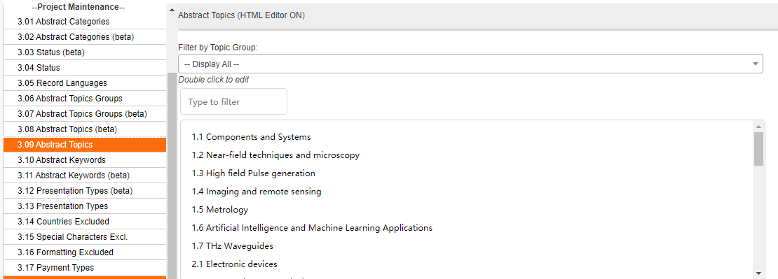
Configure author Demographics
1. Set the main topics of submission
2. Set sub topics for submission

Slide 11
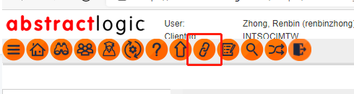
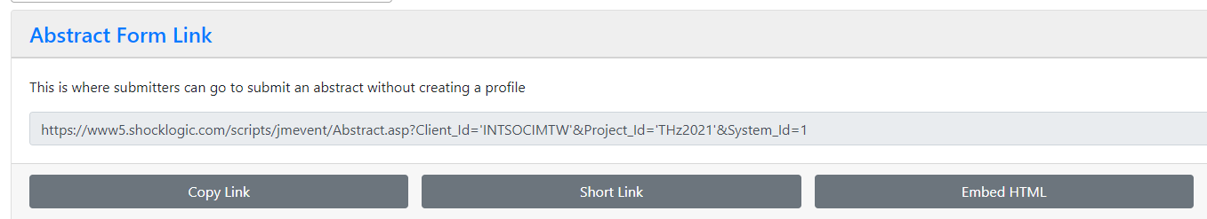
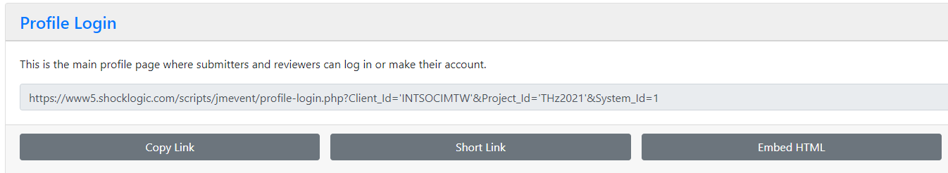
Announce submission system
1. Click to get the link
2. This link is abstract submission link without registration
3. This link is the login and registration link of the submission system. Participants need to register first and then choose to submit (Recommend)

Slide 12
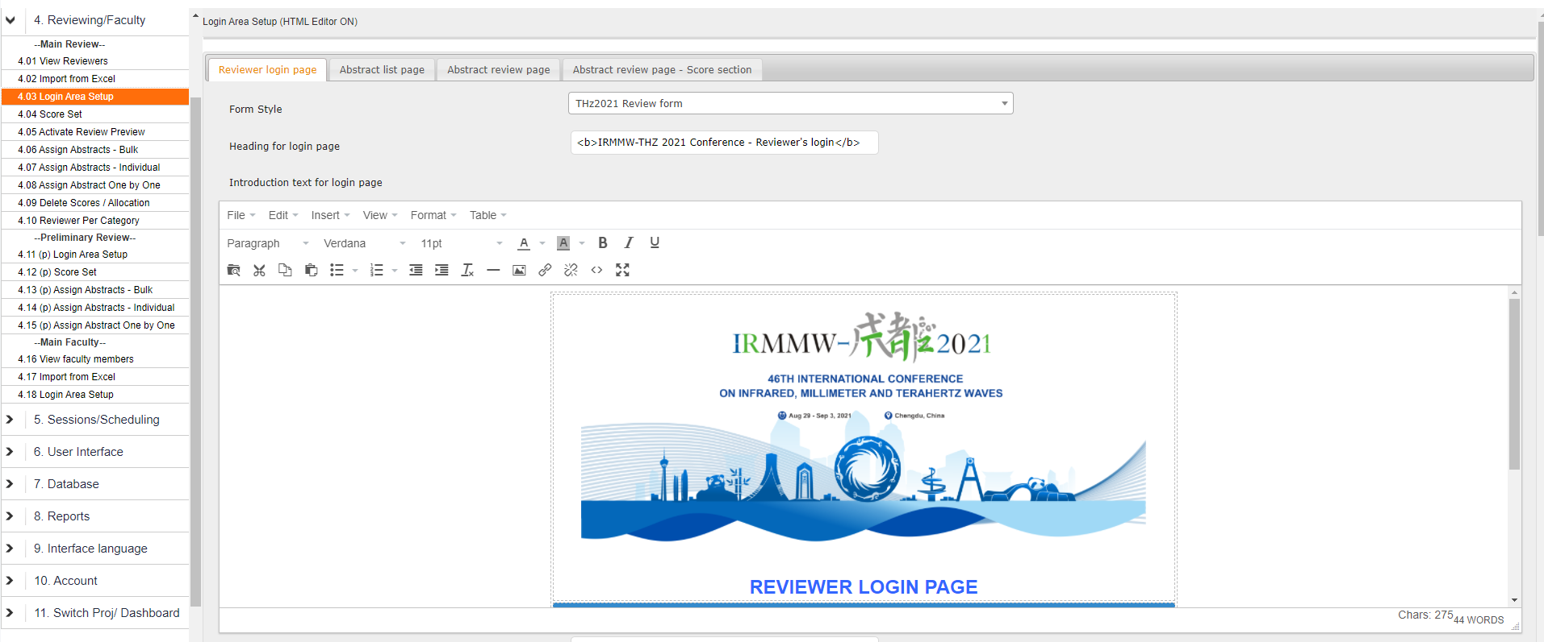
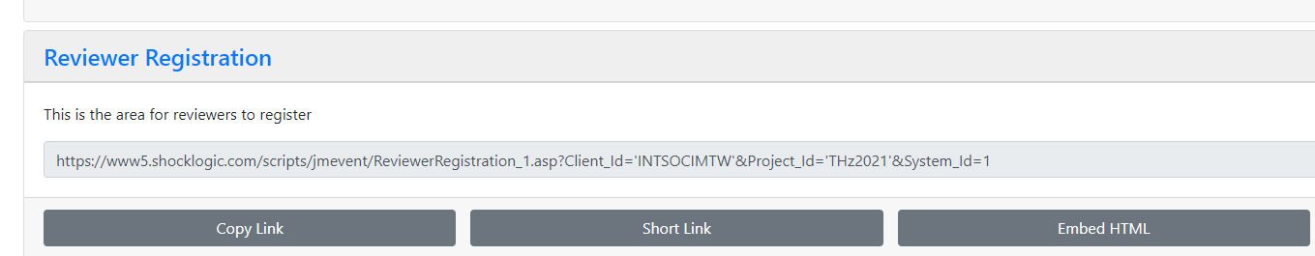
FOURTH
Shocklogic Reviewer system
Set reviewer Login Area Setup
2. Send the reviewer registration link to allow the reviewers to register and choose topics that they can review

Slide 13
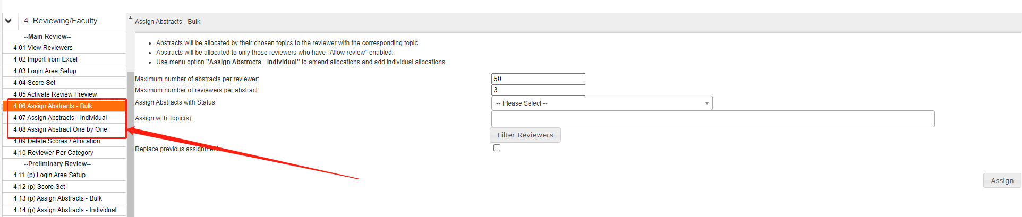
3. After all reviewers are registered, you can assign articles to all reviewers
The system provides three distribution rules. It is recommended to use the first method for distribution. Then, you can make adjustments in other ways

Slide 14
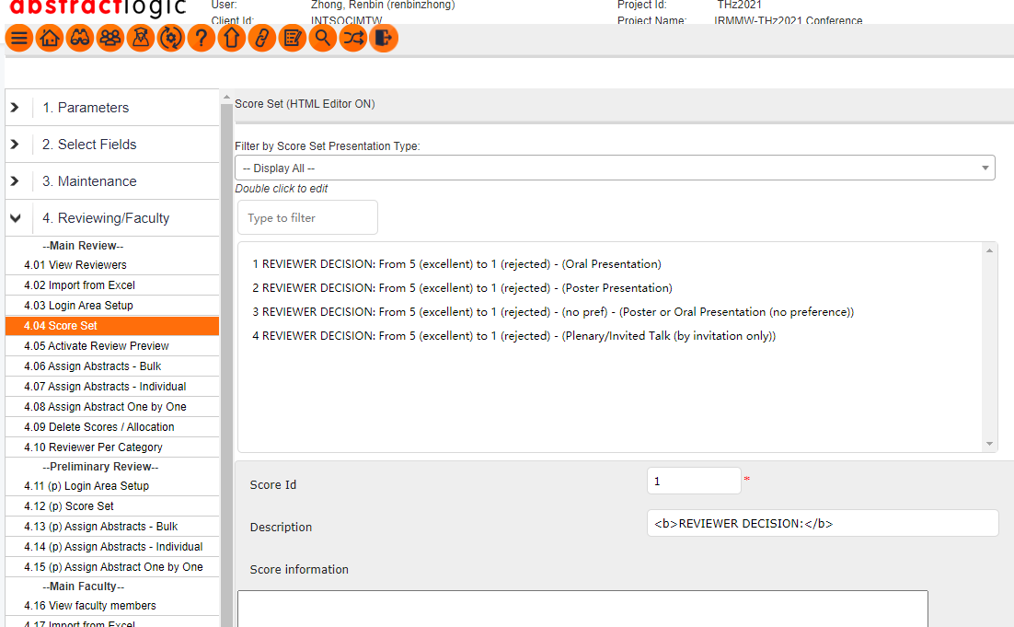
4. Set review scoring standards

Slide 15
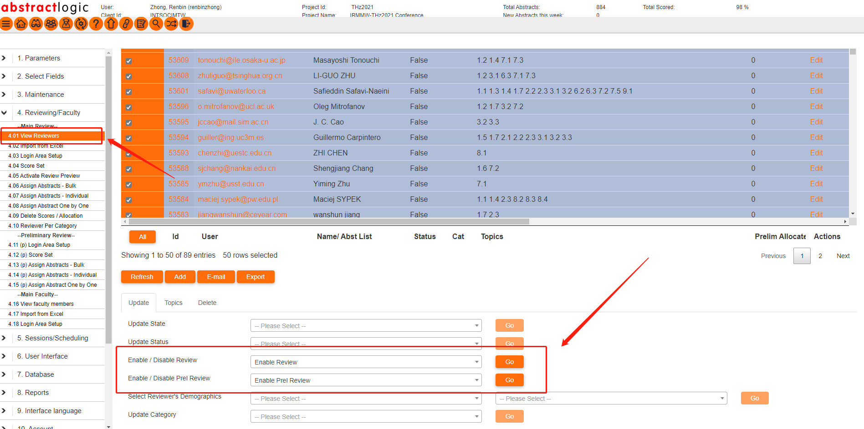
5. Before notifying the reviewers to start the audit, you MUST set all reviewers to enable review!

Slide 16
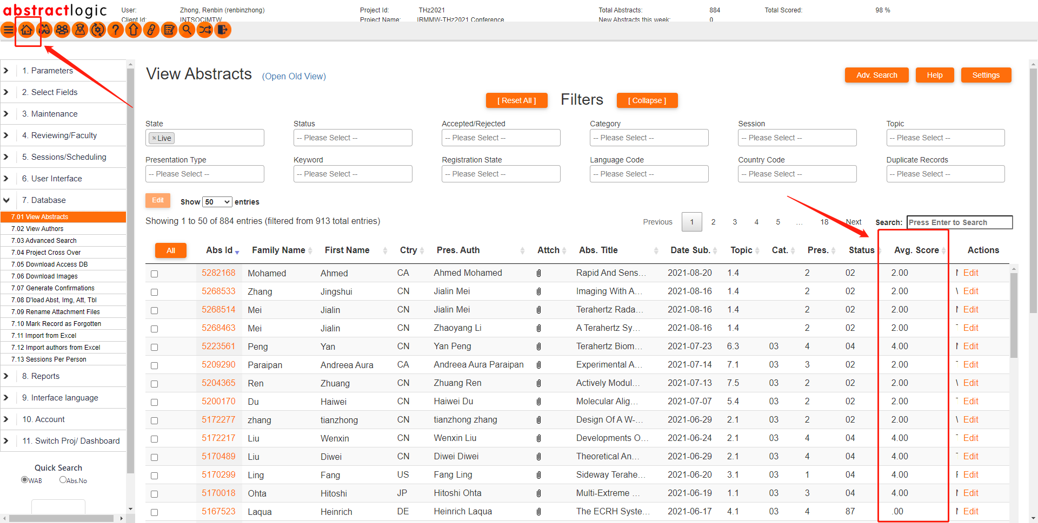
FIFTH
Select the presentation type
View the score, according to the scoring criteria, select the presentation type.

Slide 17
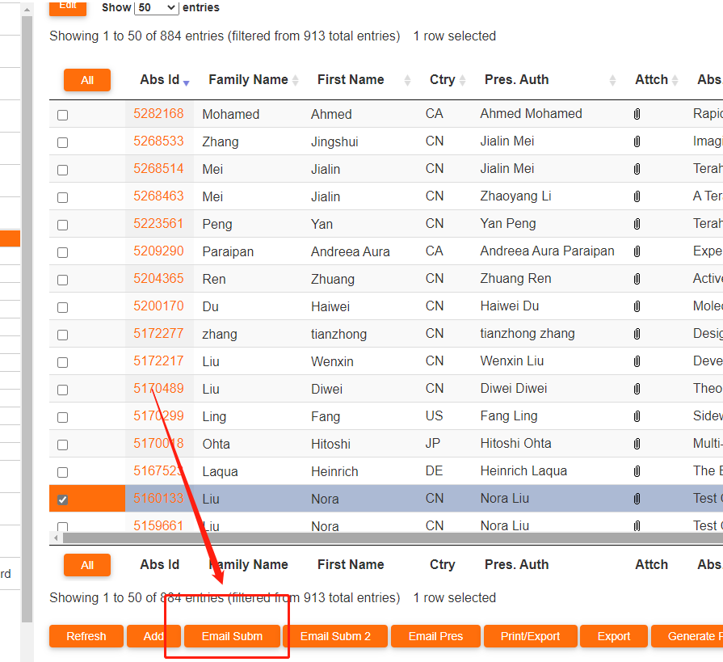
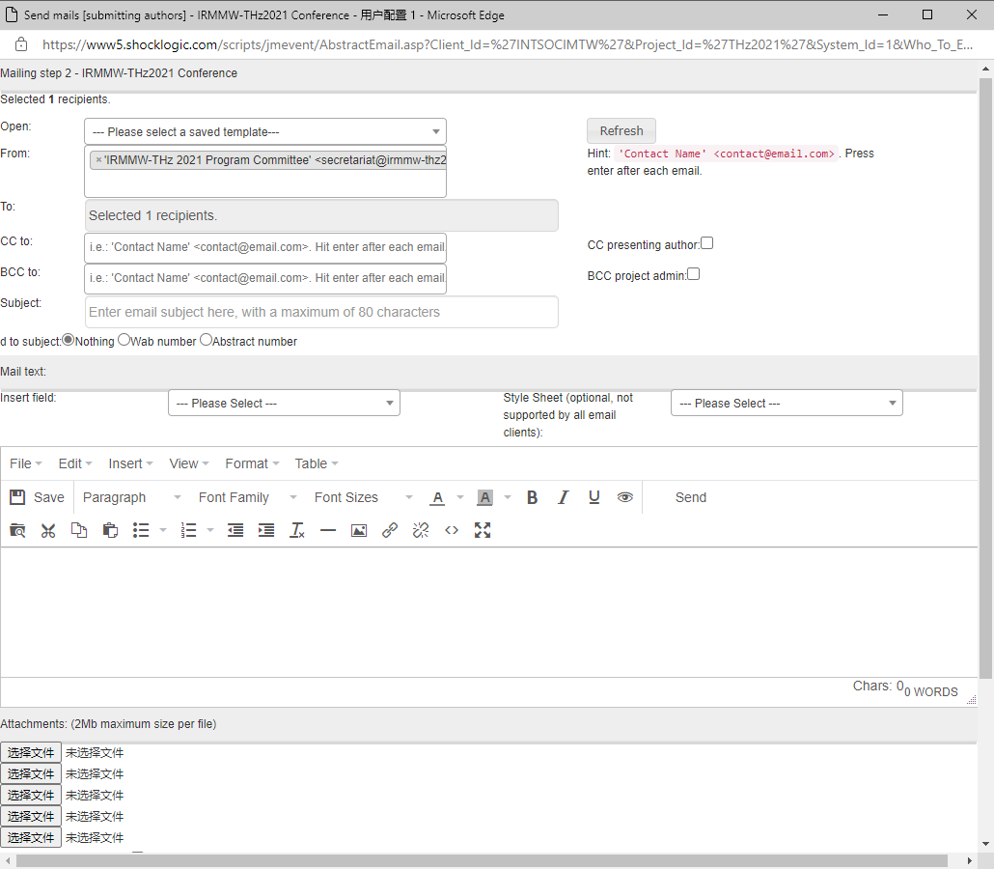
SIXTH
Send the accepted emails to participants

Slide 18
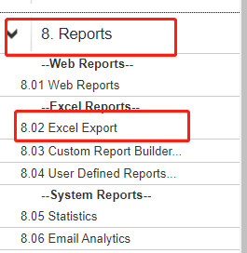
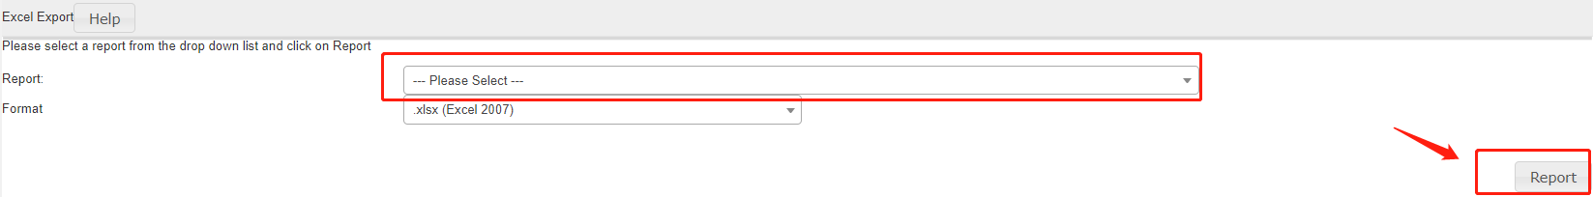
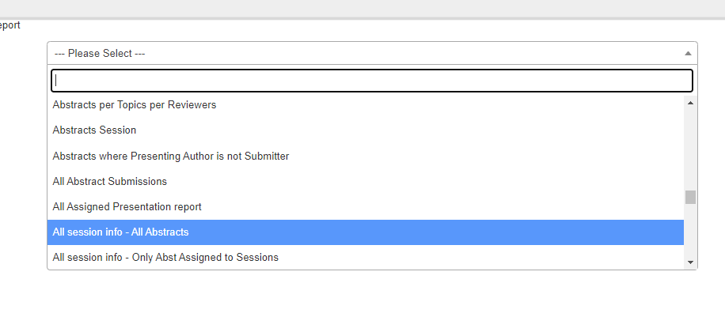
How to export data from the Shocklogic submission system?
1. 8.Reports → 8.02 Excel Export
2. Choose a preset export template, And then click Export

Slide 19
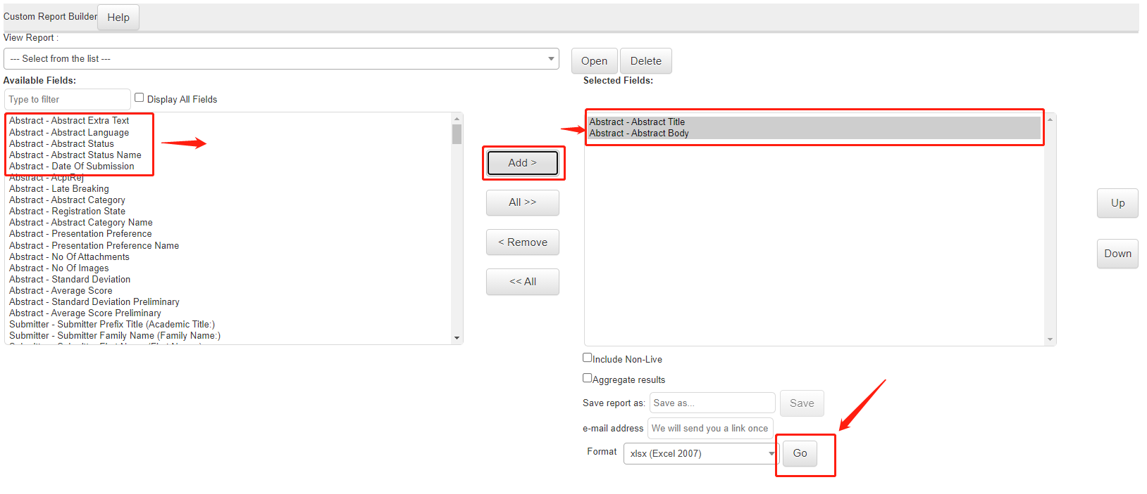
3. You can also customize the export data
Click 8.03 Custom Report Builder, move the data you want to export to "Selected Fields:", and then select the export format.
4. Finally, you can use the exported data to make a data chart to show everyone.

