Slide 1
Proposal for 48th IRMMW-THz
MONTRÉAL
September 10-15, 2023
© Moment Factory

Slide 2
Why Montréal?

Slide 3
The City at a Glance
Affordable city with vibrant atmosphere
Canada’s university capital
Canada’s R&D capital
Within 2-hour flight or drive from 90 million people
2nd largest city of Canada (Population of 4.2 million)

Slide 4
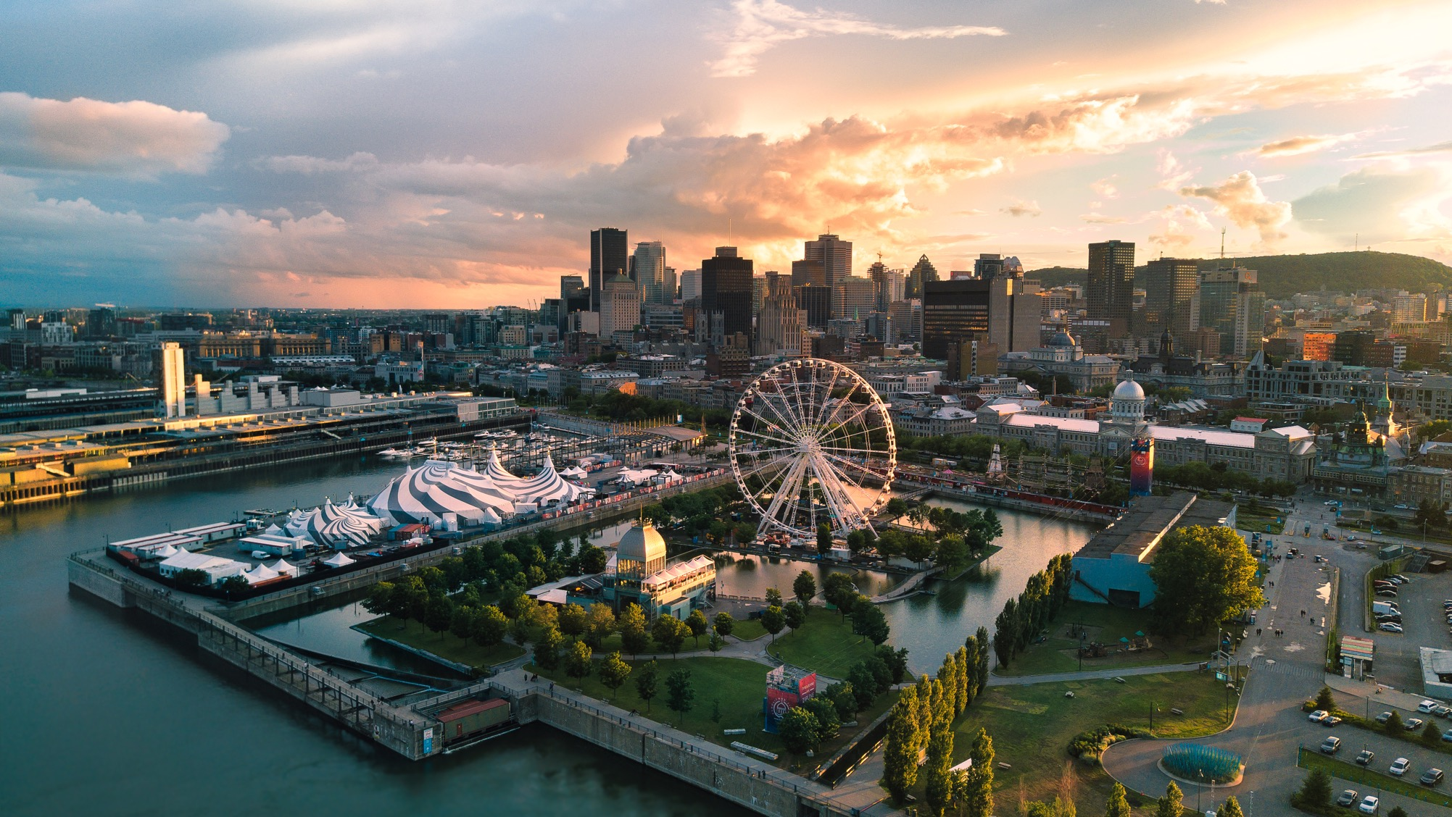
A city that has it all
© Loïc Romer

Slide 5
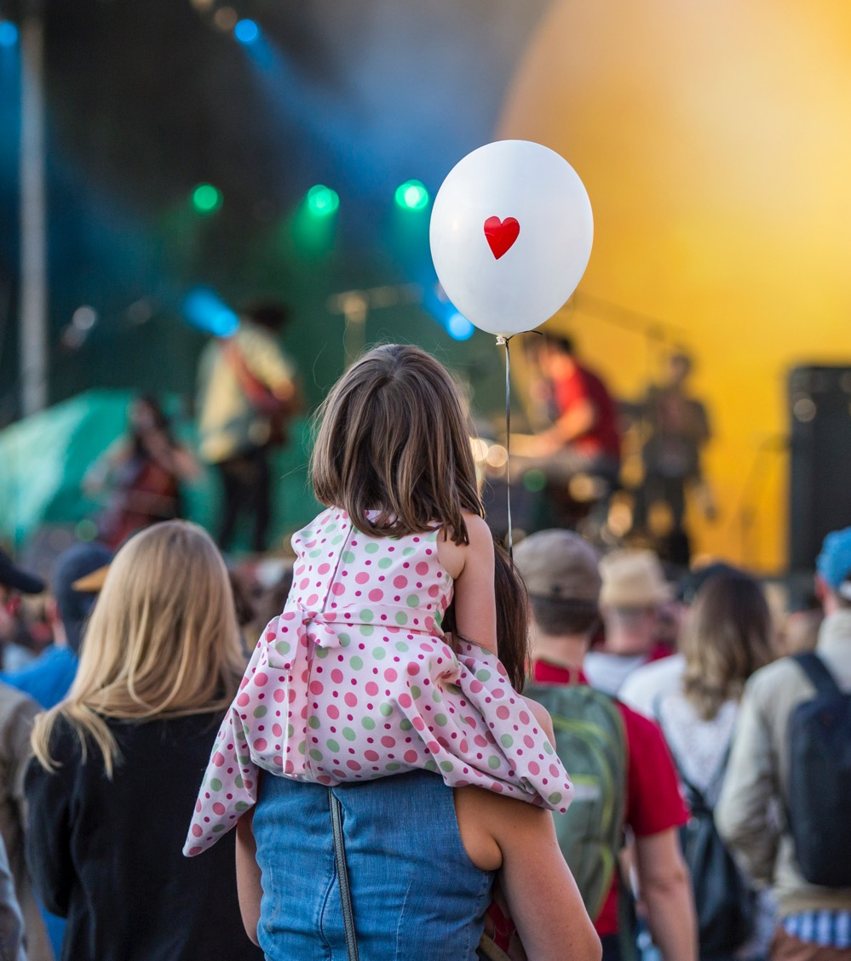
Easy to love
    World-class events
    (over 100 festivals year round)
    A thriving culinary and cultural scene
    Renowned joie de vivre and hospitality
© Eva Blue

Slide 6
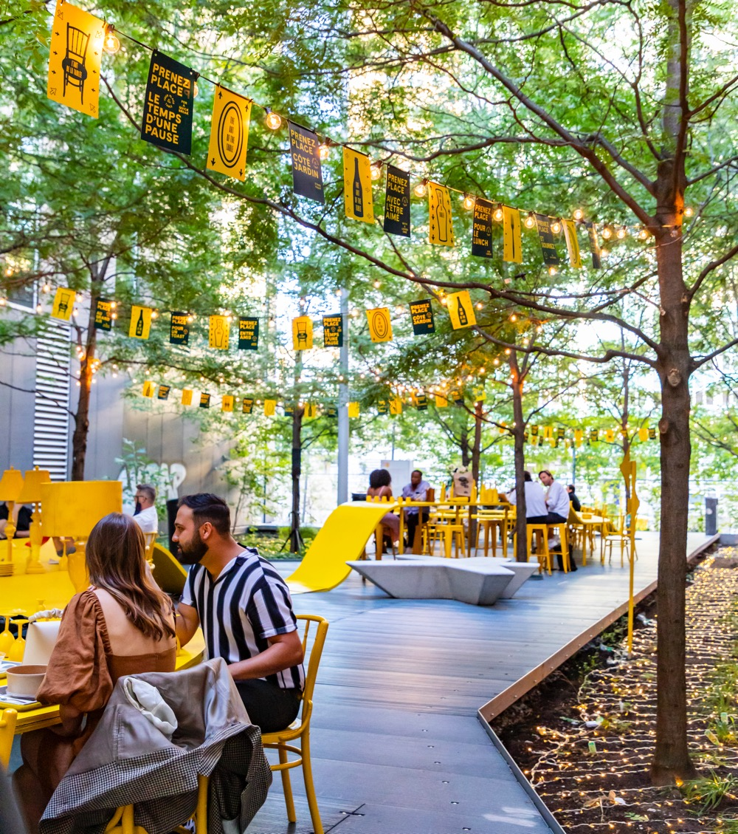
Destination
    1st IRMMW-THz in Canada
    Fantastic time of the year to visit Montréal. Amazing weather, food, music, entertainment
    #1 city in North America for hosting international events (ICCA 2016-2019)
    You don’t need to speak French
    Safest city among 20 major cities in Canada & the US (Montréal International.com 2018)
    Politically stable with visa letters provided upon request.
© Moment Factory
Notes:
ICCA – International Congress and Convention Association

Slide 7
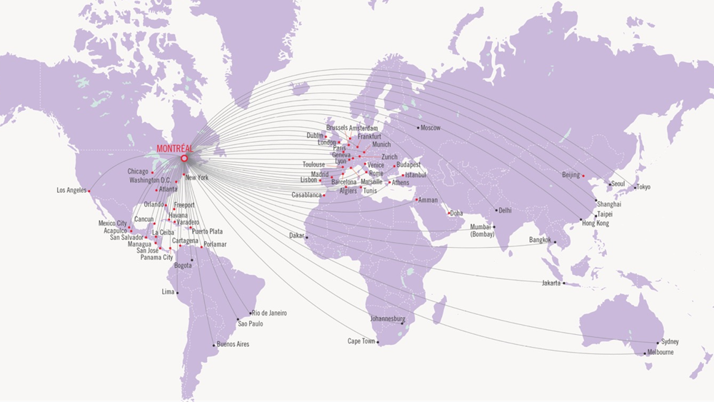
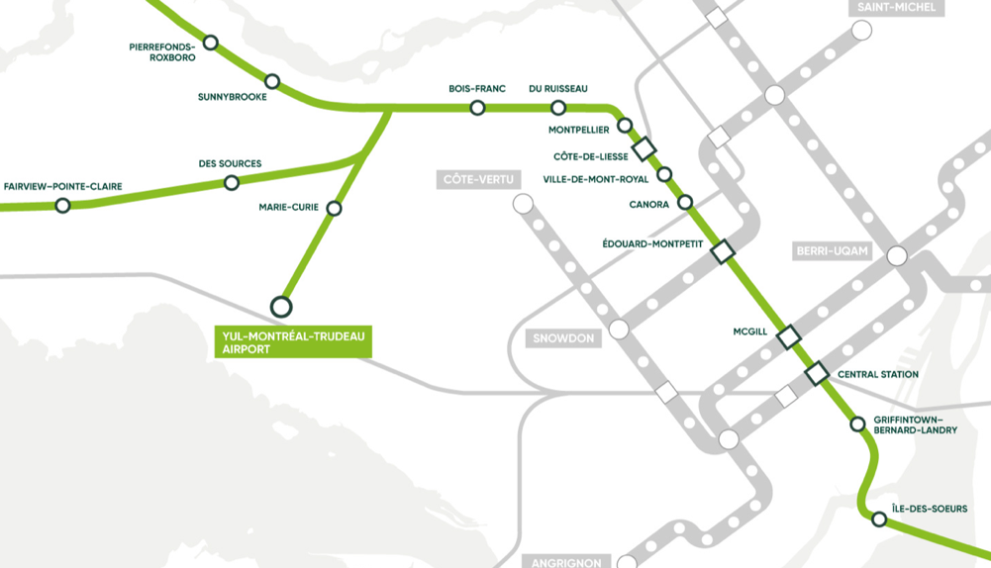
Easily accessible
Montreal Pierre Trudeau offers direct flights to most major destinations.
New light rail transit system open in 2023. Airport to downtown in 25 min.
Taxi and limo service (18-30 min) ($40)
747 airport bus (24/7) (40 min + 5 min walk) ($10)
Uber (18-30 min) ($20-30)
Rental car (20 min)
Hotel shuttle bus (40 min)

Slide 8
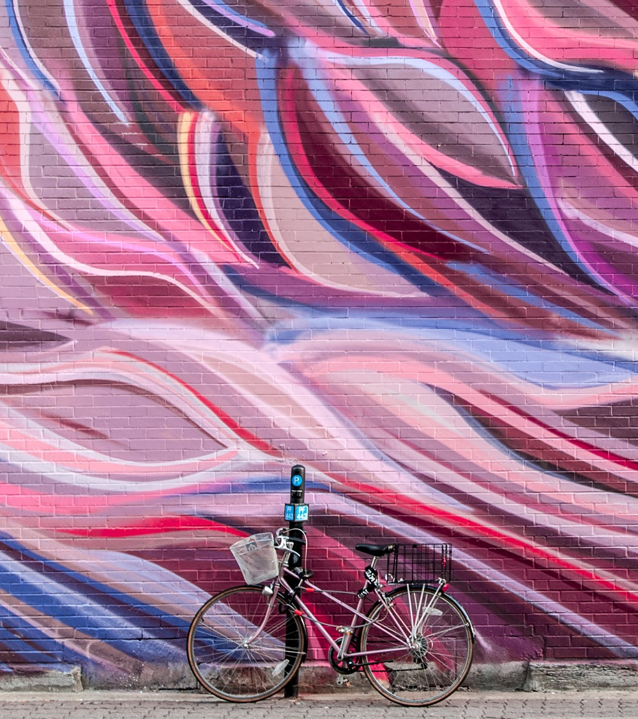
Easy to get around
    Compact, walkable and SAFE
    Award-winning public transportation + BIXI
    600 km of bike paths
    32 km of underground network
© Cité mémoire - Eva Blue

Slide 9
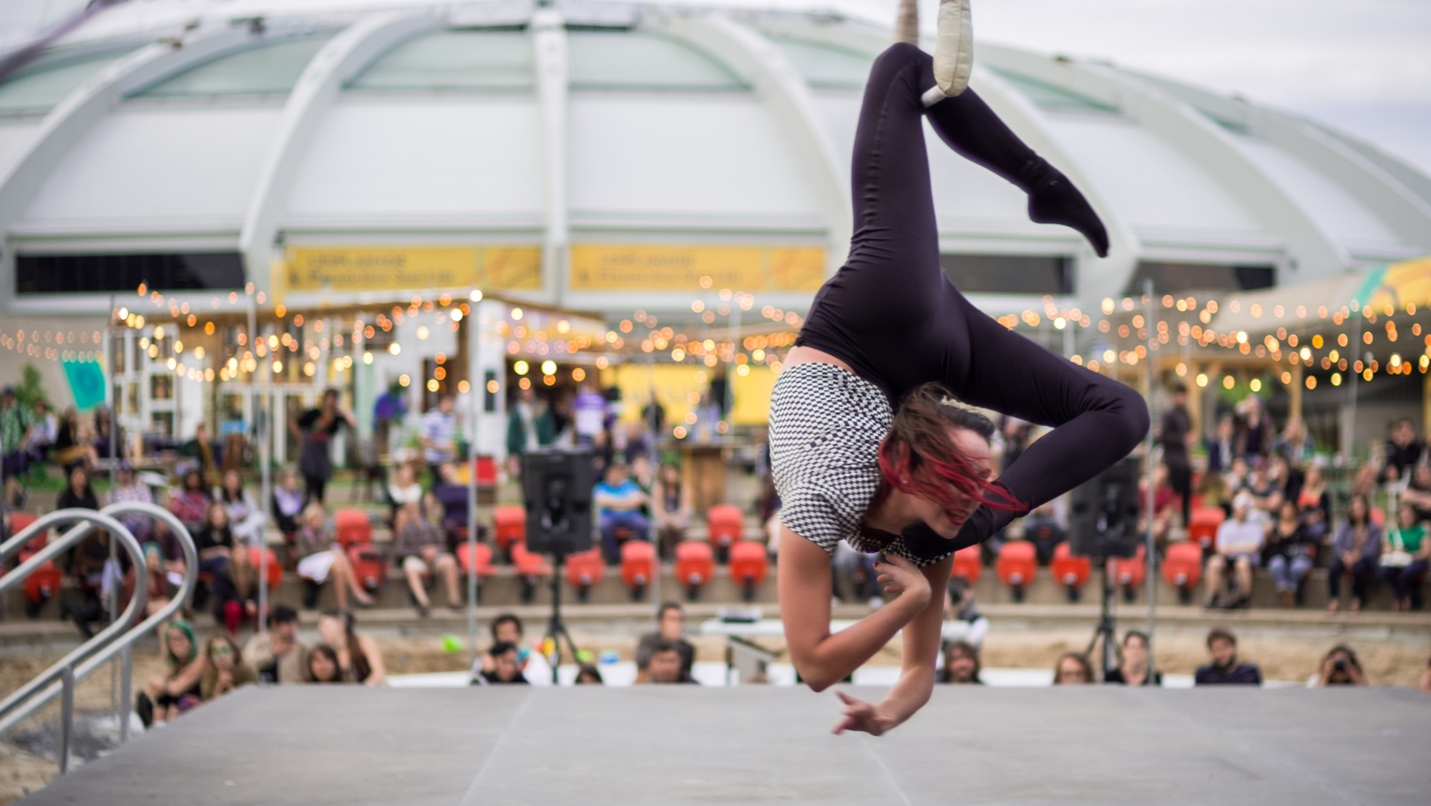
Local Hosts
© Andrew Miller

Slide 10
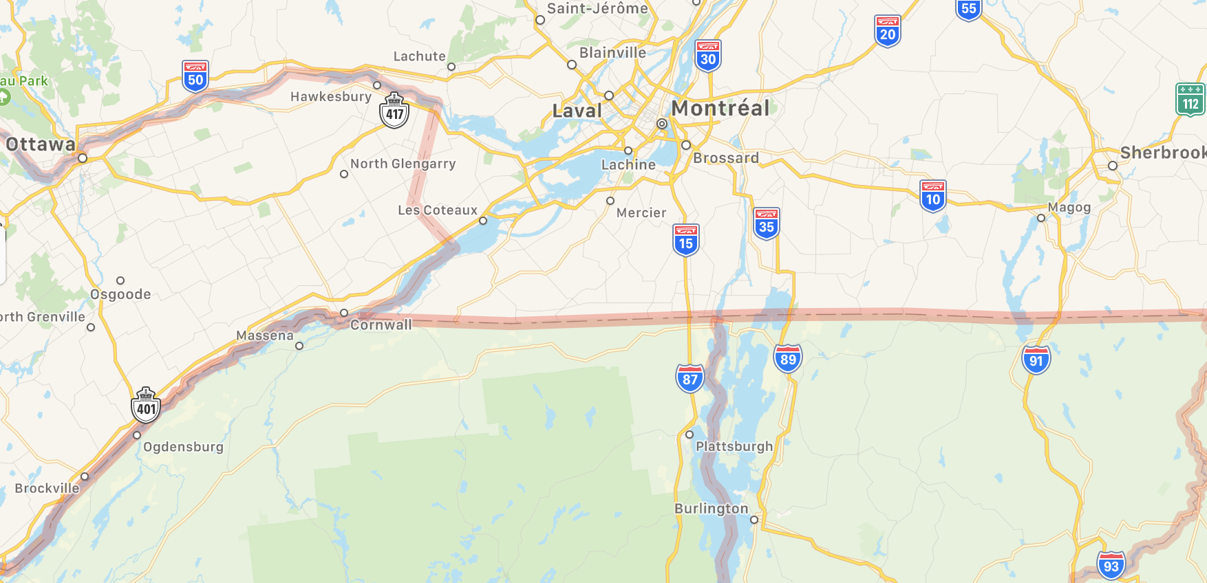

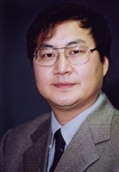
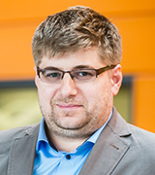
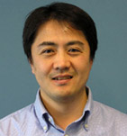
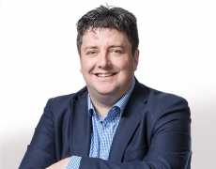
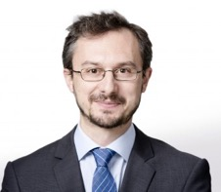

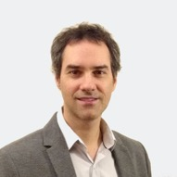
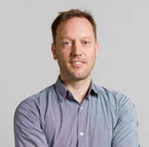
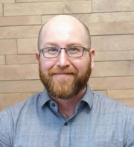
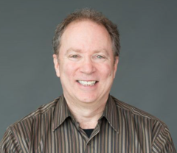




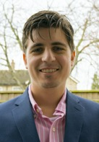

Local organizing committee
100 km
© Moment Factory

Slide 11
Local organizing committee
    10 local THz research groups
    Research spans fundamental/applied science + device engineering
    > 50 volunteers (graduate students + postdocs)
    Experienced conference organizers on the LOC
    Logistical support by Tourisme Montréal
    Professional Conference Organizer
David Cooke
McGill University
Ke Wu
Ecole Polytechnique
Denis Seletskiy
Ecole Polytechnique
François Blanchard
ETS
Tsuneyuki Ozaki
INRS
Luca Razzari
INRS
François Légaré
INRS
Denis Morris
University of Sherbrooke
Jean-Michel Ménard
University of Ottawa
Michael Ruggiero
University of Vermont

Slide 12
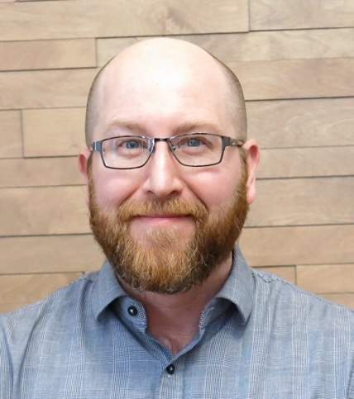
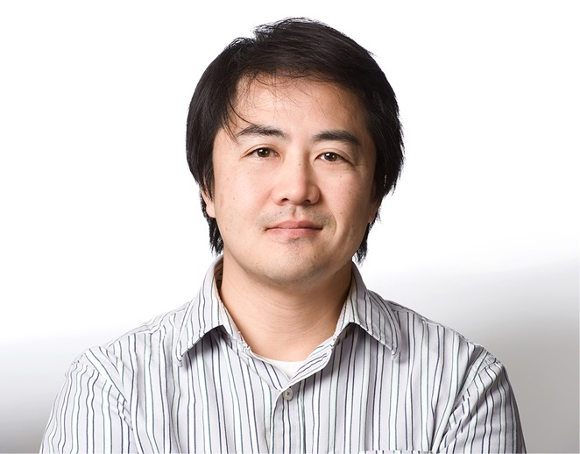
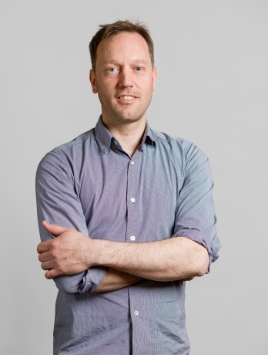
Conference chair:
David Cooke, McGill University
    Tenured associate professor at McGill University
    Director of the Centre for the Physics of Materials
    Associate editor for Optics Express from 2016 – 2019
    Conference organization
      2015, 2016 CLEO S&I 5 (chair) THz Science and Technologies
      2011 Optical Sensors (co-chair w/Peter Jepsen) OSA Advanced Photonics Congress
Technical program co-chairs
Tsuneyuki Ozaki
Professor, INRS
Former director Advanced laser light source
François Blanchard
Associate prof. ÉTS
CRC T2 THz Technology

Slide 13
Technical program
Material science
THz Multi-Physics
Sources and Detectors
Applications and Devices
Condensed matter spectroscopy
Metamaterials and plasmonics
Near-field techniques and microscopy
Free electron lasers and synchrotron radiation
High field and Nonlinear THz Interactions
THz interactions with gaseous media
THz plasma interactions
Electronic sources
Laser driven sources
Gyro-oscillators and amplifiers
Nanoscale and quantum devices
Imaging and remote sensing
Metrology and radar
Biology and medical diagnostics
Astronomy and atmospheric measurement
Quantum optics

Slide 14
McGill University
Host Institution
    Public university, founded in 1821
    One of Canada's best-known institutions of higher learning and one of the leading universities in the world
    Recognized for the excellence of its teaching and research programs

Slide 15
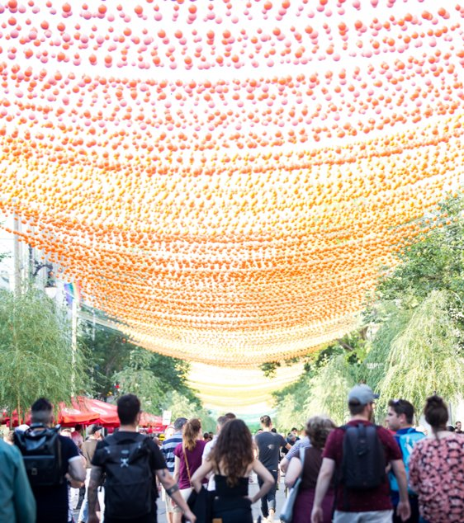
Global Recognition
Strongest economic growth in Canada
Most reputable city in the Americas
Most affordable city in Canada and the U.S.
Second-best city in the world for millenials
Safest city in Canada and the U.S.
Best student city in the Americas and 4th in the world

Slide 16
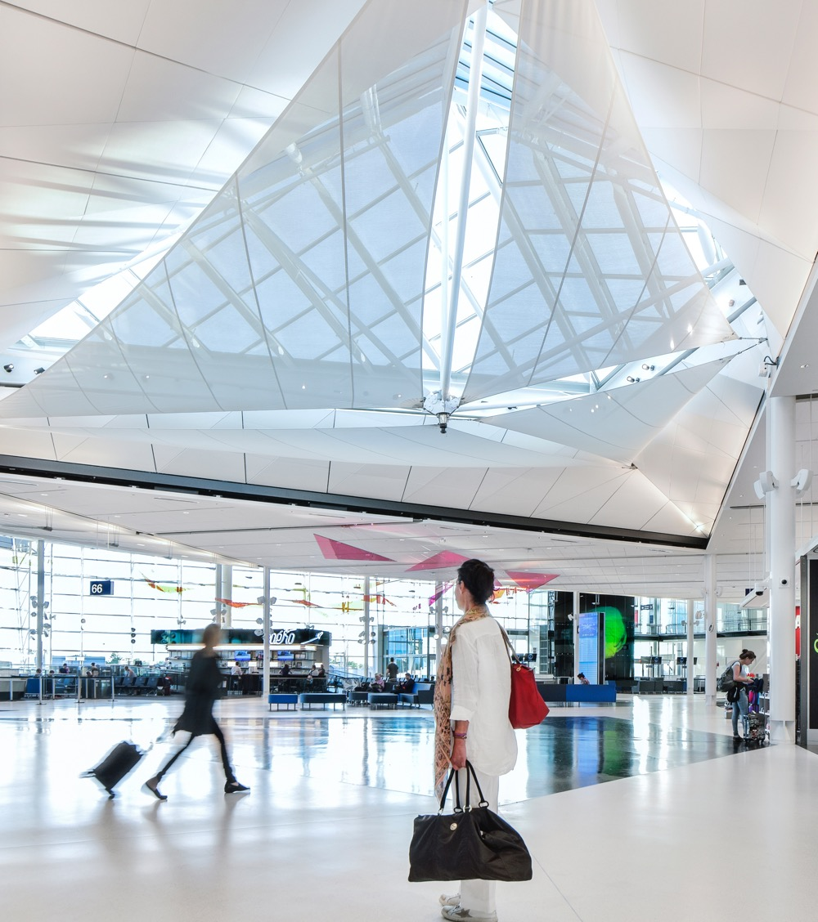
Easy to get to from anywhere
    90 million people live within a 2-hour flight or drive
    160 direct global destinations
    Montréal-Trudeau Airport located 20 minutes from downtown
    20.3 million passengers in 2019
© ADM-EN
Notes:
Direct flights – 100 international, 29 US and 31 Canadian

Slide 17
Venue Options
Hôtel Bonaventure
Le Centre Sheraton

Slide 18
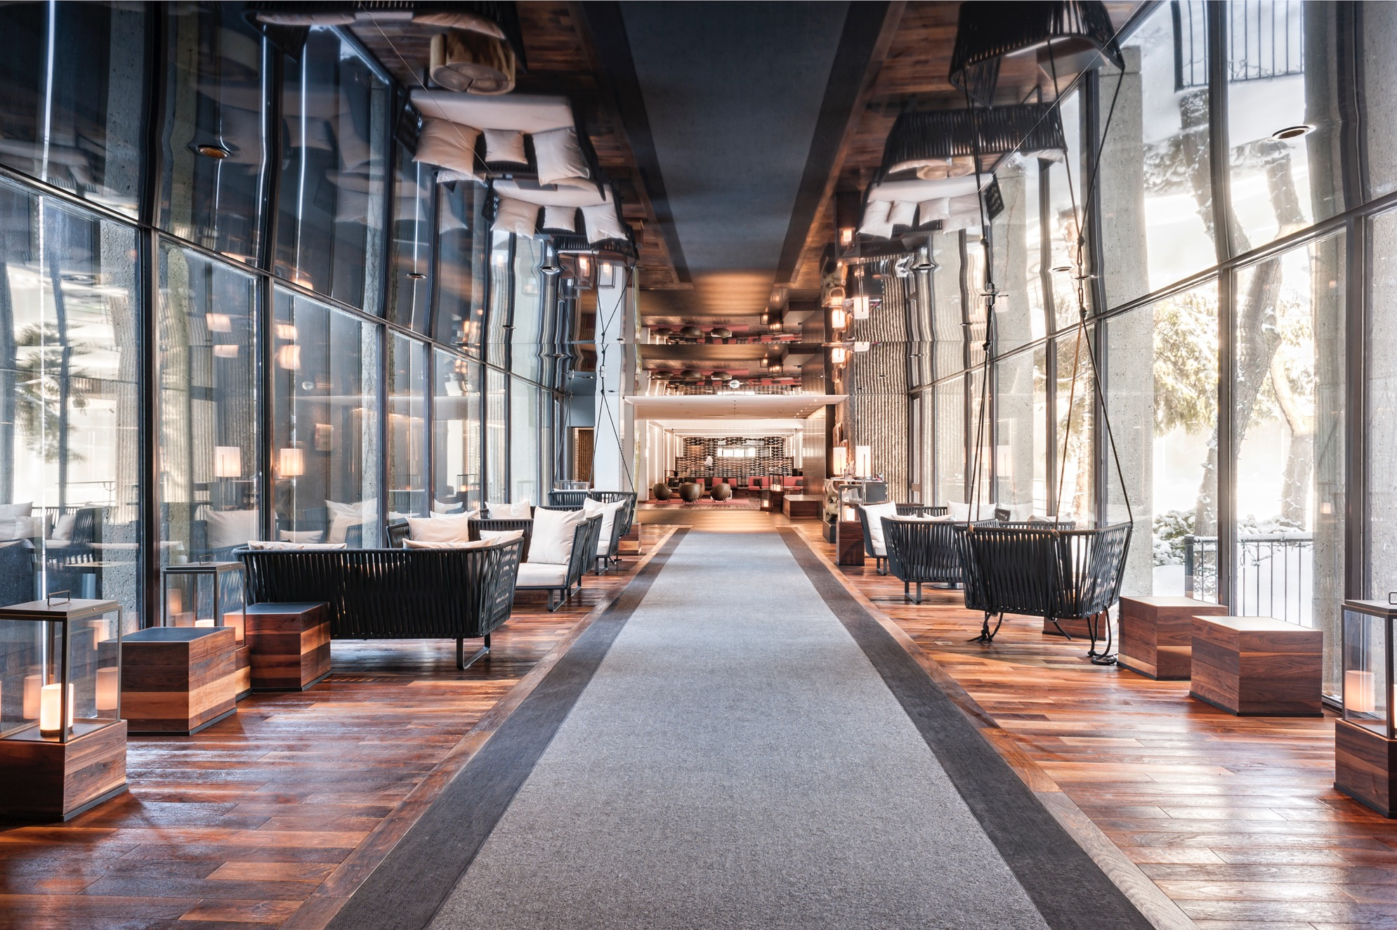
Hôtel Bonaventure

Slide 19
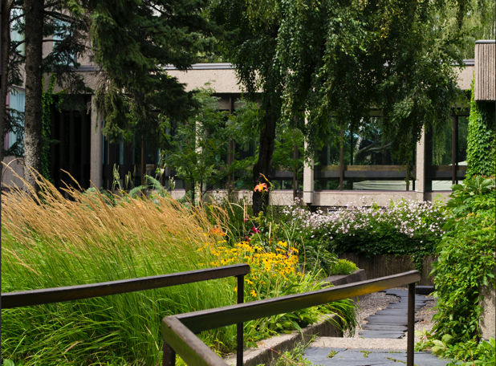
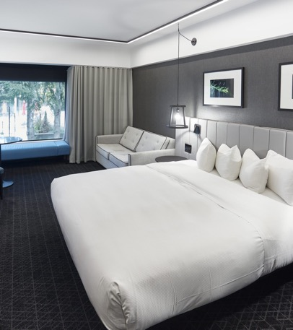
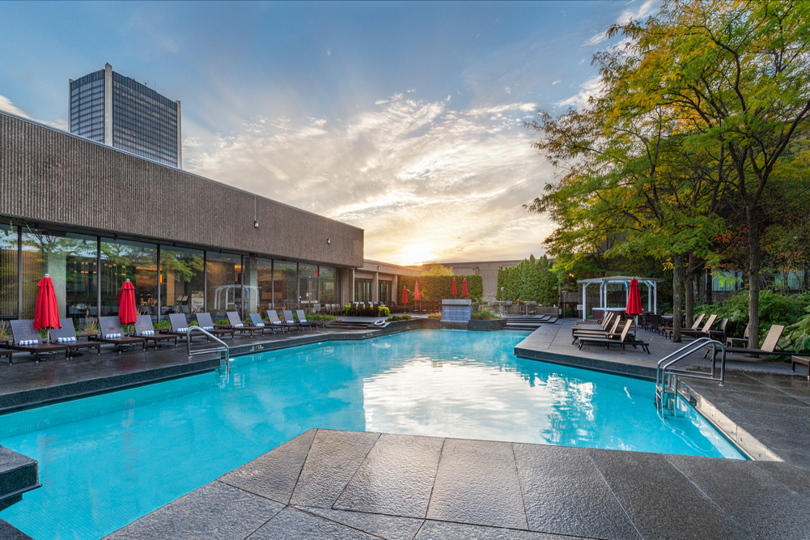
Hôtel Bonaventure
AVAILABLE DATES: SEPT. 10-15 OR 24-29
Urban oasis on the rooftop of a downtown building (2.5 acres of outdoor gardens)
Connected to train station, métro and pedestrian networks
395 spacious guestrooms
Guaranteed rate of Can$259 for 2023 (today = US$197)
Complimentary high-speed internet access + access to the health club and pool
Dining options on-site and within walking distance from a large number of restaurants

Slide 20
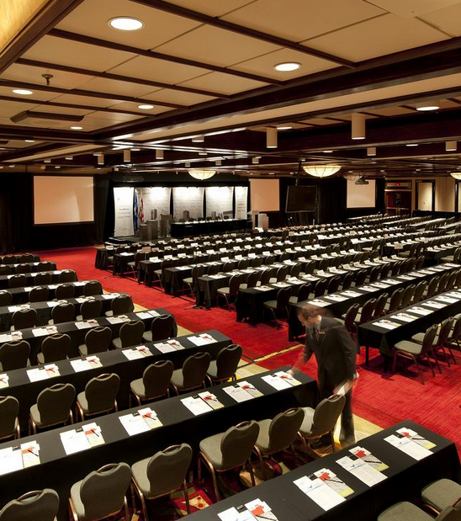
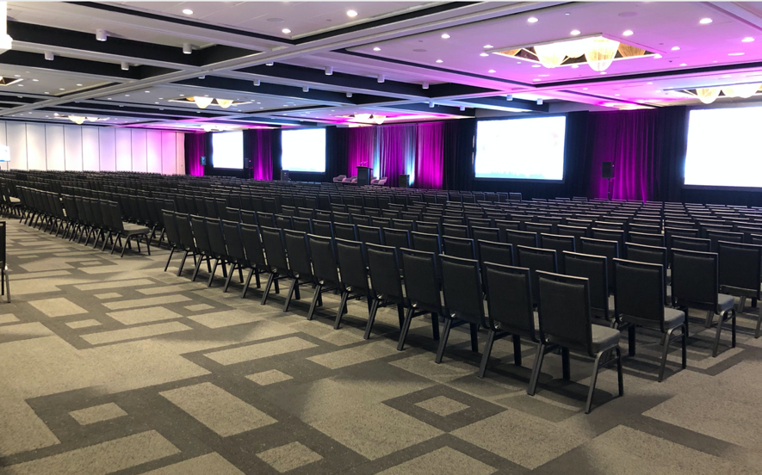
Meeting Space
Up to 35 meeting rooms on one floor
50,000 sq. ft. (4650 m²) meeting space
Exclusive use of entire meeting space
Built-in registration area
Outdoor gardens and terraces that can be used for social functions
Example of the ballroom in classroom seating
Example of the ballroom in theatre seating

Slide 21
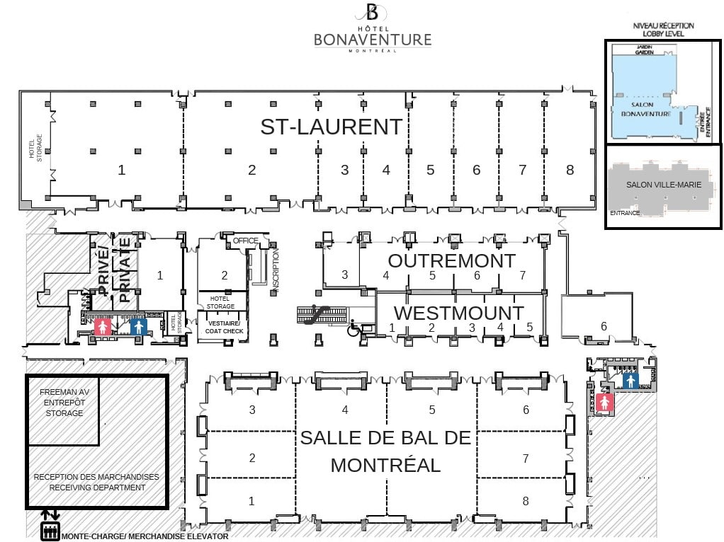
50-60 posters
23 booths
Seating capacity
Montréal 1-3, 6-8, 4 & 5: 312 theatre (each) = 1248 total
St-Laurent 1: 60 poster boards
St-Laurent 2: 23 exhibit booths
jagshemash

Slide 22
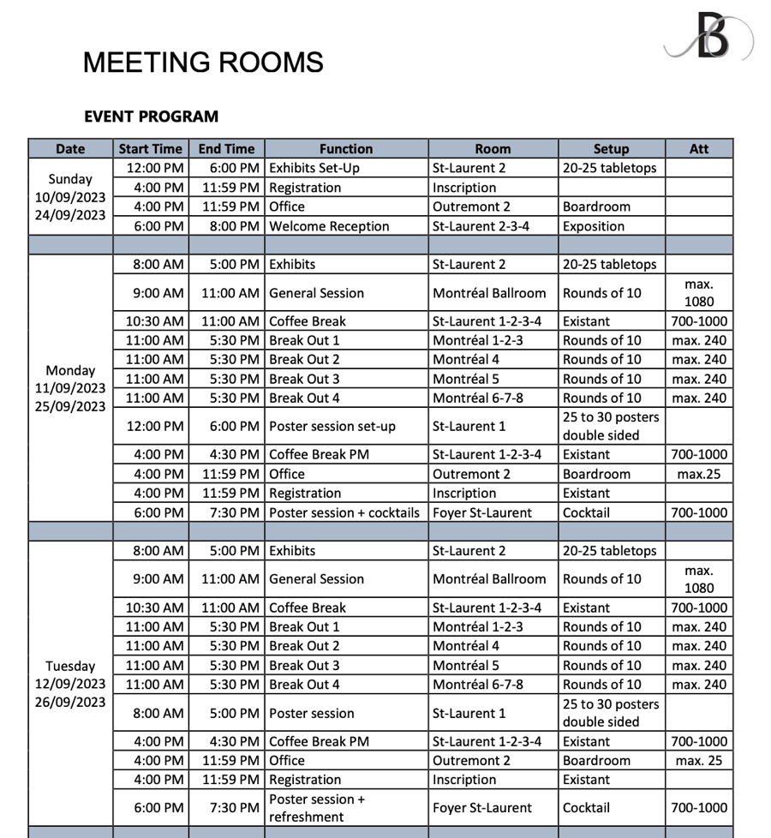
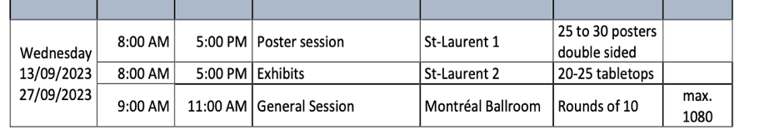
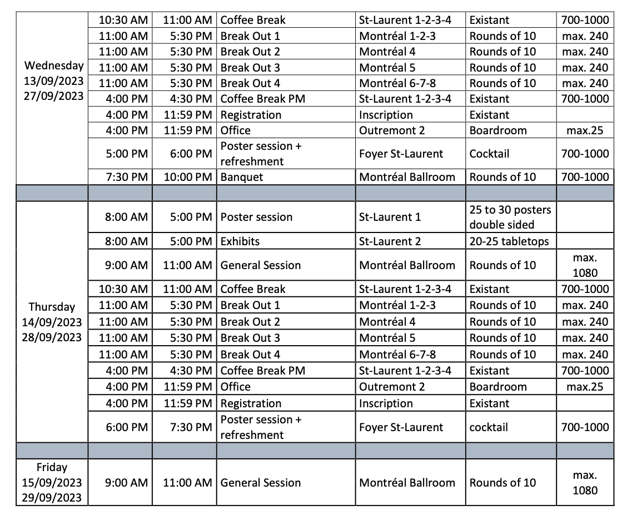

Slide 23
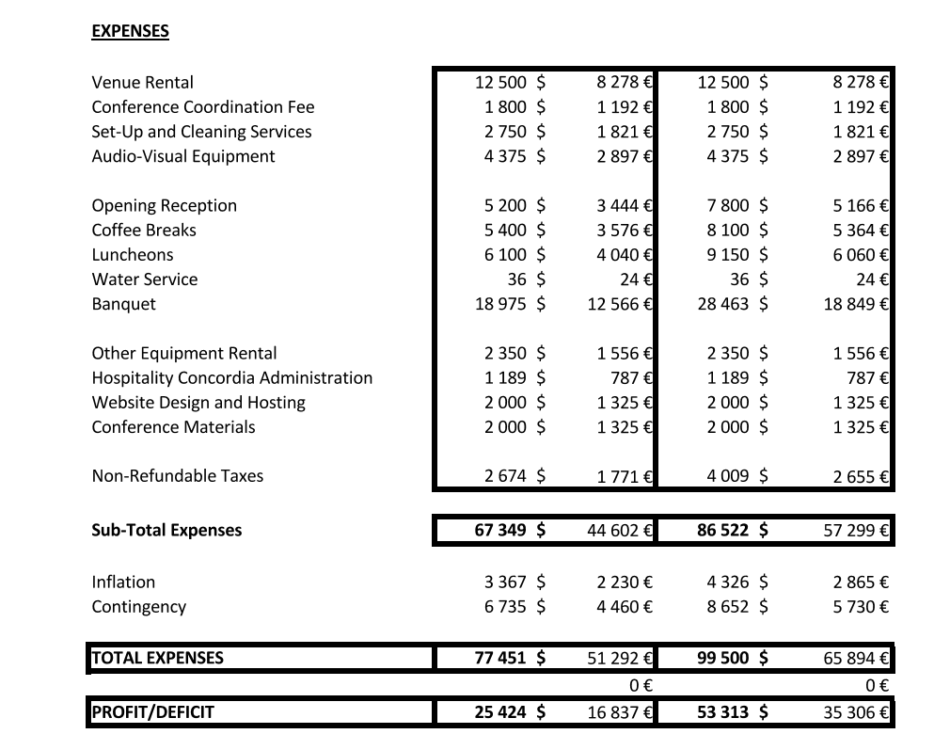
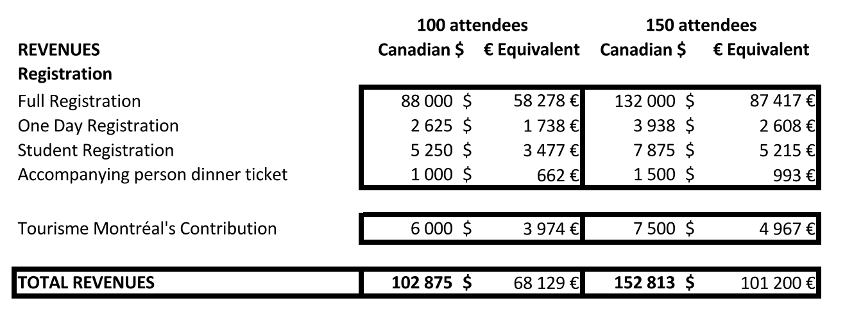
Preliminary Budget: Revenues
 | USD | Incl. tax
Average registration fee | $760 | $875
Average student registration fee | $400 | $460

Slide 24
Preliminary Budget: Expenses

Slide 25
Accommodations

Slide 26
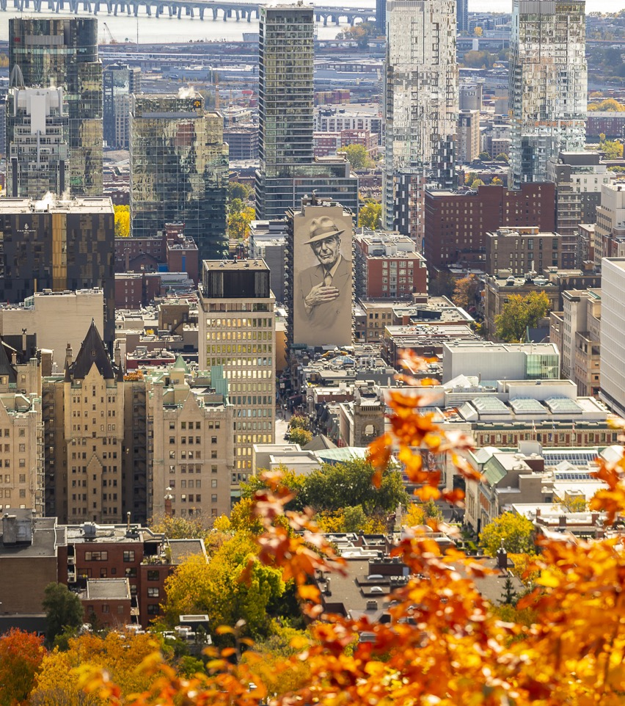
Accommodations
    Both hotels offering affordable guest room rates
    Ample additional options available outside the main hotels:
    15,000 rooms in the downtown core
    All categories, for all budgets
© Cité mémoire - Eva Blue

Slide 27
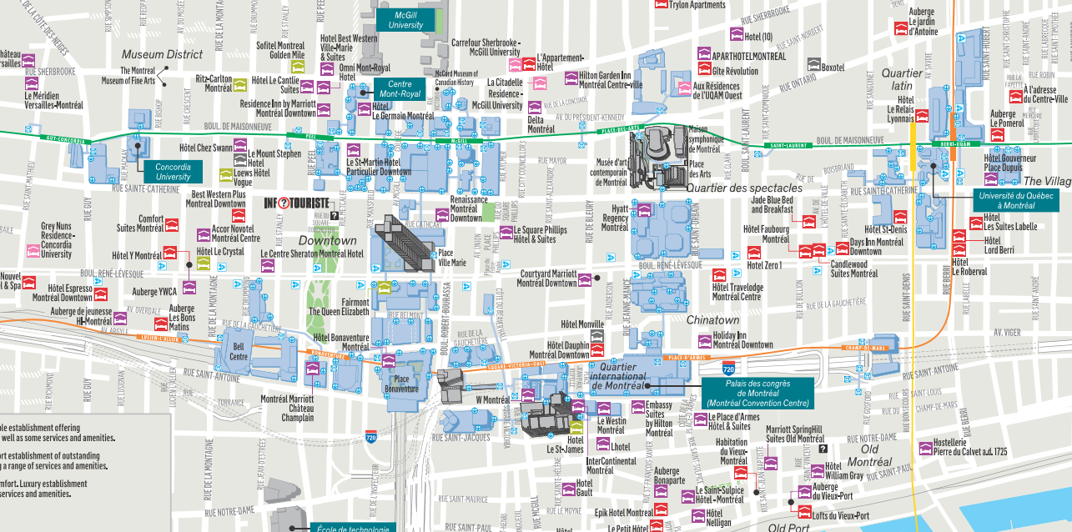
Accommodation Map
500 m

Slide 28
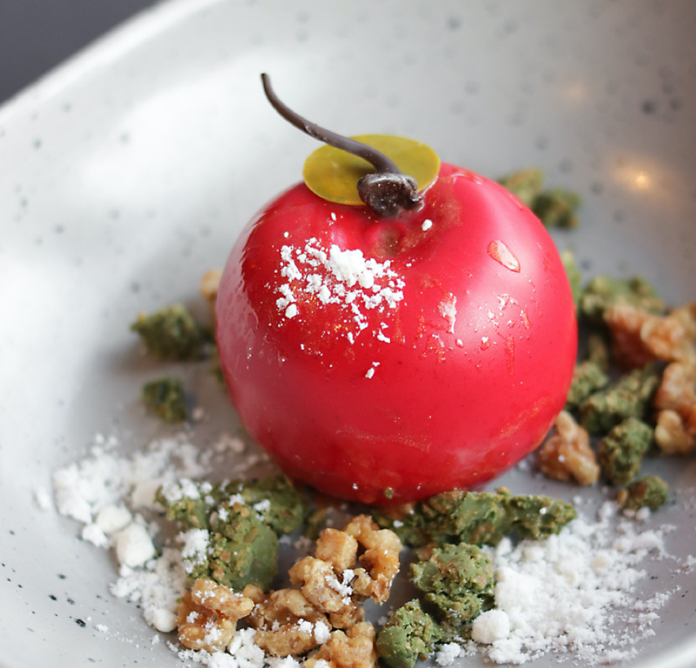
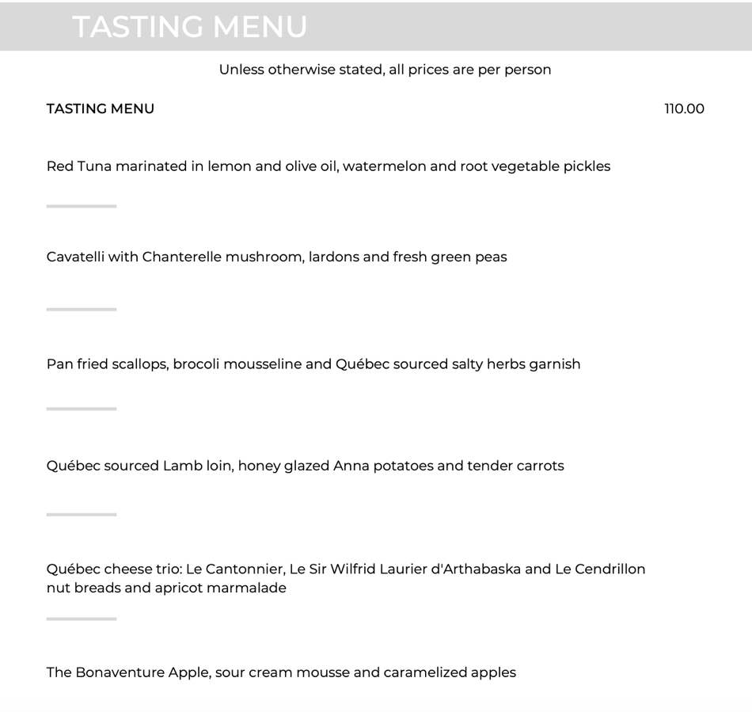
Banquet

Slide 29
Excursions & Activities

Slide 30
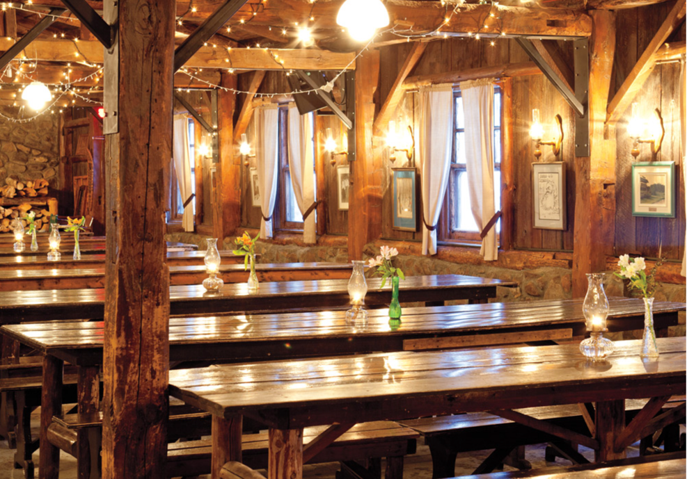
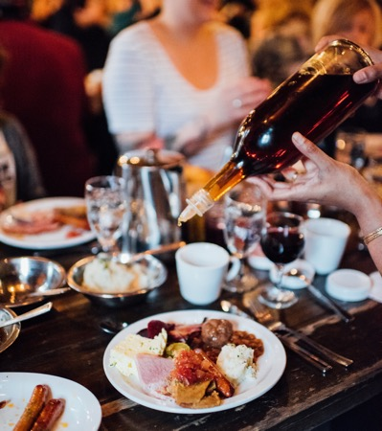
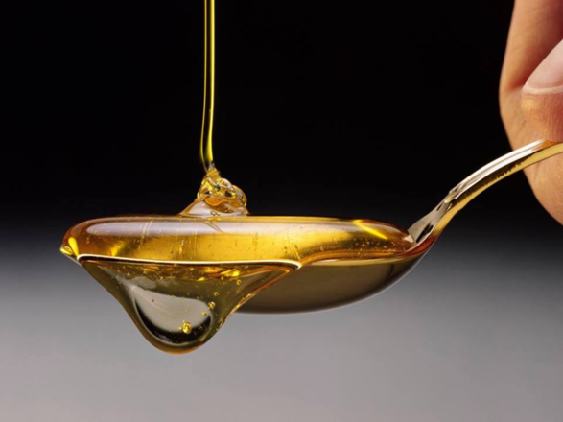
Suggested Day Excursions
    Sugar Shack experience at Sucrerie de la Montagne
    Hiking at Gault Nature Reserve of McGill University
    Scenic cruise on the St. Lawrence River to Québec City
    Day trips to Mont-Tremblant (resort in the Laurentians mountains)
    Tour of vineyards or microbreweries in the Eastern Townships
© Moment Factory

Slide 31
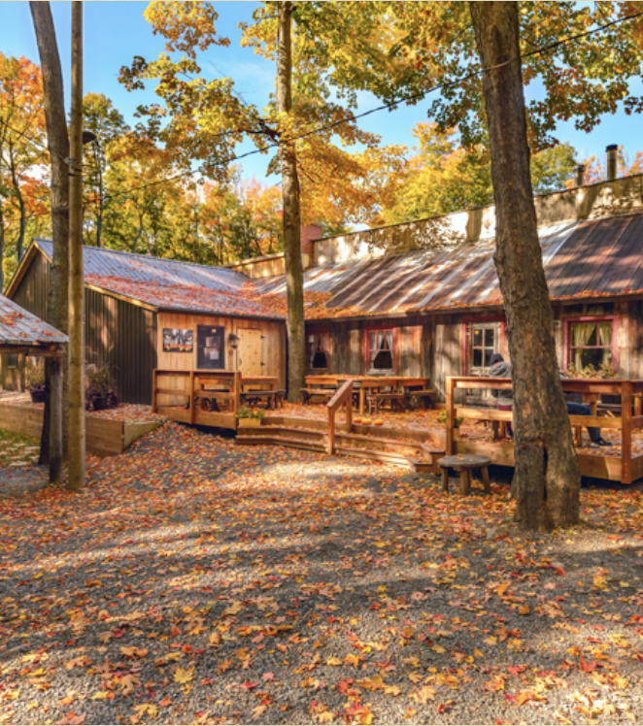
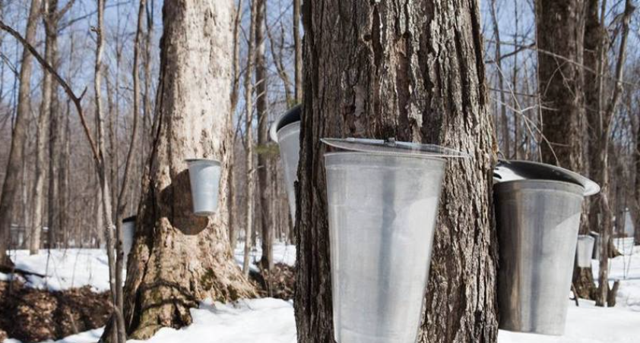
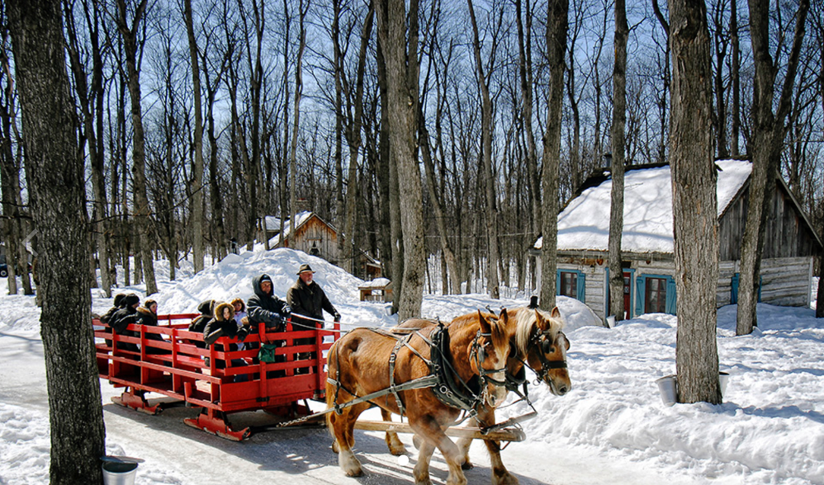

Slide 32
Merci

Slide 33
Extra slides

Slide 34
Budget calculations
70% regular attendees, 30% student attendees
PCO: 50 days x 8 hours x $60/day = $24k (Jacqueline Sanchez)

Slide 35
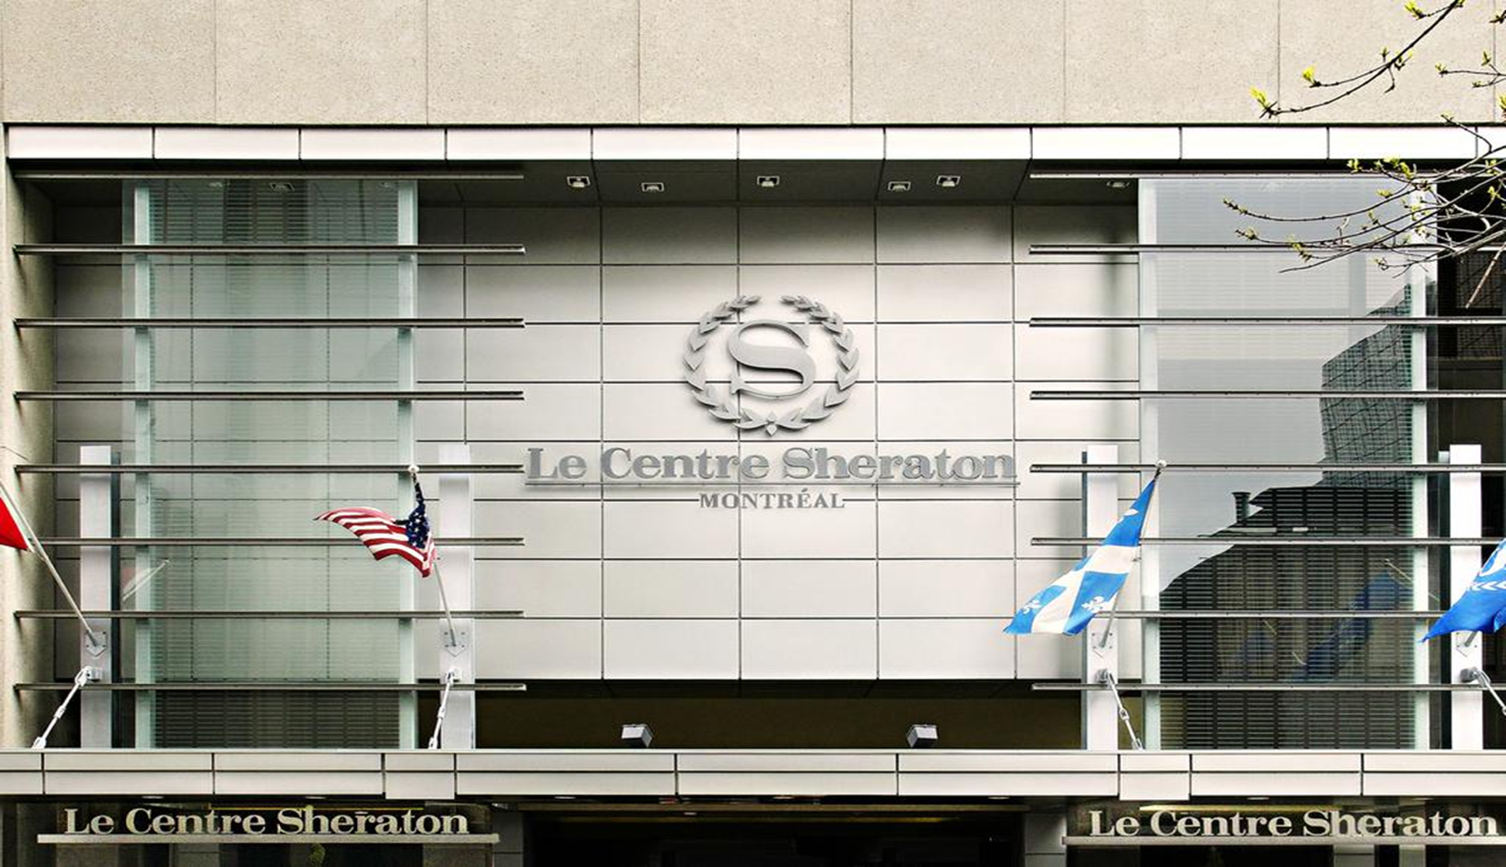
Le Centre Sheraton

Slide 36
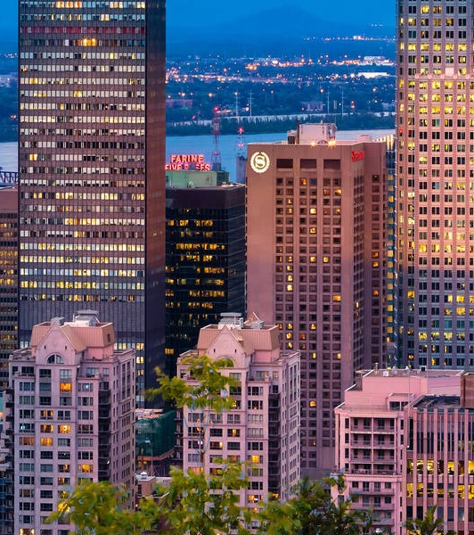
Le Centre Sheraton
Downtown location
825 spacious guestrooms
Guaranteed rate of Can$239 for 2023 (today = US$182)
Complimentary high-speed internet access in the rooms
Complimentary access to the health club and pool
Dining options on-site and within walking distance from a large number of restaurants

Slide 37
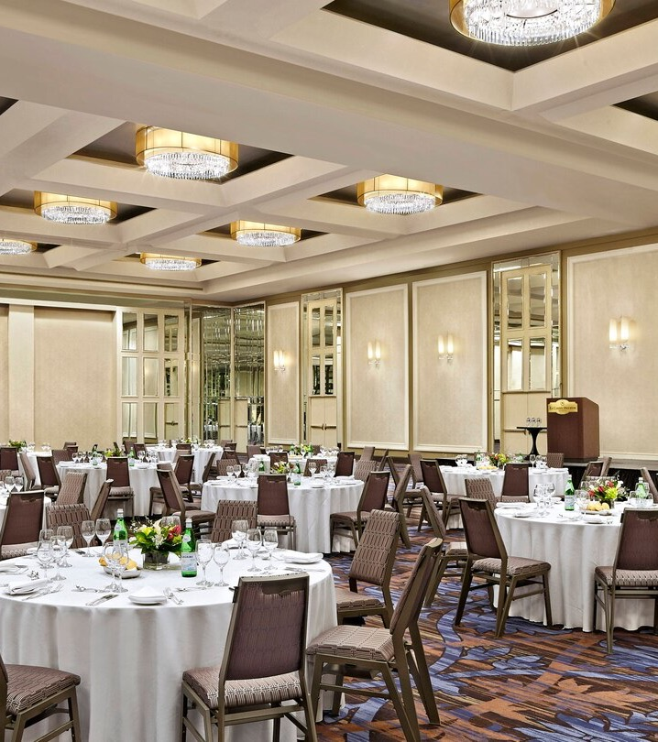
Meeting Space
35 meeting rooms
41,423 square feet of meeting space
Ballroom of over 8,000 square feet allowing ample space for side-by-side 1000 person plenary and poster session
18 foot high ceilings
5,000 square feet of foyer space for registration and coffee breaks
4 breakout rooms of 100 persons each
Excellent flow between the meeting rooms (breakouts directly below plenary room)

Slide 38
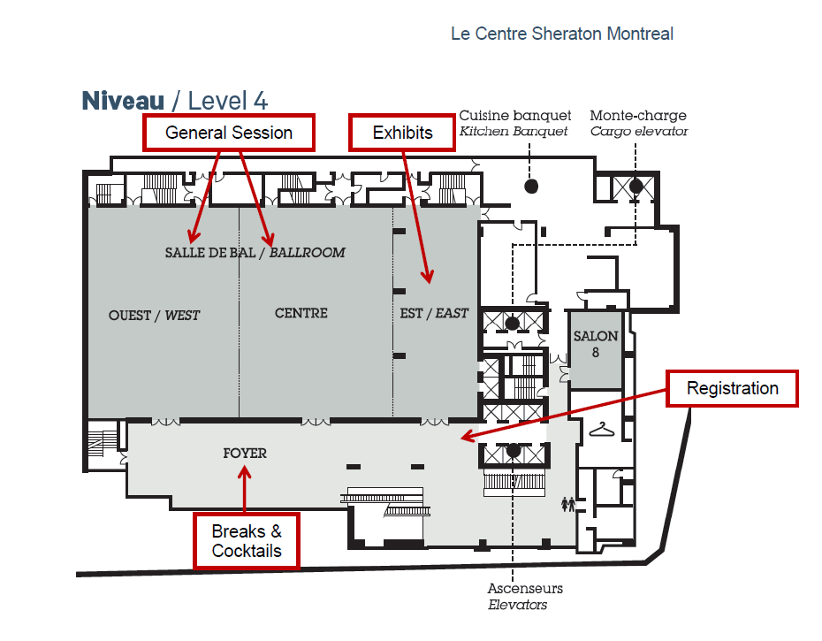
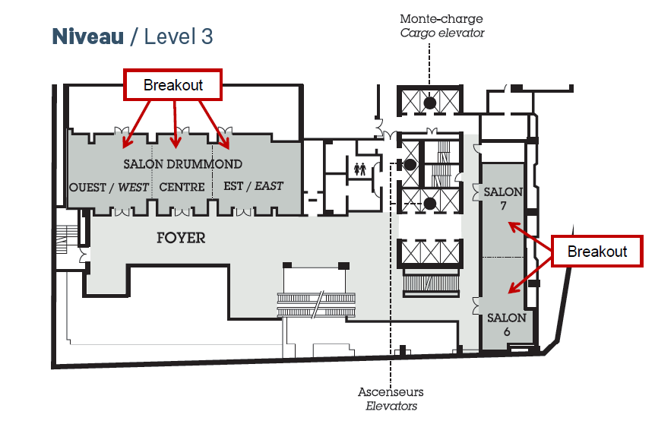
Taxi and limo service (18-30 min)
747 airport bus (24/7) (40 min + 5 min walk)
Uber (18-30 min)
Rental car (20 min)
Hotel shuttle bus (40 min)

Slide 39


Preliminary Budget

Slide 40

Suggested Activities
    Walking tour of historic Old Montréal
    Visit of one of many museums and galleries
    Golf or enjoy a water activity (surfing, jet boating, paddleboard)
    Attend a cultural event: symphony, opera, ballet, theater
    Attend a sporting event: hockey, soccer or football
    Bike along the canal Lachine
    Eat your way through the city (food tour)
    Drink your way through the city (brewery tour)
© Moment Factory

